Slide 1
The Herschel Science Archive
David R. Ardila
User Support coordinator / NHSC Archive Scientist

Slide 2
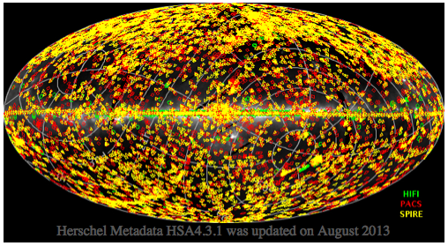
Looking at the Archive
Over 60000 observations and over 20000 hours, but no full sky
Everything is public six months after observed (except for some calibration observations)

Slide 3
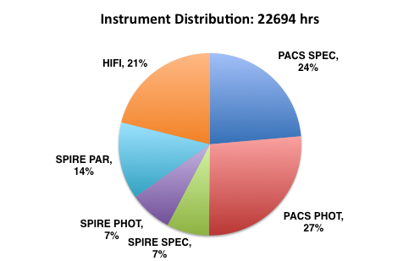
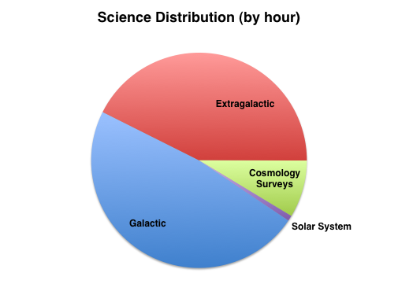
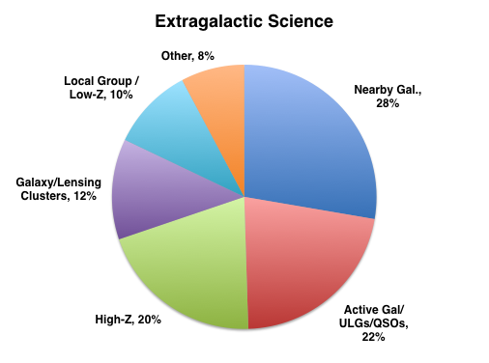
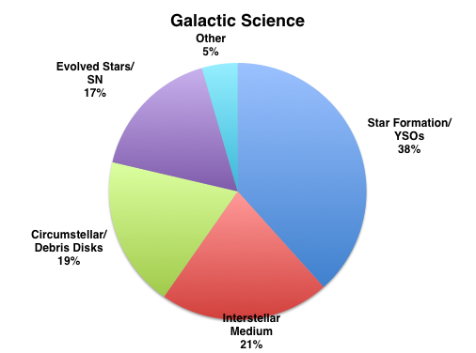
The Archive
Herschel @ IPAC

Slide 4
This talk
First, the mechanics
How to get data
How to inspect it
Then the contents:
What’s in the archive?
Have I been scooped?

Slide 5
More than one way of accessing these data
Some metadata can be accessed via the Observing Log
Access via the Herschel User Interface (HUI)
Access via the Herschel Interactive Processing Environment (HIPE)
Access via the Herschel portal at IRSA
Important: The Archive is not the Interface

Slide 6
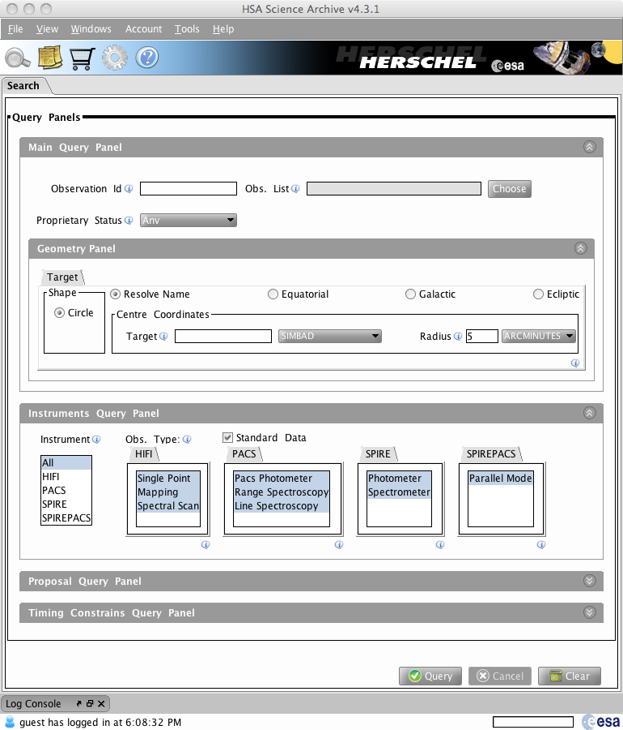
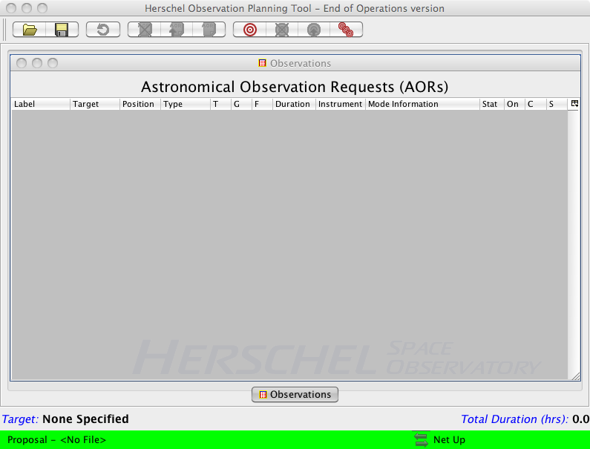
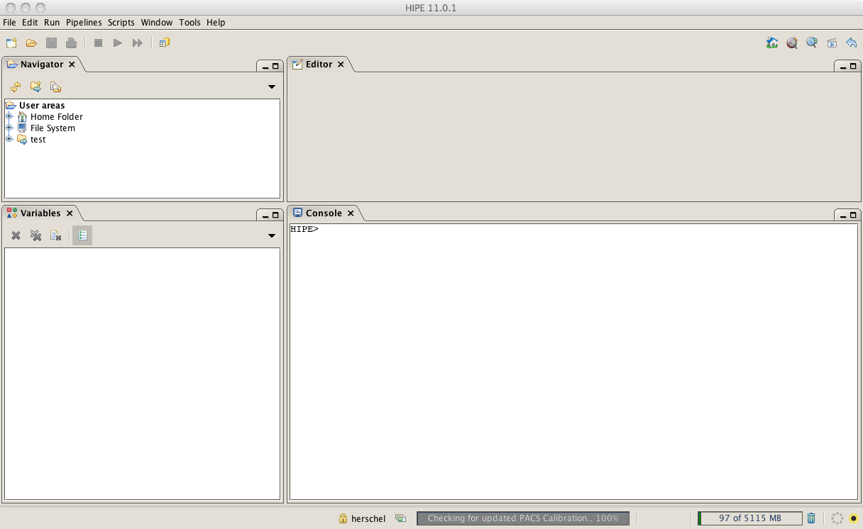
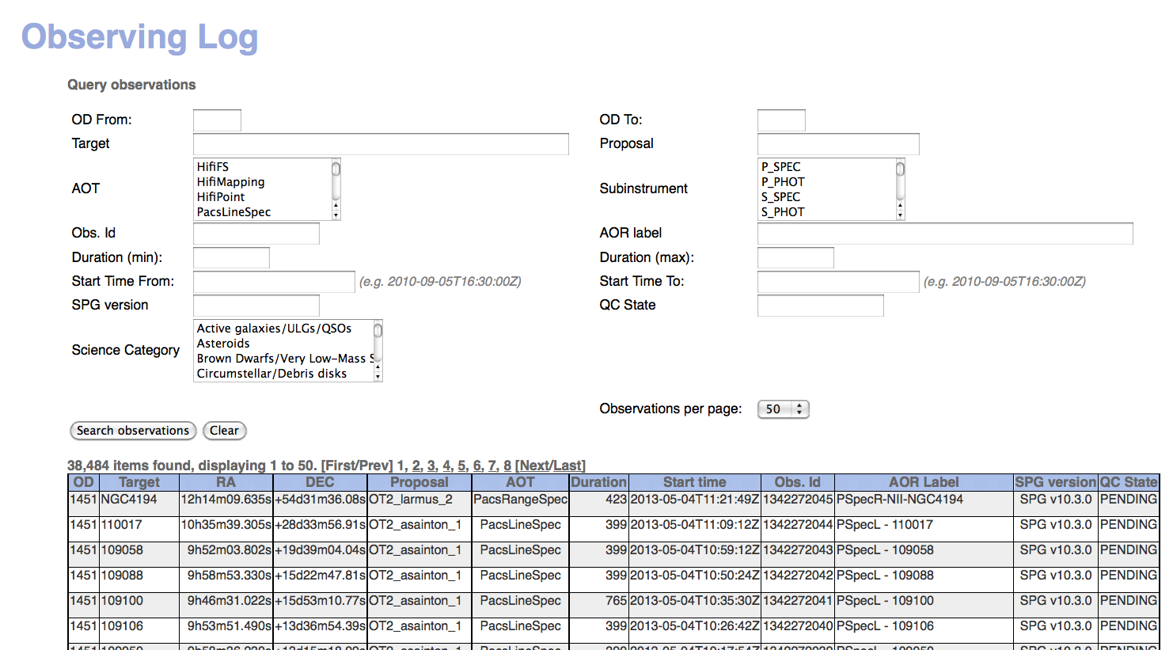
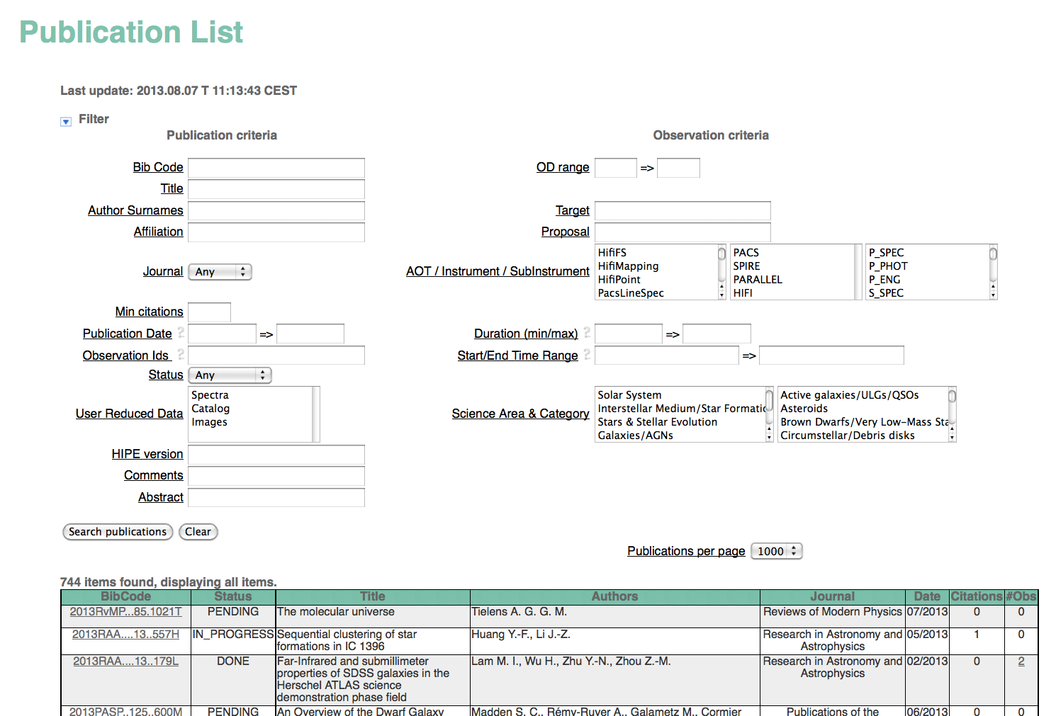
I will tell you about…
The Herschel Observing Log
The Herschel Archive User Interface
The Herschel Interactive Analysis Environment (HIPE)
HSPOT: The observation planning tool
The Herschel Publications Tool

Slide 7
The Herschel Observing Log
Double-click on Observations

Slide 8
The Herschel Observing Log

Slide 9
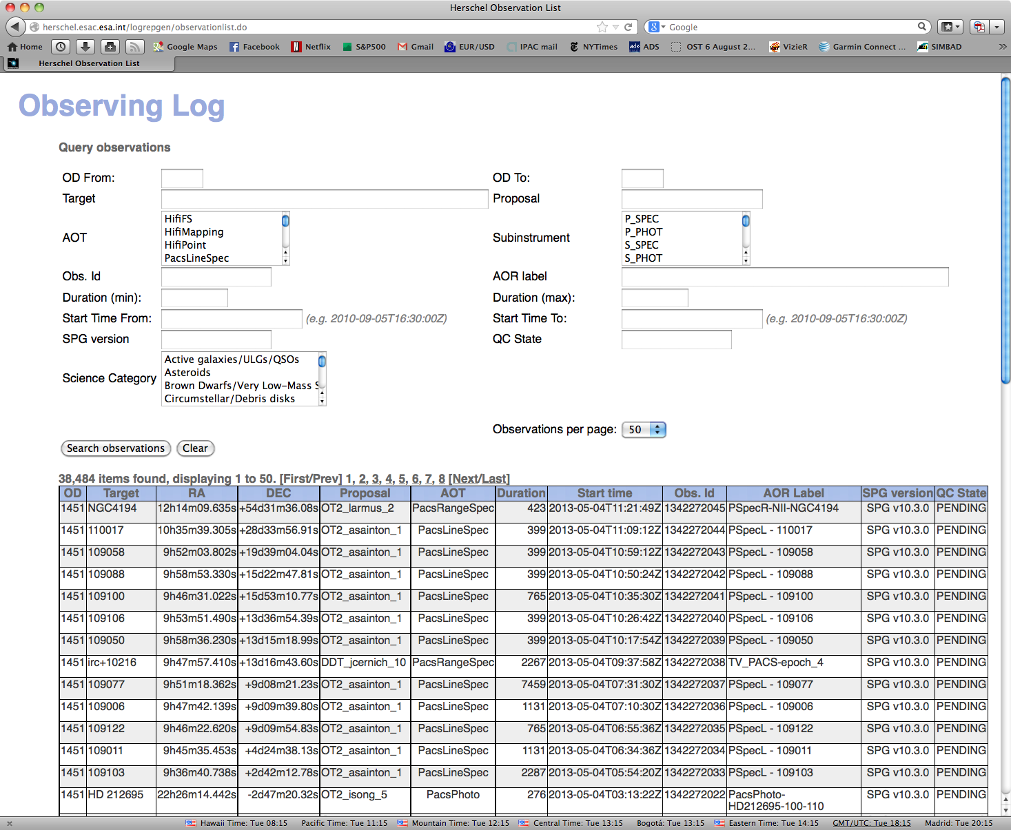
Observing Log: good but limited…
No name resolution
Searches by science category!
Notes:
Good but limited

Slide 10
Some lingo
OBSID: A unique 10-digit identifier for the observation
Proposal: Each proposal is identified with a unique string:
Program_FirstInitialLastNameXX_number
For example: OT2_dardila_2, AOTVAL_cwilso01_2
Programs:
OT: Open time; GT: Guaranteed time; DDT: Director’s Discretionary Time; TOO: Target of Opportunity; KP: Key Program; AOTVAL: AOT validation; OBS: Filler program; SDP: Science Demonstration Phase

Slide 11
More Lingo…
AOT: Astronomical Observation Template
The name of the observing mode used
AOR: Astronomical Observation Request
OD: Operational Day
The day the observation was done, from 120 to 1451
SPG: Standard Product Generation
The pipeline version, updated every 6 mo. to 1 year. Currently 10.3.0
QC State: Manual quality control verification – Failed, Pending, Passed, <blank>

Slide 12
HSPOT: The observation planning tool
Inspect AORs
Learn what the AOR parameters mean
Overlay AORs
Demo
Liaison Activities

Slide 14
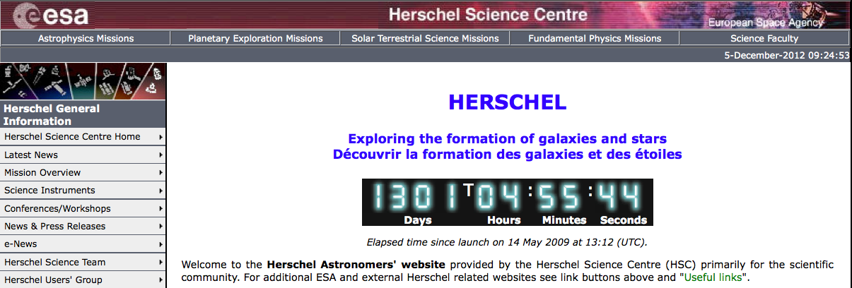
Using the Herschel Archive User Interface - HUI (see HSA flyer)
Go to the Herschel Science Center webpage: http://herschel.esac.esa.int/
Double-Click the Archive link: “Herschel Science Archive (HSA)”

Slide 16
More lingo…Levels
Level 0: Raw data, minimally manipulated.
Also level 0.5
Level 1: Detector readouts converted to physical units.
Also level 1.5
Level 2: Science-quality products. All good observations should have data to level 2. If the level 2 is not present something went very wrong.
Level 2.5: Enhanced products (e.g. combinations for multiple OBIDS, extracted spectra).
Level 3: More enhanced products (e.g. for SPIRE, combinations of all imaging observations in that coordinate, zero-point corrected).

Slide 17
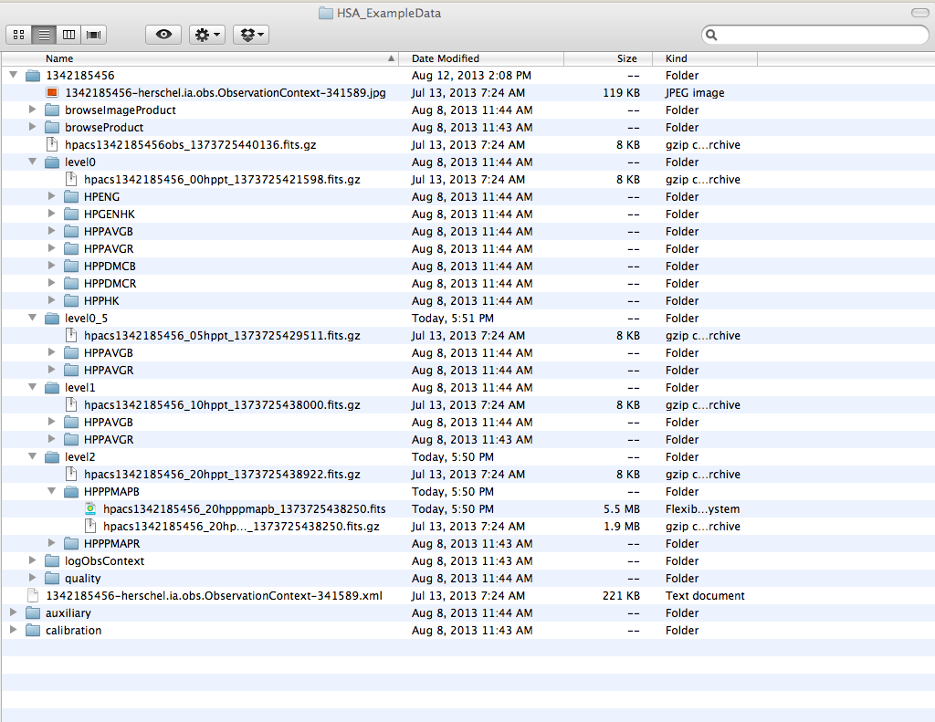
Data are downloaded in standard FITS files
These directories are:
BIG: 500 MB for a small PACS observation, if you download all the products
Take a long time to download
With these method, you should download only individual levels
The whole thing is called an Observation Context
The folders within are called products

Slide 18
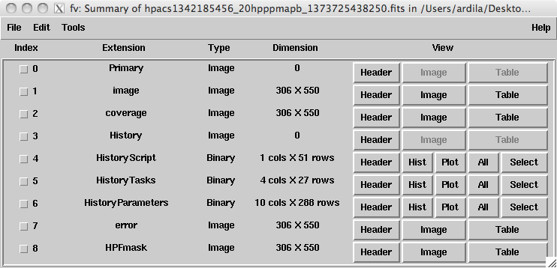
The FITS are multi-extension files
Example: This typical PACS level-2 file has 8 extensions (four images and four tables)
FV output

Slide 19
The Herschel Interactive Analysis Environment (HIPE)
HIPE is the software used to re-process data, but it also has strong display and analysis capabilities geared to Herschel.
It allows scripts and GUI work.
HIPE does many, many things in many different ways, and it can be a little bit overwhelming.

Slide 20
HIPE
Demo:
Ingesting tarball
Send to external application

Slide 22
Some (current) limitations of the HUI
Simple point-within-circle search
No searches by target list
Solutions:
Resolve names, search by coordinates in the Observing Log, produce a list of OBSIDs: see script.
Search by target list using IRSA, produce list of OBSIDs
No searches by any spectral variable (wavelength, frequency, band)
Solution: Use data mining techniques (Friday)
Only jpegs to inspect
Solution: Send to HIPE

Slide 23
The story so far…
Data can be downloaded from HUI using
“Retrieve Data” -> Tarball. Big. Use to retrieve fragments of observation context only.
“Send to External Application” -> send to HIPE (reference pointers only aka ‘lazy loading’). Good for inspection and reduction.
To understand what the observer was thinking, load the program in HSPOT
A list of all observations is available from the Observing Log.
Are you lost? Never fear!!!
Notes:
Add save with fits, no spire, registration, on demand

Slide 24
Approved Programs
Notes:
Demo

Slide 25
Key Programs
42 large programs submitted at the beginning of the mission. 40% of all time in Herschel.
Two kinds:
Open Time Key Programs (KPOT - The community)
Guaranteed Time Key Programs (KPGT - Instrument groups)
Required to produce User Provided Data Products (UPDPs) : High level products with custom processing.
Notes:
Demo

Slide 27
There are counterparts to Spitzer Legacy programs
Spitzer’ SINGS (The Spitzer Infrared Nearby Galaxies Survey - Physics of the Star-Forming ISM and Galaxy Evolution) → Herschel Kingfish (Key Insights on Nearby Galaxies: A Far-Infrared Survey with Herschel)
Spitzer’s GLIMPSE and MIPSGAL → Herschel’s Hi-Gal (The Herschel infrared Galactic Plane Survey)
Spitzer’s C2D → Herschel’s DIGIT
Spitzer’s FEPS → Herschel’s GASPS

Slide 28
Some UPDPs are already available

Slide 29
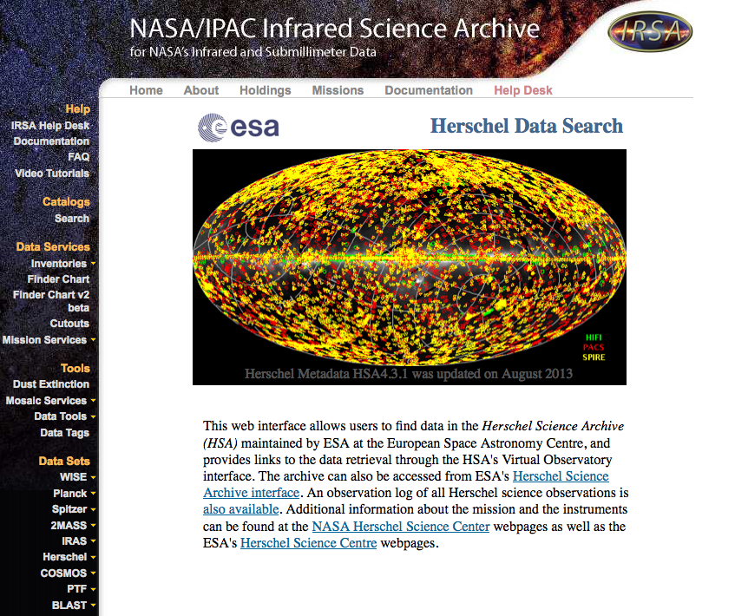
The Herschel portal at IRSA
IRSA is the NASA Infrared Science Archive
The Herschel portal is available from the IRSA page
Searches the Archive (list of targets OK!)
Provides an interface for UPDP
It will allow direct inspection independently of HIPE
Cross-mission comparison!
Notes:
Demo

Slide 31
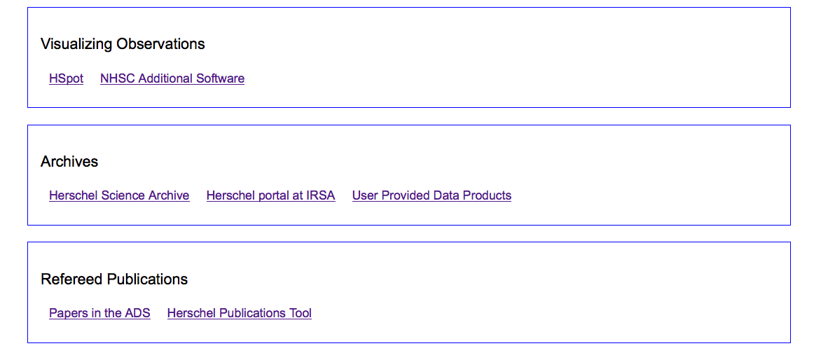
How to know if you have been scooped?
Links to refereed papers. These are manually vetted!
Notes:
Demo

Slide 32
Publications list
Refereed publications after launch
Hand-checked

Slide 33
Things that are not so simple
I want to find all PACS observations of the CII line for list of targets
List of targets: Use IRSA or the Observing Log to find the list of obsids for the targets
Use HIPE to write a script to query the HSA, read the metadata, and download those with CII observations (Friday)

Slide 34
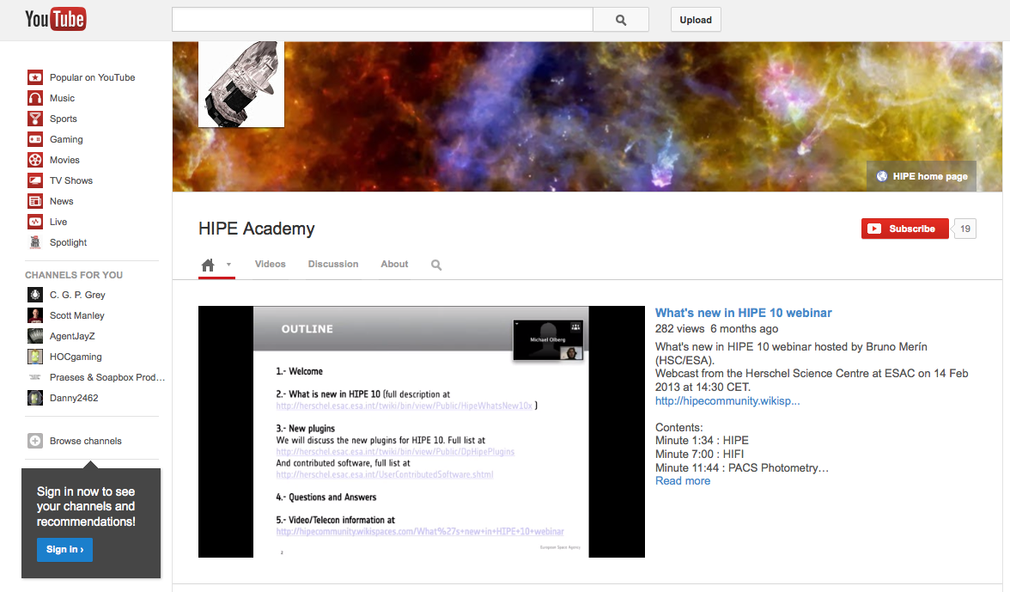
Learn more!
Lots of videos in youtube

