Slide 1
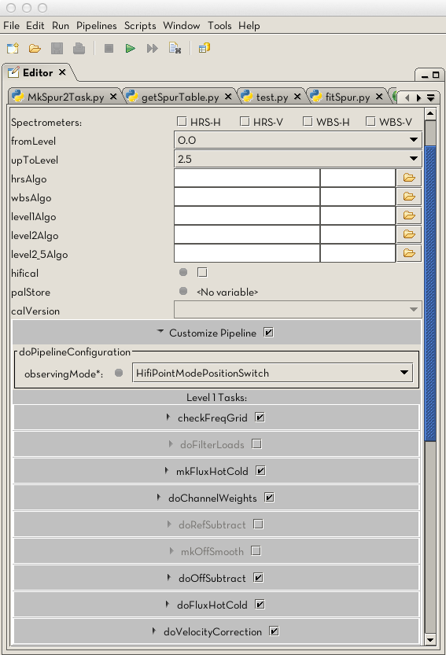
HIFI Calibration and Pipeline
Colin Borys (NHSC)

Slide 2
Outline
Why would it be necessary to reprocess data?
  Take advantage of new calibrations
  Take advantage of improved pipelines
  Adjust parameters in existing pipeline
  Reprocess data after cleaning
Basic overview of the pipeline
  What is done at each level
How to reprocess HIFI data (Demos)
  HSC on-demand re-processing
  Command line based
  GUI based re-pipelining (configurable)
  Script based re-pipelining
Notes:
Emphasis the why and the how.

Slide 3
Data by Level
Level -1
Raw data from telescope
Users do not have access to this
Level 0
Data frames and telemetry frames merged
Pointing product applied
Data from proposal system added.
Level 0.5
Spectrometer specific pipelines
Frequency calibration
Level 1
‘Generic’ pipeline
Flux calibration and reference subtraction
Level 2
Gain and velocity corrections applied
Data averaged
Data split into LSB and USB
Level 2.5
Decon (sscan)
Cubes (mapping)

Slide 4
Some pointers about HIFI frequencies
From channel number to IF frequencies
  The assignment of spectrometer channel number to IF frequency is performed in the WBS and HRS branch of the pipeline (between L0 and L0.5)
Space-craft radial velocity
  The correction of the space-craft velocity along the source line-of-sight is done in the L1 pipeline
  For fixed target, it brings the frequency scale in the LSR
  For moving targets, it brings the frequency scale into the target frame
USB/LSB scales
  The L2 pipeline creates two products: a USB and an LSB spectrum
  The two products are not only mirror spectra of one another wrt the LO frequency – intensity calibration can vary (Sideband ratio)
Velocity scales
  No pipeline product is given in velocity scale
  Conversion to velocity scale can be done by the user, e.g. in HIPE.

Slide 5
Common use-cases
Data cleaning at level 2
  Flagging of bad channels and/or spectra
  Baseline and/or fringe removal
Data cleaning at level 1
  Flagging of bad spectra before averaging
Applying new calibrations
Less common:
  New pipelines
  Pointing updates
  Modifying pipeline steps or parameters

Slide 6
We are here to help
The HIFI pipeline is actually very stable.
Almost all work on data is done with standalone interactive tools, and not the pipeline.
If you find that you need to adjust parameters or modify the standard pipeline steps, you should consult us first.

Slide 7
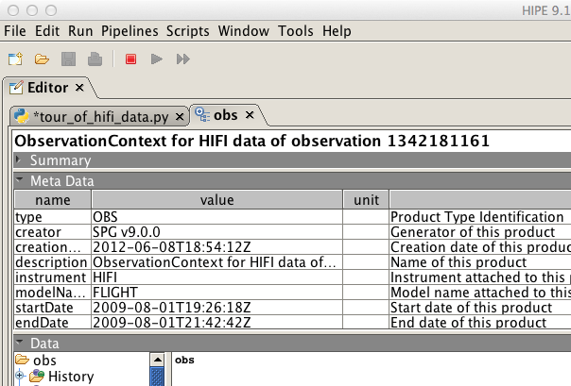
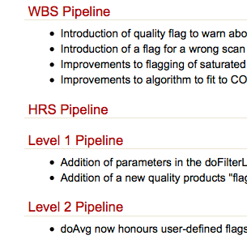
Example 1: new pipeline
Compare the SPG meta data against the `what’s new’ web
http://herschel.esac.esa.int/twiki/bin/view/Public/HipeWhatsNew
Notes:
Demo this later.

Slide 8
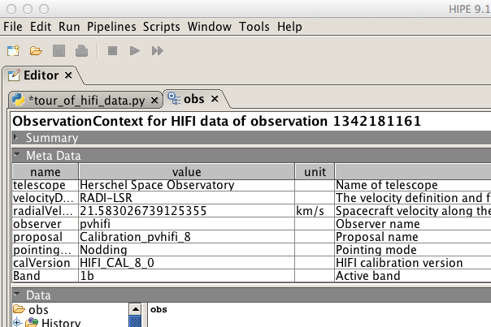
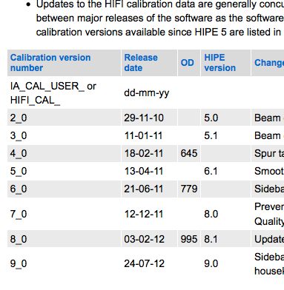
Example 2: changes in calibration
Compare calVersion meta data in the observation context against the list on the HIFI calibration web page.
Cal updates usually tied to major releases but not always.
http://herschel.esac.esa.int/twiki/bin/view/Public/HifiCalibrationWeb

Slide 9
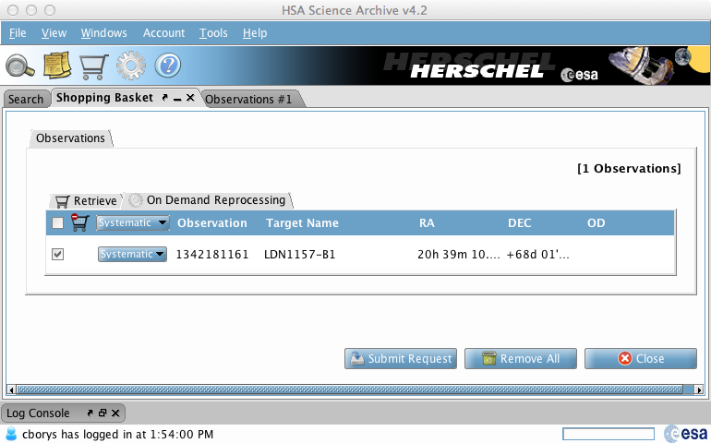
HSC on-demand reprocessing
Use HSA web page or via HIPE:
Window->Show View->Data Access-> HSA
Notes:
Reasonable option for getting the latest default pipeline and most up to date calibration releases.
However it can take the most time (but is just a 1 time hit per version)

Slide 10
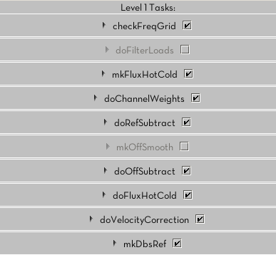
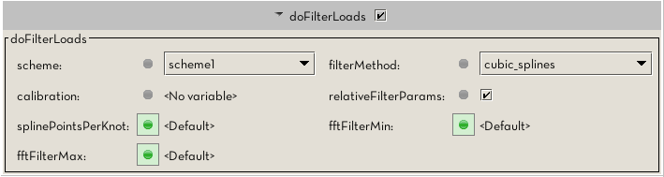
Example 3: tweaking pipelines
The HIFI Pipeline GUI gives a good overview of the pipeline steps and their options.
Alternatively one can edit the pipeline scripts directly.

Slide 11
Example 4: most common
By far the most common reason for pipelining is to reprocess the data after using one of the following three standalone tools:
  flagTool
  fitBaseline
  fitHifiFringe
Normally done on level 2 data, by re-running the level 2.5 pipeline, one gets a much improved final product.
We now go through a few demos illustrating the use of the HIFI pipeline task.

Slide 12
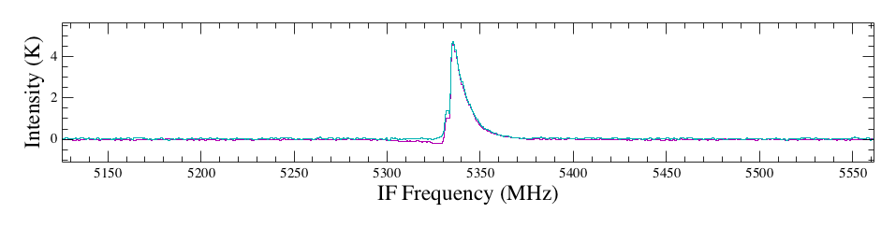
Data used in this demo
1342190183: Point Mode DBS with emission in a reference position
POSITION
Reference
Position
Target
Position
Reference
Position
TIME
1
2
NOD 1 (ON)
180” chop throw
3
4
(1-2) + (4-3) =
(ON) – (OFF)
NOD 2 (OFF)
180” chop throw
Calibrated Spectrum (blue)
OFF Spectrum only (pink)
Notes:
Can use HSPOT if interest.

Slide 13
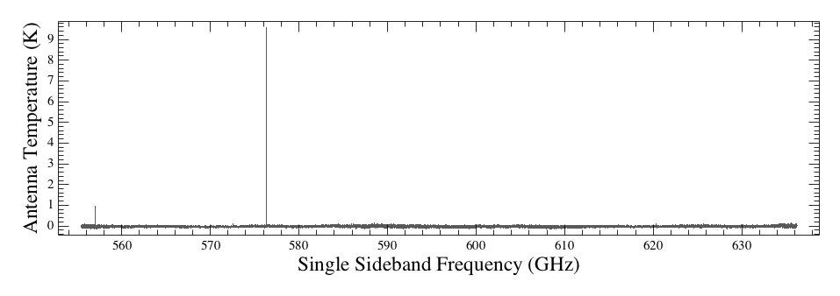
Data used in this demo
1342181161: DBS Spectral Scan
  No emission in the reference beams
  Pipeline performs an extra step compared to point mode
  Deconvolution (discussed later) combines the spectra at different frequencies into a single spectra.

Slide 14
DEMOS
Basic command line or GUI use
Updating calibration
Re-pipelining after cleaning data
Modifying the pipeline via a GUI

Slide 15
Data calibration: general concept
The ultimate goal of the data calibration is to recover the original source signal from the total signal measured by the detectors
Measured detector counts
C = F [S_{sou} + S_{sky}] + C_{tel} + C_{inst}
Instrument emission
Telescope + inst. response function
Source signal
Sky signal
Telescope emission
The detection chain function involves (time-dependent) transformations by the optics, electronics, and the environment between the source and the telescope (esp. the atmosphere for ground-based facilities)
Instrument
Sky
C
Telescope

Slide 16
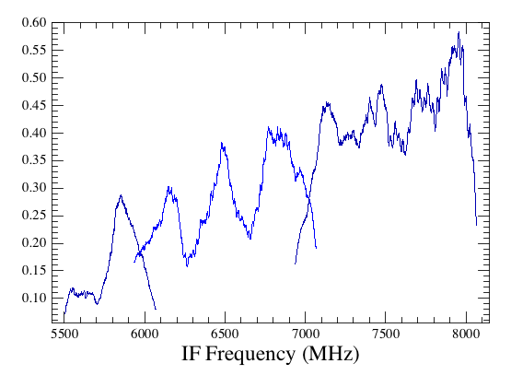
HIFI flux calibration (1)
1
J_{sou} – J_{OFF} = [C_{sou} – C_{OFF}]
Source and reference counts
η_{sou}η_{l}G_{inst}
Instrument response
Source and reference brightness temperature (K, Double-Side-Band)
Source efficiency
Forward efficiency
Example of an HIFI band-pass function
HIFI works with differential signals, allowing to cancel out to 1st order the telescope and instrument background (so-called T_{rec})
The instrument response is expressed as a band-pass function, measured on two internal (hot and cold load) black-bodies
As such, the HIFI data are calibrated as brightness temperature [J_{ν}=B_{ν}(T)]
Coupling to the loads
Hot and cold load counts
C_{h} – C_{c}
G_{inst} =
(η_{h} + η_{c} - 1)[J_{h} – J_{c}]

Slide 17
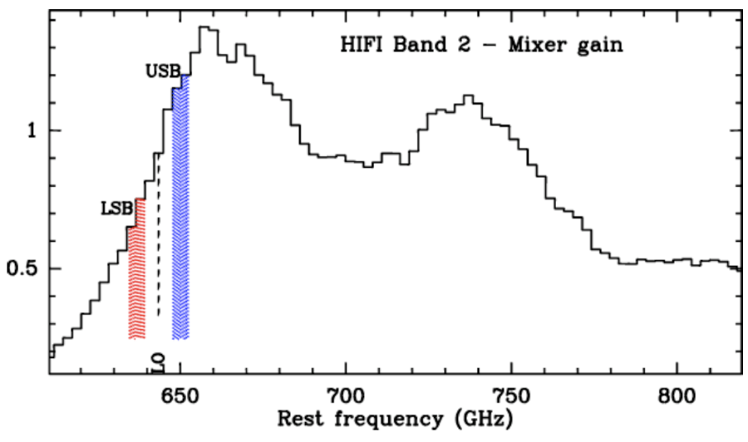
HIFI flux calibration (2)
The HIFI calibration is thus based on a three points (hot, cold, blank sky OFF) measurement scheme
  Unlike for the ground-based radio-telescopes, the OFF is not used for atmosphere calibration, but rather for standing wave mitigation
  The rate at which those points are visited depends on the drift characteristics applying to each of the 14 detector bands
The standard HIFI products are calibrated on the so-called T_{A}* scale
  Calibration onto a single-side-band scale require correction from the side-band ratio (SBR)
  Source coupling correction depends on the source extent compared to the beam – many radio-astronomers convert their data into a main beam temperature:
[J_{sou} – J_{OFF}]_{DSB}
[J_{sou} – J_{OFF}]_{SSB} =
G_{ssb}
SBR
Receiver gain response (unpumped mixer)
η_{l}
T_{mb} = T_{A}*
η_{mb}

