Slide 1
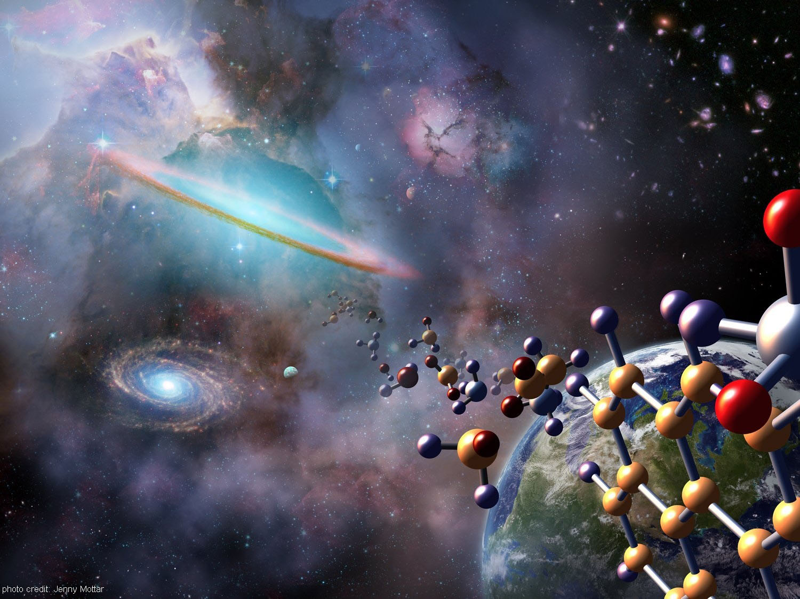
Kinematics and Chemistry with Herschel/HIFI:
An Introduction to Access and Processing of HIFI observations in the HSA
Pat Morris
Adwin Boogert, Colin Borys, Annie Hoac, Joan Xie
Sylvie Beaulieu, Emmanuel Caux
Inputs from everywhere
Thanks esp to T. Marston, D. Teyssier, E. Puga DPWS @ ESAC 27 June

Slide 2
Outline
Motivation for HIFI, some nice examples from the KPs.
HIFI in the Herschel Science Archive
  Statistics
  Searching for observations
Instrument Characteristics
AOTs and Observing Modes
Intensity and Frequency Calibration Basics
HIFI Products
Motivations for IA and re-pipelining in HIPE
  Mainly what to expect on Thursday
Resources: Literature and exo-HIPE tools

Slide 3
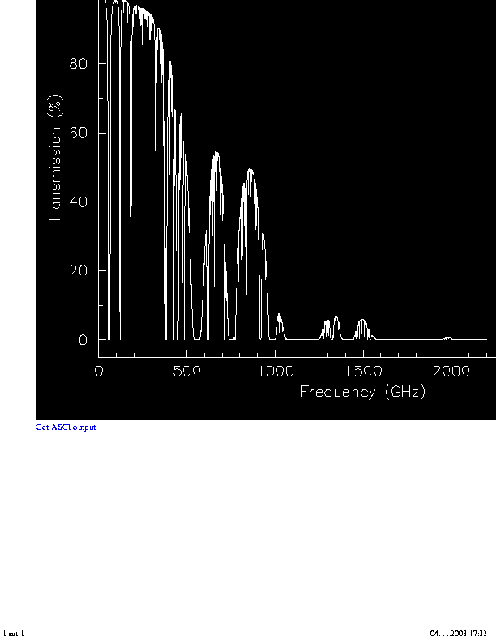
As of July 2013…
175 molecules with unambiguous detections in the ISM or circumstellar shells. 13 detections are since 2012 http://www.astro.uni-koeln.de/cdms/molecules
Millions of transitions are possible over FIR-subMM wavelengths.
The Herschel spectrometers give access to those species at different spectral and spatial resolutions.
Atmospheric transmission in ideal weather conditions
Frequencies > 500 GHz almost completely blocked by Earth’s atmosphere
HIFI RANGE
Adapted from C. Ceccarelli,
http://herschel.esac.esa.int/FirstResultsSymposium/presentations/A32_CeccarelliC_CHESS.pdf

Slide 4
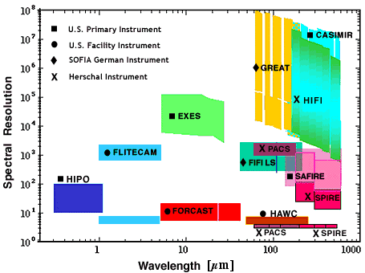

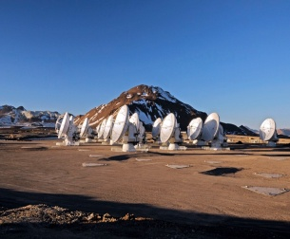
Spectral Resolution
Herschel, SOFIA, ALMA
*
ALMA
R up to 30x10⁶ possible at ALMA
(0.01 km/s at 110 GHz)
CASIMIR
NOTE: ALMA currently observes at one frequency setting; no spectral scan mode until later Cycles.
HIFI heterodyne observations populating the HSA offer science over previously unexploited wavelengths at the highest spectral resolution ever offered in the range of wavelengths it covers.

Slide 5
HIFI’s Science Objectives reflected in the KPs and follow-up programs.
At the outset of the mission, the major scientific objectives of the HIFI instrument:
to probe the physics, kinematics, and energetics of star forming regions through their cooling lines, including H₂O;
to survey the molecular inventory of the wide variety of regions that participate in the life-cycle of stars and planets;
to search for low-lying transitions of complex species (i.e. PAHs) and thus study the origin and evolution of the molecular universe;
to determine the out-gassing rate of comets through measurements of H₂O and to study the distribution of H₂O in the giant planets;
to measure the mass-loss history of stars which regulates stellar evolution after the main sequence, and dominates the gas and dust mass balance of the ISM;
to measure the pressure of the interstellar gas throughout the Milky Way and resolve the problem of the origin of the intense Galactic [CII] 158 micron emission measured by COBE;
to determine the distribution of ¹²C/¹³C and ¹⁴N/¹⁵N ratios in the Milky Way and other galaxies (to constrain parameters of the Big Bang and explore nuclear processes that enrich the ISM);
to measure FIR spectra of nearby galaxies as templates for distant, possibly primordial galaxies.
See HIFI paper by T. de Graauw in proceedings of
“The Promise of the Herschel Space Observatory”
herschel.esac.esa.int/Publ/2001/sp460_toledo_hifi.pdf

Slide 6



HIFI in KPAction
(Data public in the archive, soon “UPDP”)
Orion KL Spectral Survey
HEXOS KP (T. Bergin PI)
Note also the smooth continuum levels and shape (but uncalibrated for changing beam size).
Over 100,000 lines are detected. Many un-ID’d.
Observations carried out with the Spectral Scan AOT, with continuous frequency coverage over each Mixer Band one at a time, on a single point on the sky.
Each scan is a different observation in the HSA.
Plot adapted from C. Ceccarelli,
http://herschel.esac.esa.int/FirstResultsSymposium/presentations/A32_CeccarelliC_CHESS.pdf

Slide 7
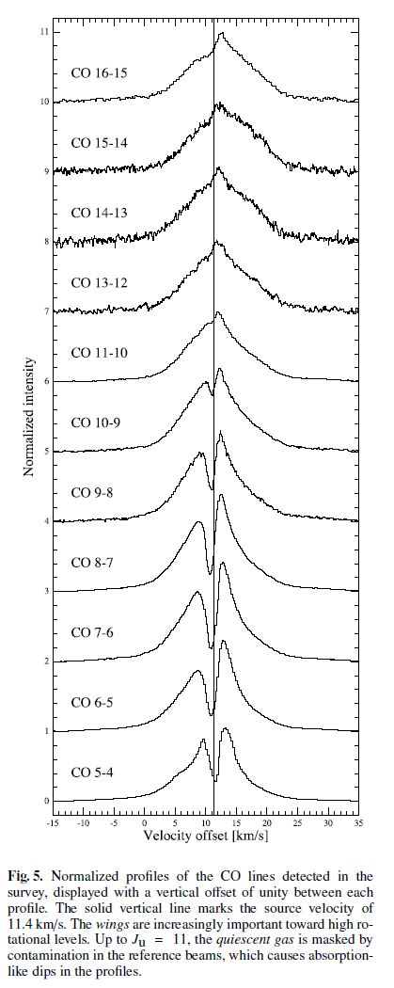
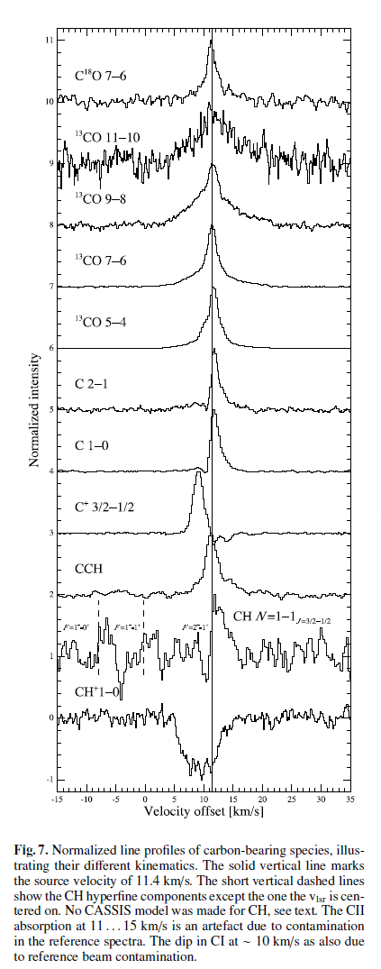
Line Profiles
OMC-2 FIR4 intermediate mass protostar
CHESS KP (C. Ceccarelli PI)
Also observed using Spectral Scan AOT.
Line profiles trace varied kinematics across different C-bearing species, structures resolved at a few km/s.
Contrast with Orion KL SFR indicates 2 orders of magnitude difference in contribution of sulfur oxides to line cooling.
M. Kama et al. 2013 A&A

Slide 8
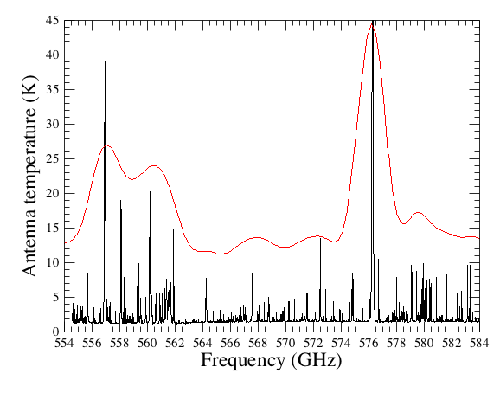
Another fine example of how high spectral resolution matters
HIFI band 1b (part)
Orion KL
SPIRE SLWC3 apodized (scaled)
Antenna temperature (K)
40
35
30
25
20
15
10
5
554 556 558 560 562 564 566 568 570 572 574 576 578 580 582 584
Frequency (GHz)
With line widths sub-km/s to some tens of km/s, high resolution is the only way to distinguish otherwise blended lines and Hyper Fine Structure
Resolving spectral profile allows us to understand the chemistry & dynamics of the observed regions (infall, outflows, P-Cygni, self-absorption, etc)

Slide 9
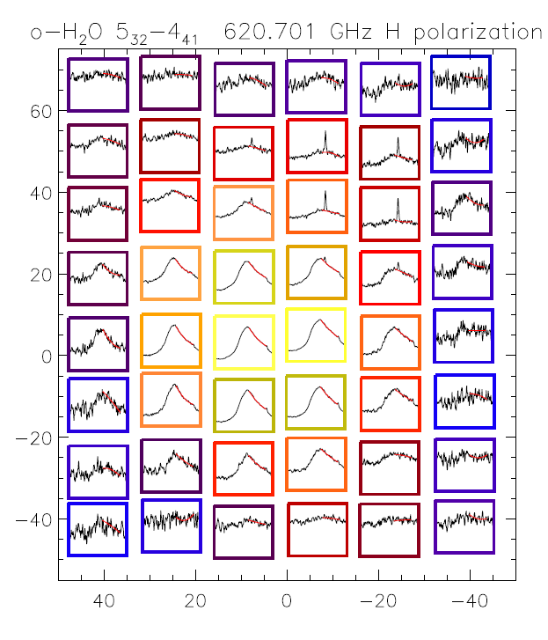
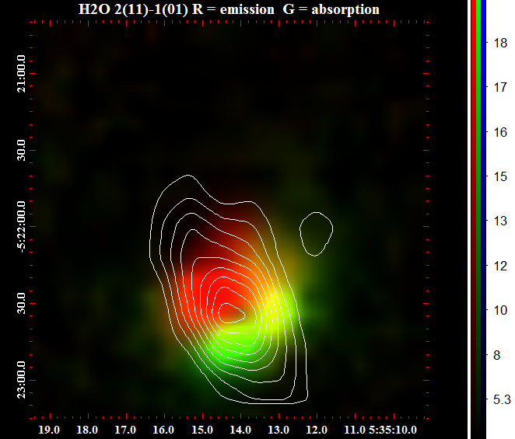
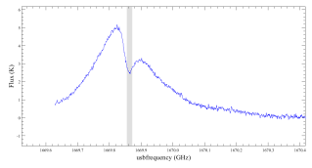
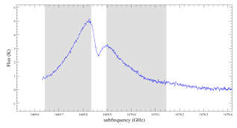
HIFI has also produced spectral images at high resolution
Orion KL
Neufeld et al. 2013 ApJ
Beam = 33 arcsec
Beam = 14 arcsec
Spectral Maps taken at a single LO setting using On-The-Fly (OTF) and Dual Beam Switching (DBS) modes. Maps are typically “small”.

Slide 10
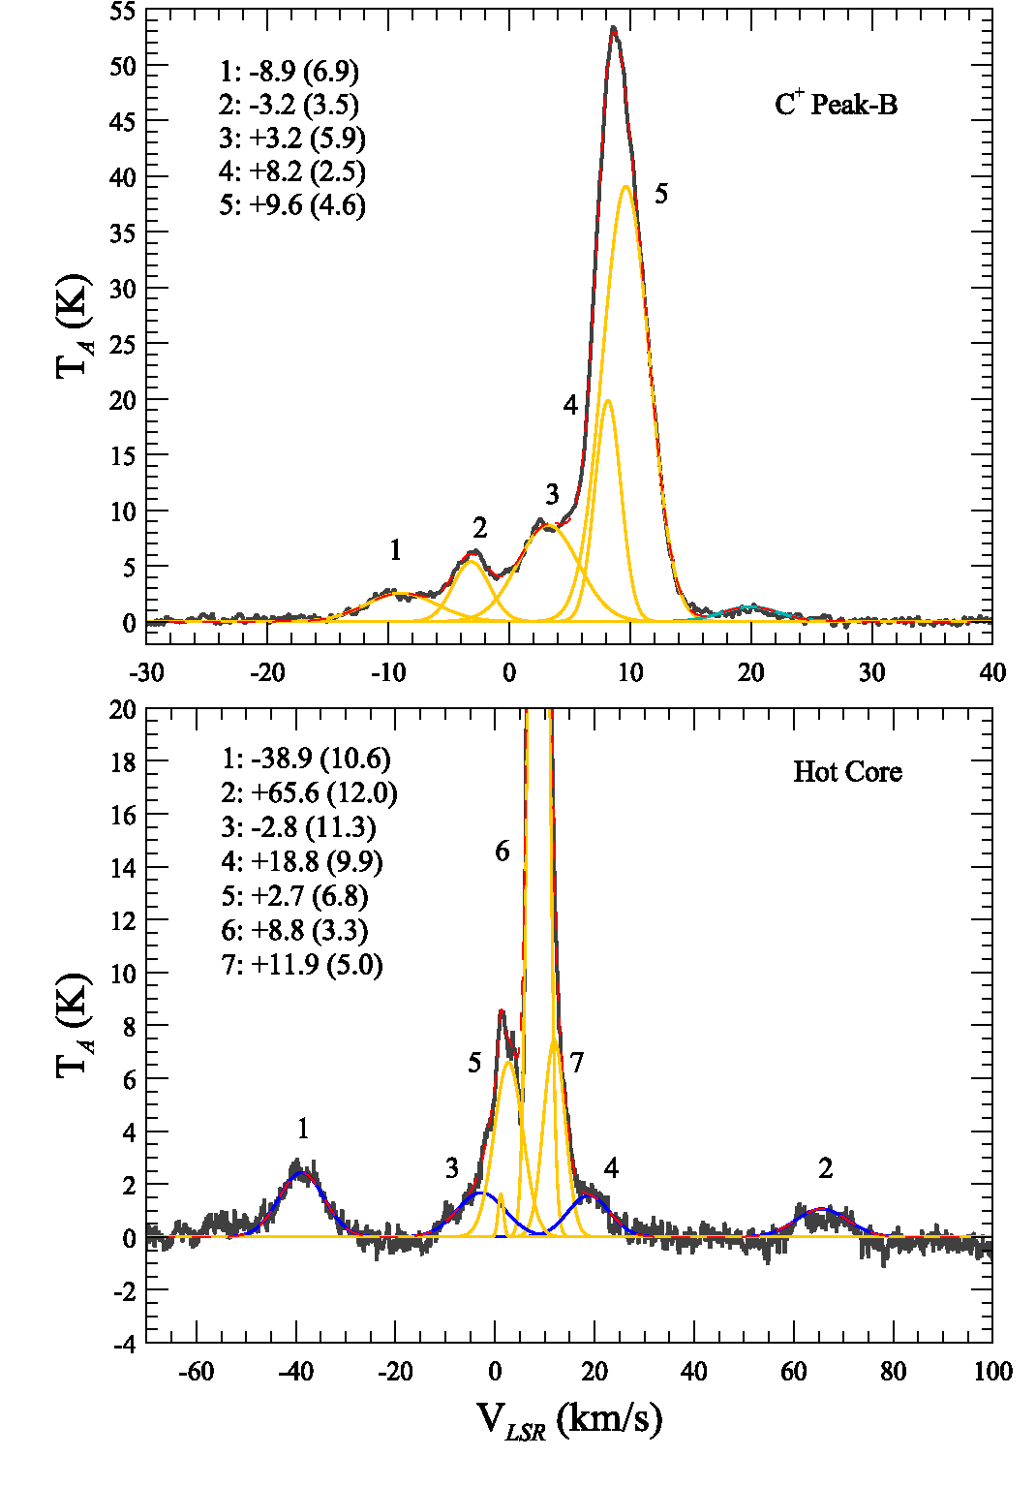
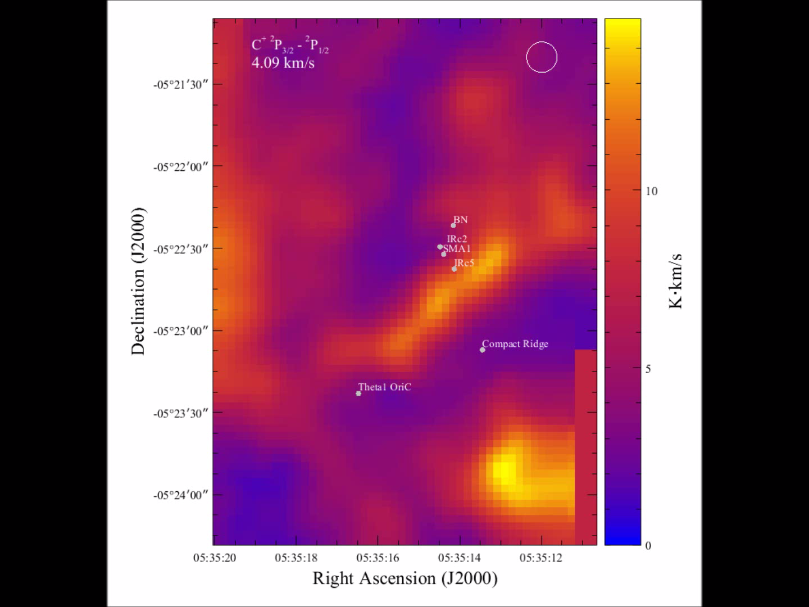
Orion C+ velocity channels
Morris, Gupta, Pearson et al. 2103

Slide 11
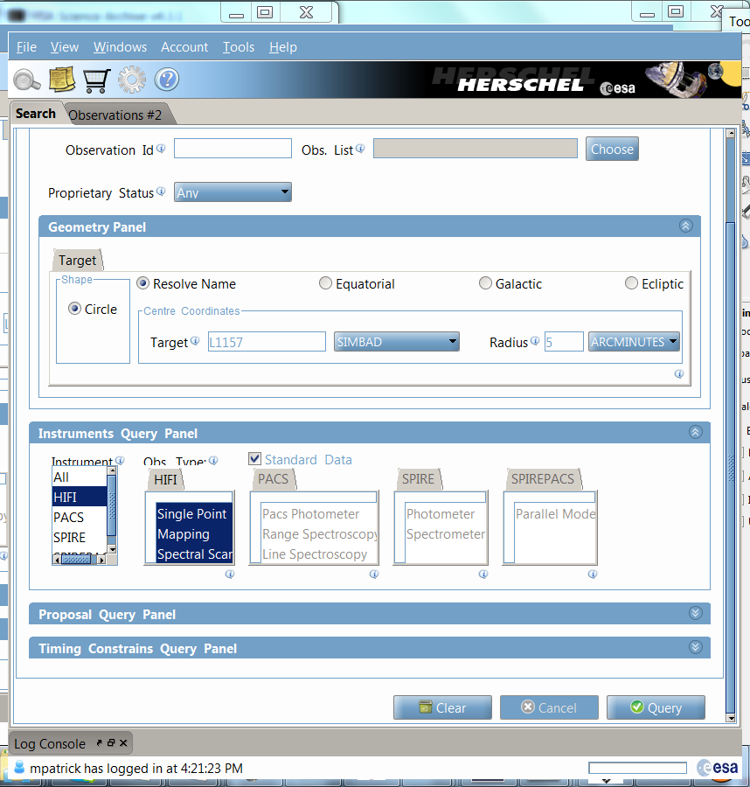
Starting at the HSA…
It makes sense to first search on your interest area, then go to what you need to know about the way the data were taken (instrument setup and performances), the products you are offered, and data (re-)processing.
The front panel of the HUI is simple for target and coordinate based queries.
Target-based query.
TIP: verify first that the name can be resolved by SIMBAD, NED, or target name given by original proposer; on failure to resolve you will get “undesired” query results (a bug).
The 3 HIFI AOTs, standard modes (non-engineering).
TIP: The AOTs can be individually (de-)selected.
More about the AOTs later.

Slide 12
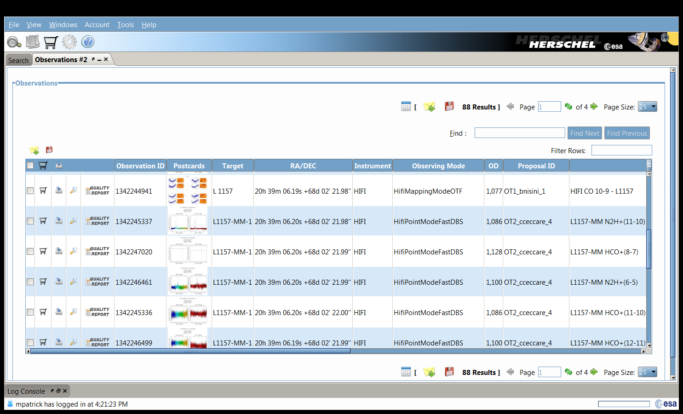
Managing Query Results
(see slides re HSA and query output by D. Ardila)
For target L1157, 88 HIFI observations found.
TIP: you may prefer to see all or many results on the same page, up to 100 per page can be displayed.
For searching on column contents, e.g. “CO”, should be possible with the Find utility.
TIP: Output can be saved in table form, also as a VO Table that can be viewed in HIPE.

Slide 13
More Advanced Searching
At this time (version 4.3.1) advanced, and still some basic, searching is limited with the HUI.
Example: What excited CO (J_{u} > 8) has been observed around 10 of my most favorite AGB stars?
  A list of obsids can be loaded into the HUI.
  Observed sky frequency range, the tuned instrument frequency, species names or rest frequecies cannot be searched. Query should proceed on the position list.
  Similarly, in the output, neither sky frequency nor tuned frequency are present. There are 3 options:
    Save the output to a table, and search for strings like “CO” the AOR labels. This is unreliable since the AOR labels have been“free-form”, at the discretion of the original proposers, sometimes unrevealing.
    Open the Browse Product images (jpgs) if they are present, and check for coverage of the observed frequency ranges over the transitions of interest, taking redshift into account if needed.
    [Dave Shupe’s script?]

Slide 14
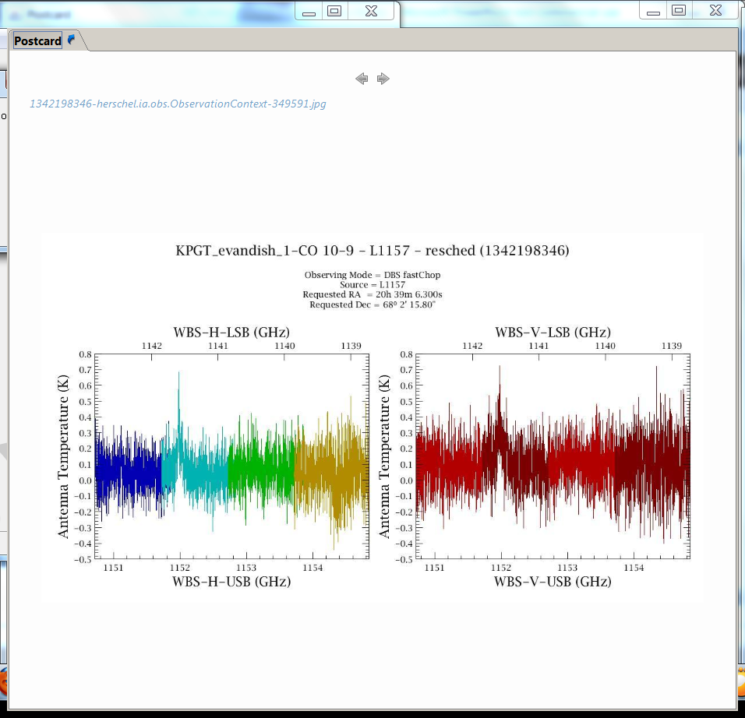
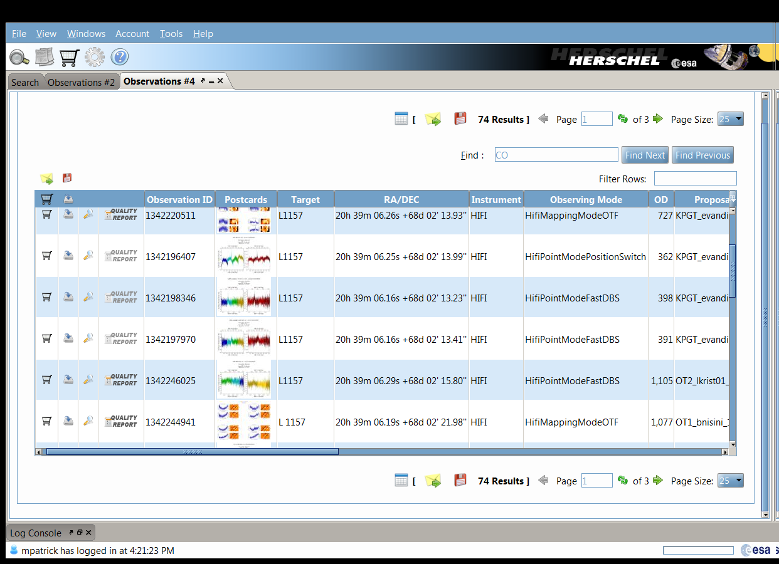
click
But click only once! And be patient.

Slide 15
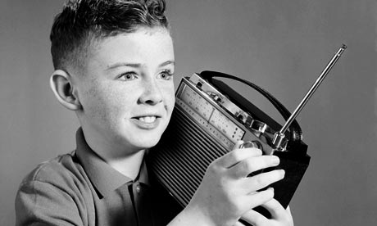
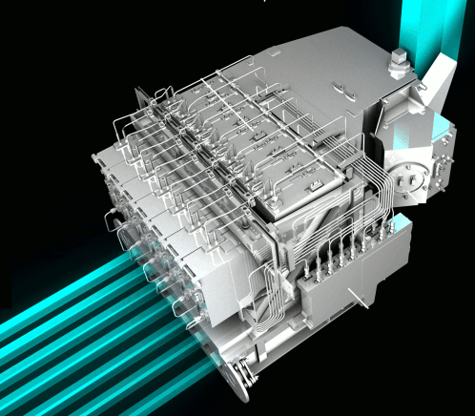
RF Frequency, LO Frequency, Mixing, and IF
The HeterodyneIFI instrument uses signal mixing technologies to convert input signal frequencies to lower frequencies matched to state-of-the-art detection technologies.
In such a system, the sky signal (RF) is combined with that of a synthetic source (the Local Oscillator – LO) tuned to a nearby frequency, in a non-linear electronic device (the mixer)
The mixing of the two signals creates a beat of the two frequencies, that pulses at a much lower frequency (the Intermediate Frequency – IF), but holds the amplitude and phase of the original signal (coherent detection)
This operation is called down-conversion, used in many domestic devices (radio, TV, etc)
HIFI Focal Plane Unit
RF
Thermal Loads
Mixer Assemblies
IF Amplification
LO

Slide 16
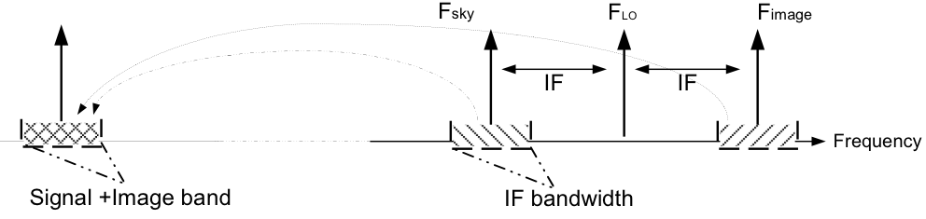
RF (Sky) signal is obtained over two spectral ranges
Intrinsically, the sky frequency domain down-converted from RF to IF is not unique: two spectral ranges at [F_{LO}-F_{IF}] and [F_{LO}+F_{IF}] are covered simultaneously
F_{IF}
F_{LO}
DSB
LSB
USB
LO frequency is what the User has requested in the AOR, aided by visualizing the sidebands in HSpot (more later)
The two ranges are called the Lower Side-Band (LSB) and the Upper Side-band (USB) and the information they contain are folded onto each others, merged into a Double-Side-Band (DSB) spectrum. Single-Side Band systems can be designed by rejecting one side-band (requires additional hardware).
The spectral resolution is ultimately limited by the LO stability, but in practice it is defined by the spectrometer (backend) used to sample the signal at the IF. It can be as high as R ~ 10⁷ (λ/Δλ), e.g. HighResolutionSpectrometer of HIFI.
The backend also sets the instantaneous spectral coverage
Double SideBand (DSB) spectrum.
Frequencies provided for both sidebands….
and both of HIFI”s mixer band polarizations.

Slide 17
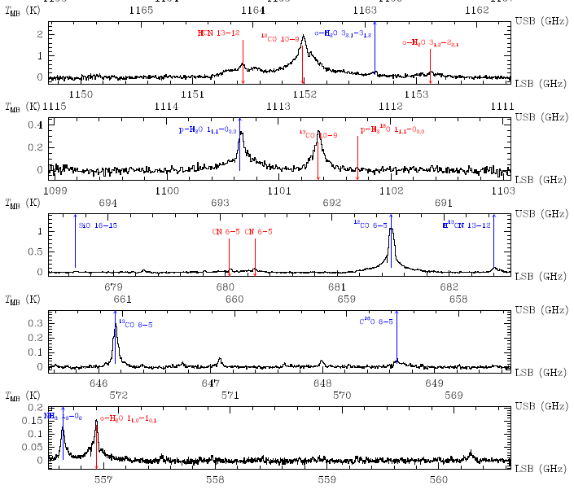
PPN CRL618 (5 different obsids shown)
Note broad profiles and lines from both sidebands
How to know which lines fall in which sideband?
Let’s use this spectrum as an example: a search for fundamental water in this target.
2 options:
Search spectral line databases (JPL, CDMS, …) over USB & LSB freq. ranges, here 1099 – 1103 and 1111 – 1115 GHz, if you have a good idea of what species will be present. Searching all possibilities over 8 GHz gives huge output.
Visualize with the HIFI Frequency Editor in HSpot.

Slide 18
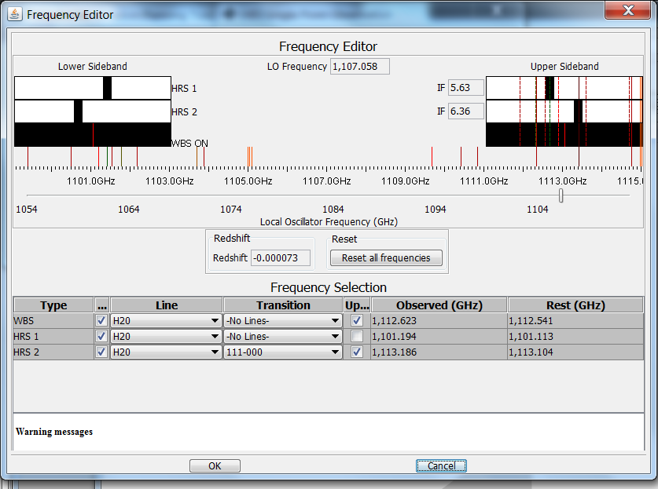
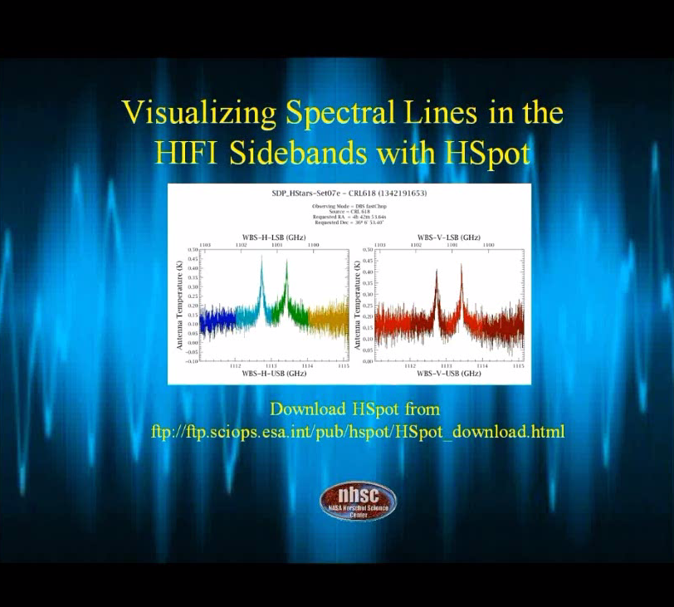
HIFI Frequency Editor
Video tutorial on the workshop wiki.

Slide 19
HIFI’s Main Characteristics
Single pixel on the sky, in two polarizations “H” and “V”
7 mixer bands (14 LO sub-bands) covering the 480-1270 GHz (236-625 μm) and 1430-1910 GHz (157-210 μm) ranges
F_{LO} (GHz)
480
640
800
960
1120
1270
1430
1700
1910
Band 1
Band 2
Band 3
Band 4
Band 5
Band 6
Band 7
SIS mixers
HEB mixers
IF bandwidth: 4 GHz
Beam: 44” – 17”
IF bandwidth: 2.4 GHz
Beam: 15” – 11”
Two types of spectrometers, simultaneously available
Wide- Band Spectrometer (WBS)
High-Resolution Spectrometer (HRS)
Covers the whole IF (2.4 or 4 GHz)
Spectral resol.: 1.1 MHz (0.2–0.8 km/s)
Variable spectral resol.: 0.125, 0.25, 0.5 and 1 MHz (0.02–0.8 km/s)
IF coverage from 0.25 to 2 GHz
4 GHz full IF coverage for the WBS, over 4 sub-bands.
HRS has the same IF range available at 0.25 – 2.0 bandwidth.
The HIFI Instrument

Slide 20
HIFI AOTs and modes
HIFI observations have employed one of 3 AOTs, and a calibration reference scheme:
 | Point | Map | Spectral Scan
LO frequency | fixed | fixed | variable range
Pointing | fixed | Continuous scan (OTF) or Raster | fixed
Calibration mode
Position Switch | X | X
Dual Beam Switch | X | X | X
Frequency Switch (with P.Sw. option) | X | X | X
Thermal Load Chop (with P. Sw. option) | X | X | X
The calibration schemes are modeled after established ground-based practices. HIFI’s (successful!) adaptations are for fully autonomous operations under instrument + telescope performance conditions.

Slide 21
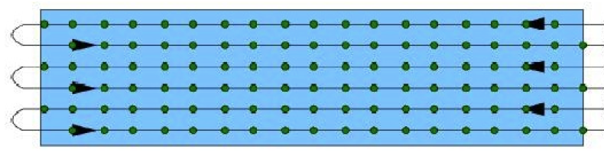
The AOTs visualized
DBS raster map
On-the-fly Mapping
Sampling:
Fixed: 10, 20, 40”
Half-beam
Nyquist
OFF2
ON1/ON2
Sampling:
Possible referencing scheme:
Fixed: 10, 20, 40”
Half-beam
Nyquist
OFF
Position Switching (“standard” OTF),
Load-Chop, Frequency Switch (Sky REF optional)
OFF1
WBS (and HRS) stepped in overlapping chunks of 2.4-4 GHz
Spectral Scan
Possible referencing scheme:
Dual Beam Switching, Load-Chop, Frequency Switch (Sky REF optional)
Full or partial band coverage
F_{LO}
Redundancy 2 to 12
The HIFI Instrument

Slide 22
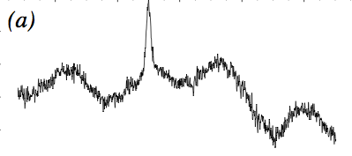
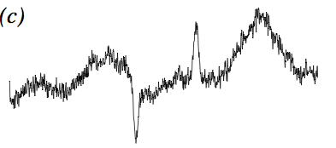
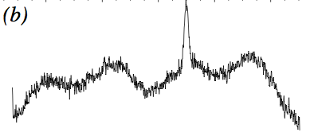
Modes visualized
Position Switch
Double Beam Switch
Load Chop
ON
OFF
ON1/ON2
ON
REF
OFF1
OFF2
Up to 2°
(optional)
Fixed 3’
Internal load
Telescope slewing
COLD
Chopping/nodding
Reference signal taken by slight LO shift
Frequency Switch
ON2 @ LO2
ON1-ON2
ON1 @ LO1

Slide 23
Basics of the Intensity Calibration
(more in Supplemental Slides at end)
The final HIFI products (from level2 upwards) are calibrated in the so-called T_{A}* scale:
  This scale thus includes the correction from the side-band gain ratio (called G_{ssb} in HIFI)
  Source coupling correction depends on the source extent compared to the beam (not included in pipeline)– many radio-astronomers convert their data into a main beam temperature T_{mb}
[J_{sou} – J_{OFF}]_{DSB}
[J_{sou} – J_{OFF}]_{SSB} =
G_{ssb}
η_{l}
T_{mb} = T_{A}*
η_{mb}
HIFI flux calibration accuracy
  The absolute calibration accuracy varies with the bands and frequency ranges – the main contributors to the calibration errors are the side-band ratio and the accuracy of the planetary models used to derive efficiencies
  Conservative figures of 15% in bands 1-2, 20% in bands 3-5 and 30% in bands 6-7
  The relative calibration accuracy is still being assessed, G_{ssb} at important frequencies is a main calibration activity towards the Final Archive in 2016.
  Reproducibility of HIFI data is usually good to better than 5%.

Slide 24
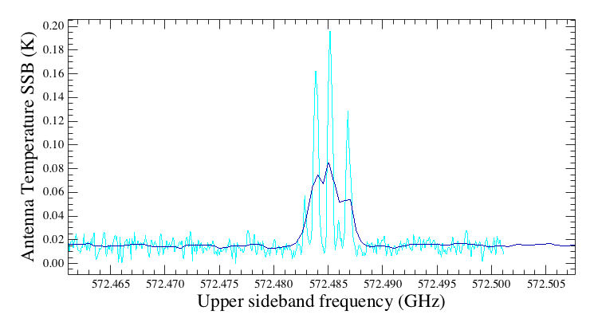
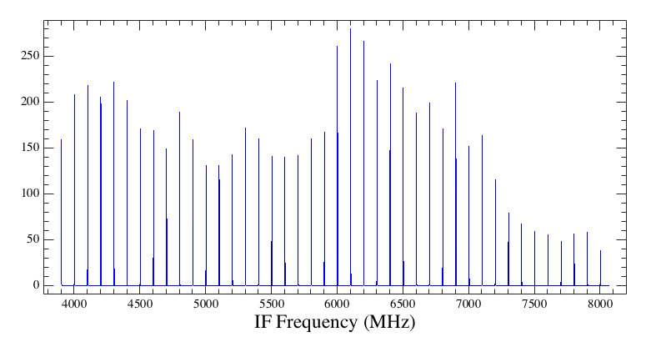
Frequency Calibration
High-Resolution Spectrometer
  Frequency calibration entirely relying on accuracy of the master oscillator
  Master oscillator has a frequency accuracy of ~0.5 part in 10⁷
  Freq. accuracy range from ~30 kHz (band 1) to ~150 kHz (band 7)
NH₃ HFS
HRS High-Res
WBS
Wide-Band Spectrometer
  Frequency calibration based on internal COMB measurement. Accuracy of the COMB reference relies on the master oscillator
  Regular COMB measurement period to monitor frequency drift due to temperature
  COMB fitting allows frequency resolution accuracy of 100 kHz
WBS COMB

Slide 25
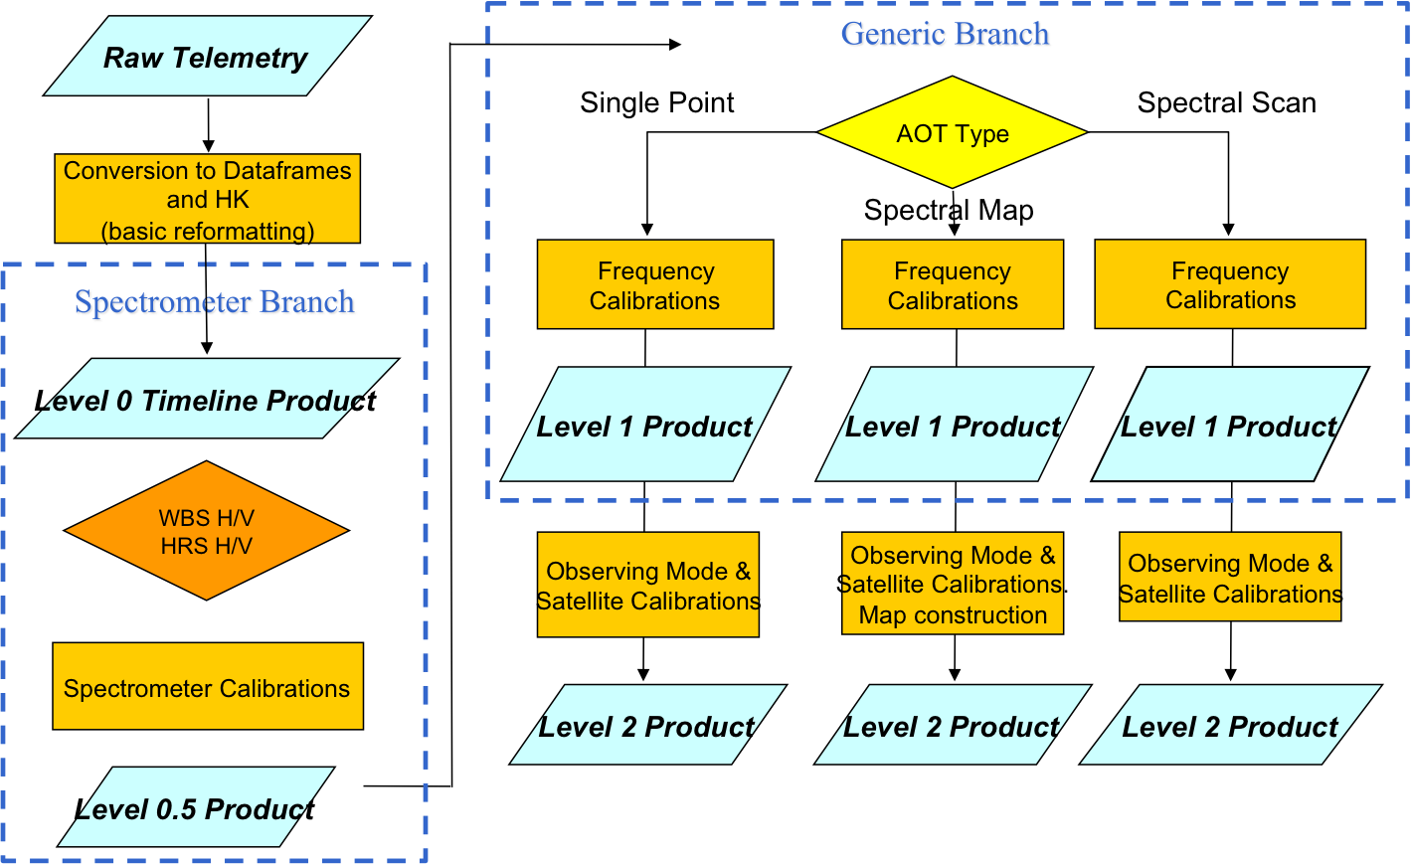
The HIFI pipeline schematic
One pipeline for all HIFI observing modes, customizable in HIPE.
H and V polarizations treated independently (not combined in the pipline), and provided on both USB and LSB frequency scales.
Double sideband
Cube Construction
Sideband Deconvolution
Level 2.5 Product
Level 2.5 Product
Double sideband
Single sideband

Slide 26
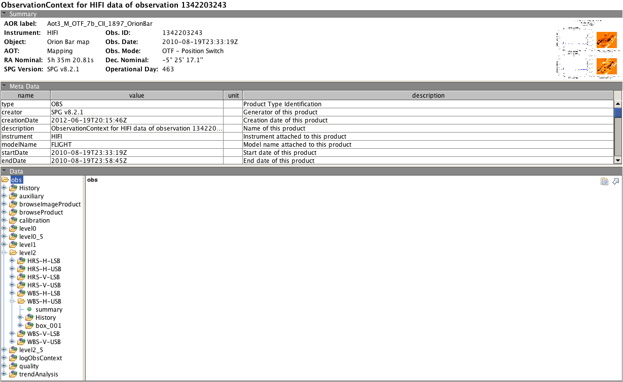
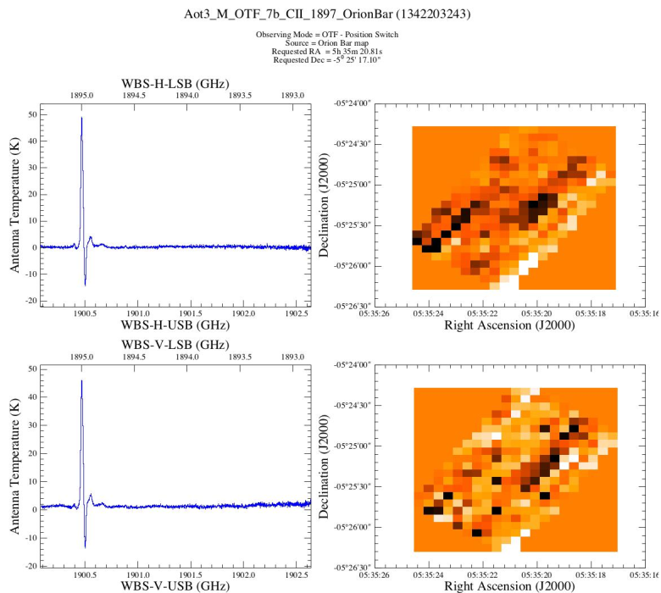
HIFI Data in (obs)Context
(Sylvie will cover in detail on Thursday)
Observation summary
Browse product
Product header
Products in observation context

Slide 27
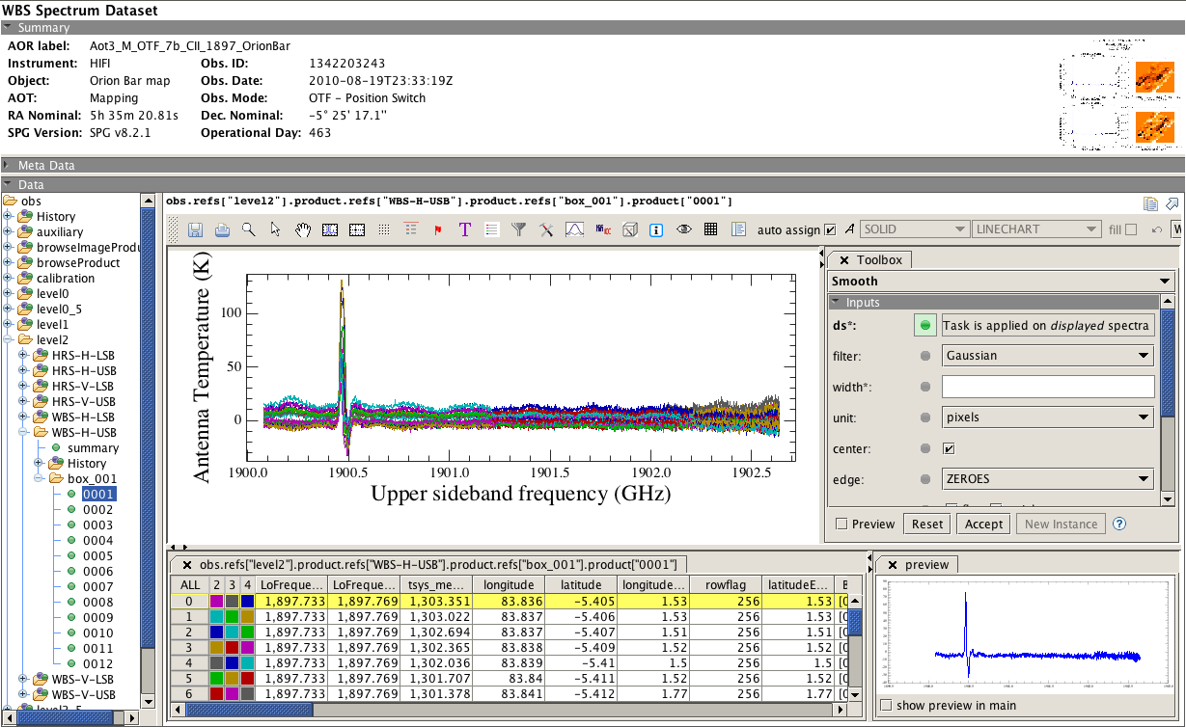
HIFI data visualization: SpectrumExploder
Tool Bar
Spectral toolbox
Scanning legs within map
Spectra within scanning leg

Slide 28
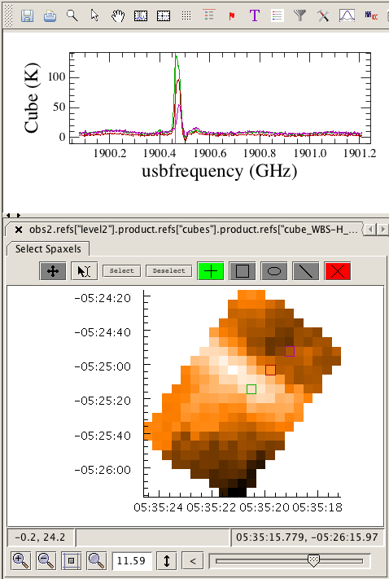
HIFI upper level products:
Spectral Cubes from Mapping Observations
Cubes
  Mapping observations also contain automatically generated cubes for each spectrometer, side-band (USB/LSB) and spectrometer sub-band.
  These cubes are stored in the so-called level 2.5 products
  The cube dimensions (typically pixel size, # of pixels, beam size, etc) based on AOR observing parameters. Ad hoc cubes can however be created a posteriori with the doGridding task
  Cubes can be visualized and manipulated with tools via Spectrum Explorer
Orion Bar
[CII] spectra
Orion Bar
[CII] map

Slide 29
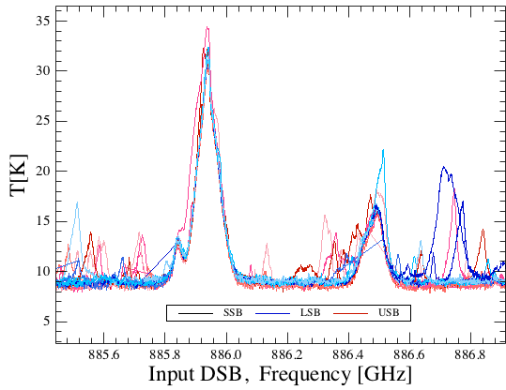
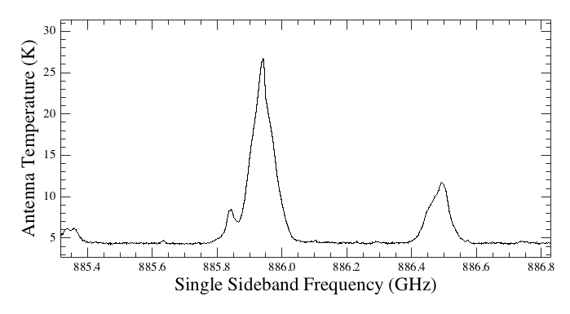
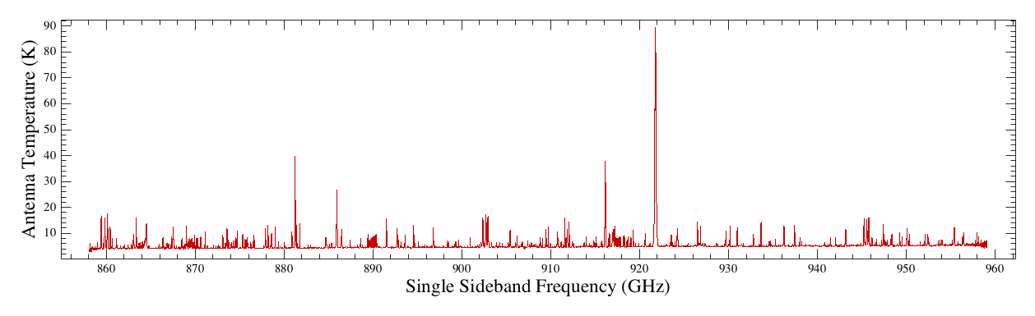
HIFI upper level products:
Single Sideband Spectral Scans
Deconvolved spectral scans
  Spectral scan observations also contain automatically generated deconvolved (i.e. Single Side-band) products for each spectrometer, stored as level 2.5 products.
  The deconvolved output can be recreated from modified level2 spectra using the doDeconvolution task (see how that’s done on Thursday).

Slide 30
Why Reprocess HIFI Data in HIPE
Are the final products good enough for science analysis and publication? In most cases --- NO. Why…
Some routine steps are always anticipated:
  Combining H and V data (all modes).
    H and V beams are slightly offset, or sometimes of different quality, thus NOT combined in the pipeline. This is up to the User.
  Data smoothing (all modes).
    Data were taken at a resolution fixed in HSpot, but the User has often adjusted the integration times to meet S/N requirements for the lines of interest. Strong, broad lines do not need full resolution, and are smoothed to a S/N goal.
  Resampling/regridding (maps):
    Cube dimensions are fixed by how the observation was carried out on the sky, however resampling often desired to bring out weak lines, match beams of observations at different frequencies, etc.
Artifacts. Treated in the pipeline, but no lights-out treatment is perfect for all observations! Judgment steps are needed.

Slide 31
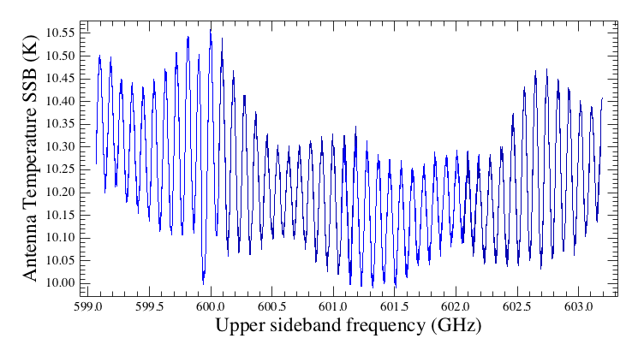
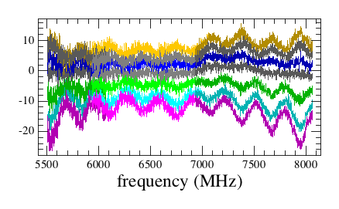
HIFI data artifacts
(1) Fringing residuals
Standing waves
  HIFI is affected both by optical (Fabry-Perot resonator) and electrical (generated in the IF chain) standing waves
  Their amplitude is enhanced by the detector gain drifts between ON- and OFF-source measurements
  The predominant standing waves depend on the band
    Bands 1 to 5 affected by optical standing waves. Worse when strong continuum in source (e.g. Planets)
    Bands 6 to 7 affected mostly by electrical standing waves
Mars – Band 1b
Drifting standing wave in Band 7b

Slide 32
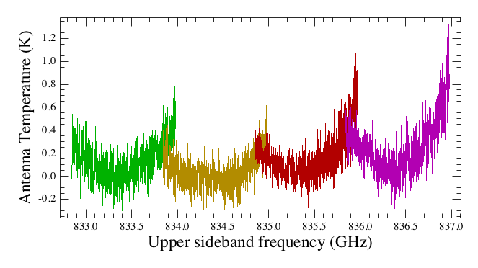
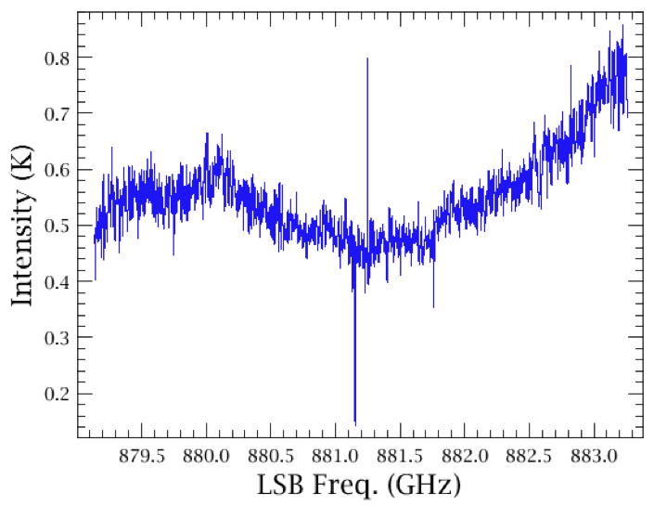
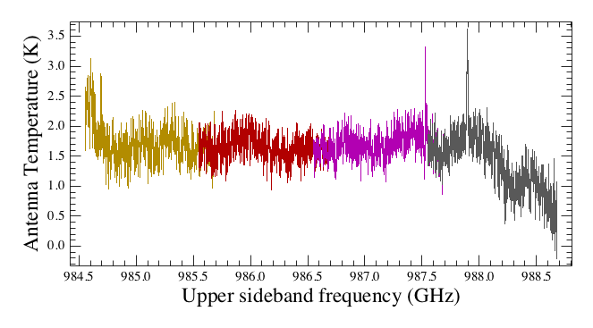
HIFI data artifacts
(2) Baseline drift
Overall baseline distortion
  On top of standing waves, additional (but not unrelated ) baseline drifts present when instabilities in the system gain are not fully calibrated out.
WBS CCD residual drift
(esp. PSW or OTF)
Slopes (esp. at edges of Diplexer bands)
Frequency Switching

Slide 33
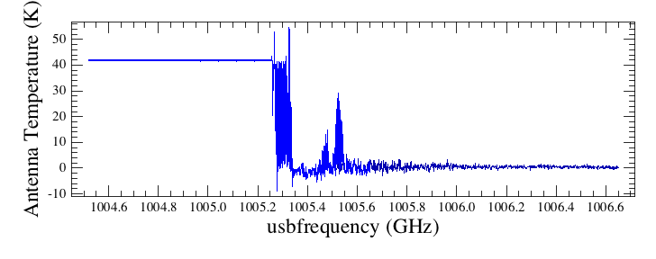
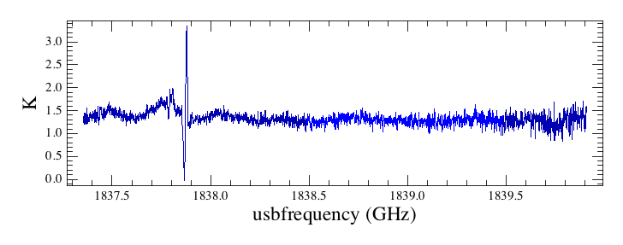
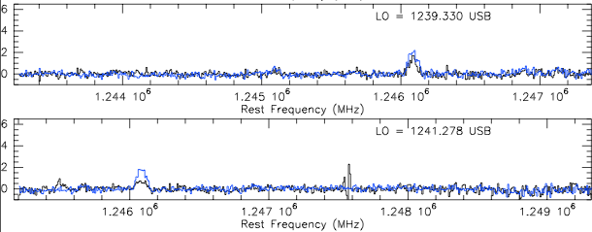
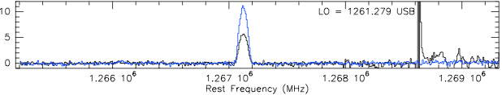
HIFI data artifacts
(3) Signal impurities
Spectral purity
  Irrespective of the master lock quality, the LO chain multipliers can oscillate under certain circumstances, and create spurious responses in the down-conversion (multi-tone source)
  Some appear as more or less narrow line spurs
    Degrades spectrum quality when blended with lines
    Can be as bad as flux saturation
  Some others appear as contribution at other frequencies (leaks)
    Fools the line identification
    Imply wrong flux calibration on expected line – if possible, to be corrected with ad hoc factor
Saturation in 4a
Spur in 7b
Band 5b
Impure
Pure

Slide 34
Telescope Pointing Accuracies
Pointing performances based almost entirely on dedicated PACS calibration observations. Refer to Roberta Paladini’s talk.
Bear in mind the statistical (1- radial) nature of these numbers, and bias towards PACS measurements. Performances are time- or mission phase-dependent.
  Improved jitter (RPE) characterizations with higher fidelity gyro data processing ongoing through this year.
  “Final” set of pointing products are anticipated and will be assessed for the HIFI pipeline by AOT and mode.
Anomalies are know occur in specific pointing modes used in the AOTs. Specifically, the line scan mode used in HIFI OTF mapping; more about this on Thursday.

Slide 35
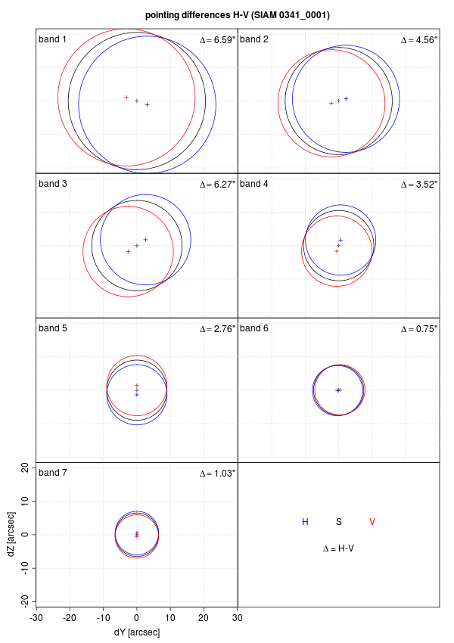
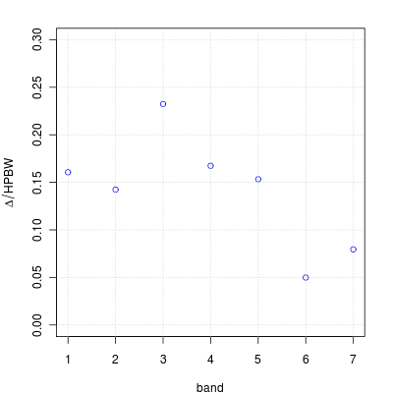
HIFI Pointing
HIFI’s H and V Mixer Beams are not perfectly co-aligned :
  Offset between H and V mixers, typically 15% of beam width
  Worst in band 3, almost quarter of a beam off
  Good alignment (< 10%) in Band 6 and 7.
Beam alignments are stored in the HIFI Calibration Tree.
These numbers and more pictures are also on the HIFI Calibration Web (linked later)

Slide 36
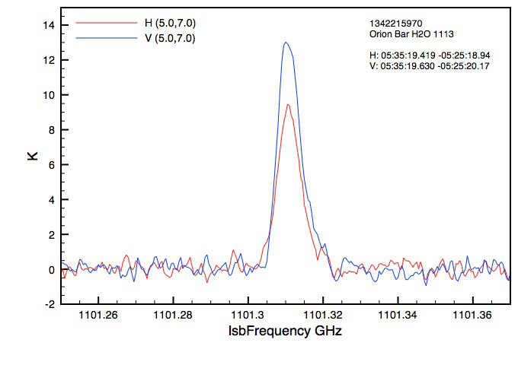
Importance of Beam Calibrations, knowledge of telescope absolute and relative pointing
HIFI is sensitive to pointing offsets as low as ~1” due to the H and V separation for both extended and point sources.
When extended sources are structured, H / V spectra may show different intensities, sometimes dramatic. H and V sample different locations.
On compact sources, H / V imbalances may occur simply because of the abolute pointing error (APE), one beam is better pointed to the intended target.
Similarly, knowledge of the relative offseting accuracies (SRPE) is meaningful in extended sources.

Slide 37
HIFI typical data-reduction workflow
Data inspection
  Know the data: freq., size, quality, etc
  SpectrumExplorer / Cube Viewer
Routine interactive steps
  Smoothing, combining H+V, etc.
Re-pipeline (if needed)
Data flagging
Fringe removal
Baseline removal
Upper level re-generation (cube, spectral scans)
Scale conversions
Data export
COVERED IN MORE DETAILS on Thursday
(and Friday option)

Slide 38
Arsenal of Tools
HIPE (Thurday)
Unit Conversions and NHSC tool
HSpot
CASSIS and XCLASS
JPL and Univ. Cologne line databases
Splatalogue
herschel.esac.esa.int/twiki/bin/view/Public/HifiCalibrationWeb

Slide 39
For the Radio-Challenged.
HIPE offers convertWavescale task to convert data in GHz to commonly needed wavenumber, μm, velocity, etc.
convertFrequency used in the HIFI pipeline is also used in SpectrumExplorer to display data on other unit scales, but the data are not modified.
Conversion of calibrated intensities T_{A}* to flux density Jy can be done with convertK2Jy, using beam parameters and efficiencies and the User’s guesstimate of emitting/absorbing source size.
For the advanced, a library of unit conversion tasks is available for scripting.
NHSC/HIFI has developed a browser-like tool for an array of useful and fast conversions, stand-alone or as a HIPE plug-in.
More on Thursday.

Slide 40
Arsenal of Tools
HIPE (Thurday)
Unit Conversions and NHSC tool
HSpot
CASSIS and XCLASS
  http://cassis.irap.omp.eu/
  http://www.astro.uni-koeln.de/projects/schilke/XCLASS
JPL and Univ. Cologne line databases
  http://spec.jpl.nasa.gov/ftp/pub/catalog/catform.html
  http://www.astro.uni-koeln.de/cgi-bin/cdmssearch
Splatalogue
herschel.esac.esa.int/twiki/bin/view/Public/HifiCalibrationWeb

Slide 41
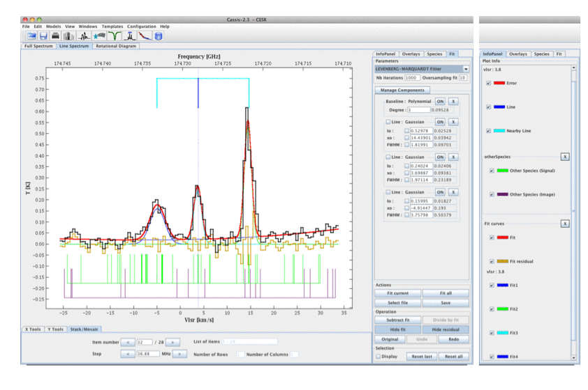
CASSIS and XCLASS
These are advanced scientific analysis tools for submm spectroscopy which can be run together with HIPE (CASSIS) or stand-alone with exported FITS files (CASSIS, XCLASS).
CASSIS will be presented by
Emmanuel Caux on Friday.
For users devoted to CLASS used at many submm observatories, HIPE offers a hiClass task to export to CLASS-FITS files. An extension of the CLASS package is the XCLASS package developed by Peter Schilke at Univ. Cologne, with similar capabilities to CASSIS.
NHSC does not provide resource support for these but we maintain a User’s knowledge of them (interpret that how you like).
Make sure you have the latest version of the plugin,
http://cassis.irap.omp.eu/download/cassis_3.4.1.jar

Slide 42
Some references
“Tools of Radio Astronomy”, T. L. Wilson, Kristen Rohlfs, Susanne Hüttemeister, 2009.
De Graauw et al., A&A 518, L6, “The Herschel-Heterodyne Instrument for the Far-Infrared (HIFI)”
Roelfsema et al., A&A 537, A17, “In-orbit performance of Herschel-HIFI”
Broadband analysis technique developed for line rich sources by Niell et al. 2012 ApJ. Source is methanol in Orion KL.

Slide 43



Additional viewgraphs
Further details which may be of help.
Read at your leisure.
of Methanol
of Methanol

Slide 44
Some pointers about HIFI frequencies
From channel number to IF frequencies
  The assignment of spectrometer channel number to IF frequency is performed in the WBS and HRS branch of the pipeline (between L0 and L0.5)
Space-craft radial velocity
  The correction of the space-craft velocity along the source line-of-sight is done in the L1 pipeline
  For fixed target, it brings the frequency scale in the LSR
  For moving targets, it brings the frequency scale into the target frame
USB/LSB scales
  The L2 pipeline creates two products: a USB and an LSB spectrum
  The two products are not only mirror spectra of one another wrt the LO frequency – intensity calibration can vary (Sideband ratio)
Velocity scales
  No pipeline product is given in velocity scale
  Conversion to velocity scale can be done by the user, e.g. in HIPE.

Slide 45
Data calibration: general concept
The ultimate goal of the data calibration is to recover the original source signal from the total signal measured by the detectors
Measured detector counts
C = F [S_{sou} + S_{sky}] + C_{tel} + C_{inst}
Instrument emission
Telescope + inst. response function
Source signal
Sky signal
Telescope emission
The detection chain function involves (time-dependent) transformations by the optics, electronics, and the environment between the source and the telescope (esp. the atmosphere for ground-based facilities)
Instrument
Sky
C
Telescope

Slide 46

HIFI flux calibration (1)
1
J_{sou} – J_{OFF} = [C_{sou} – C_{OFF}]
Source and reference counts
η_{sou}η_{l}G_{inst}
Instrument response
Source and reference brightness temperature (K, Double-Side-Band)
Source efficiency
Forward efficiency
Example of an HIFI band-pass function
HIFI works with differential signals, allowing to cancel out to 1st order the telescope and instrument background (so-called T_{rec})
The instrument response is expressed as a band-pass function, measured on two internal (hot and cold load) black-bodies
As such, the HIFI data are calibrated as brightness temperature [J_{ν}=B_{ν}(T)]
Coupling to the loads
Hot and cold load counts
C_{h} – C_{c}
G_{inst} =
(η_{h} + η_{c} - 1)[J_{h} – J_{c}]

Slide 47

HIFI flux calibration (2)
The HIFI calibration is thus based on a three points (hot, cold, blank sky OFF) measurement scheme
  Unlike for the ground-based radio-telescopes, the OFF is not used for atmosphere calibration, but rather for standing wave mitigation
  The rate at which those points are visited depends on the drift characteristics applying to each of the 14 detector bands
The standard HIFI products are calibrated on the so-called T_{A}* scale
  Calibration onto a single-side-band scale require correction from the side-band ratio (SBR)
  Source coupling correction depends on the source extent compared to the beam – many radio-astronomers convert their data into a main beam temperature:
[J_{sou} – J_{OFF}]_{DSB}
[J_{sou} – J_{OFF}]_{SSB} =
G_{ssb}
SBR
Receiver gain response (unpumped mixer)
η_{l}
T_{mb} = T_{A}*
η_{mb}

Slide 48








The HIFI pipeline: DBS example
(1) Reference and OFF subtraction
Total power
Simple diff.
Double diff.
ON-source phase 1
ON-OFF phase 1
Counts
_
OFF-source phase 1
OFF subtraction
ON-OFF
Phase 1 – Phase 2
Ref. subtraction
Counts
+
ON-source phase 2
ON-OFF phase 2
Counts
Counts
_
OFF-source phase 2
Level0.5
Level1

Slide 49


The HIFI pipeline: DBS example
(2) Bandpass Calibration
Total power
Double diff.
Double diff.
Band-pass spectrum
Hot load
Cold load
Counts
ON-OFF
Phase 1 – Phase 2
Band-pass corrected
div
ON-OFF
Phase 1 – Phase 2
From previous step
Level1
Level1

Slide 50





The HIFI pipeline: DBS example
(3) Sideband Calibration and Scan Averaging
All spectra in USB frequency scale
Level2 USB
Collection of all
ON-OFF
All spectra in LSB frequency scale
Level2 LSB
Level2
Level2

