Slide 1
Overview of the Herschel Data Processing System and Activities
Stephan Ott Herschel Science Data Processing Development Manager Herschel Science Data Processing Coordinator Herschel Science Centre on behalf of all contributors of the Herschel mission http://herschel.esac.esa.int/HerschelPeople.shtml

Slide 2
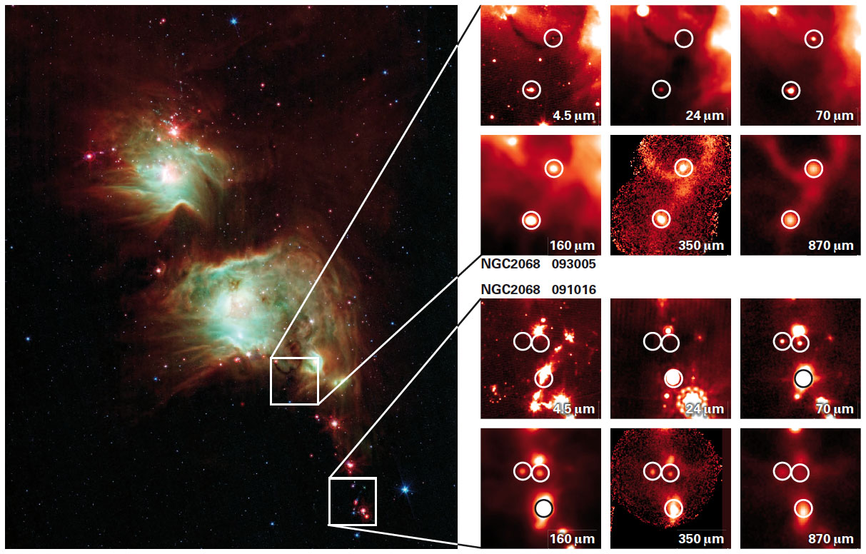
Outline
Overview of the Herschel Data Processing System and current Activities
What we can do for the Herschel Community
HIPE
Standard Pipeline Products
Priorities for the next years
What you can do for the Herschel Community
Gateways into the Herschel Treasure
E komo mai!
Herschel enables discovery of young protostars in Orion. Herschel/PACS imaging of an area in Orion, previously imaged by Spitzer, has led to a serendipitous discovery of young protostars (Stutz et al. 2013)

Slide 3
Data Processing System Overview
As part of the Herschel Common Science Software (HCSS) the Herschel Interactive Processing Environment (HIPE) and the Pipeline Processing and Quality Control software form the major packages of the Herschel Data Processing System
Data processing system combines data access, pipeline execution, data reduction and scientific analysis in one single environment
You can re-run the pipelines on your computer
Community has access to the same system as the instrument experts
The Herschel Data Processing software is coded in Java/Jython to be license free and portable for different operating systems
The Herschel Data Processing software is distributed under the lesser GNU public license, permitting general access and code re-use
For HIPE 11 formal support is provided for Linux, Windows XP, Vista and Windows7, OSX 10.6 ("Snow Leopard"), 10.7 (“Lion”) and 10.8 (“Mountain Lion”) under both Java 6 and 7
From HIPE 12 onwards only Java 7 is supported

Slide 4
Data Processing System Overview
Herschel Science Centre (ESA), the Instrument Control Centres (HIFI, PACS and SPIRE) and NHSC jointly manage and contribute to the Herschel Data Processing System
During development and operations over 250 persons worked on calibration, coding, documentation, pipeline operations, quality control, testing and tutoring, contributing to Herschel Data Processing
Despite declining resources Data Processing remains a major development project during Herschel’s post-operational phase
Notes:
90 full-time equivalents will continue to work for Herschel in 2014.

Slide 5
Data Processing System Overview
Within this talk HCSS denotes the software used for Pipeline Processing and Quality Control, and HIPE the data reduction software you install and use on your computer
Usually HCSS and HIPE version numbers correspond
Currently the latest versions are HCSS 11.0.1/HIPE 11.0.1
End 2013 we will release one more major data processing version, HCSS 12
From 2014 onwards we will release one major version at the end of each year, with the final version HCSS 15 released end 2016
Minor versions are released each few months
For each major version the Herschel Science Centre performs a bulk reprocessing with the latest software and calibration to repopulate the Herschel Science Archive with standard pipeline products
Using the on-demand processing option available from the HSA you can process observations with the latest operational software and calibration
Notes:
90 full-time equivalents will continue to work for Herschel in 2014.

Slide 6
Data Processing Activities Overview
Consolidation of telemetry and auxiliary data taken during operations
Generation of PACS photometry level 2.5 products to complete bulk reprocessing for HCSS 10.3
Quality control of products generated during operations
Working towards the next major version HCSS 12.0
Improvements for next minor version HCSS 11.1
Contributing towards Herschel’s final documentation, the Herschel Explanatory Supplement
Analysis of Herschel Users’ Group recommendations
Notes:
HUG (Herschel user’s group) and NUP (NHSC user panel)

Slide 7
Much more than a download portal
http://herschel.esac.esa.int/hipe
Worth while bookmarking
Notes:
You might take note and add it to your bookmarks

Slide 8
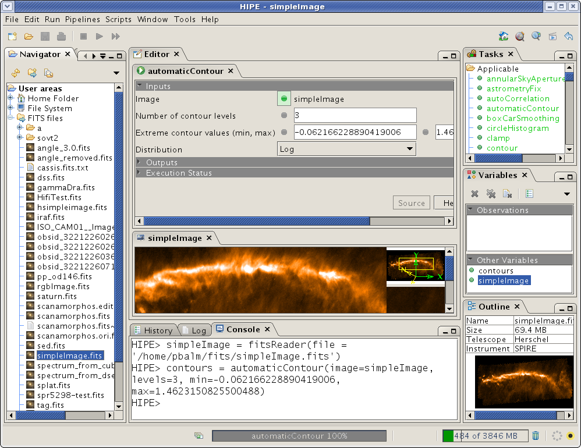
A first glimpse of HIPE
Automatic selection of
Applicable tasks
Task GUI
Contextual Help and Source Code
Start here!
Read into
variable
Command-line echo
File Navigator
Preview

Slide 9
Standard Pipeline Products
Pipelines are executed on the ESAC Grid to produce Herschel Products to different reduction levels.
Level 0 raw data
Level 1 instrumental and satellite effects removed
Level 2 scientific analysis can be performed. For many instrument modes we achieved a very high pipeline product quality
Level 2.5 level 2 like products combining two observations (HCSS 11)
Level 3 level 2 like products combining many observations (HCSS 11)
Bulk reprocessing with HCSS 11.x is expected to be completed by the end of the year
Data quality control cycle by the Technical Assistants and Instrument Calibration Scientists
Data quality control is a combination of automatic screening and manual inspection
All science observations were manually inspected at least once
Spot-checks with current HIPE version on a number of observations
Notes:
We changed the nomenclature in HCSS 11, in previous versions the highest level were level 2.5 products which were for SPIRE many observations, and for PACS 2

Slide 10
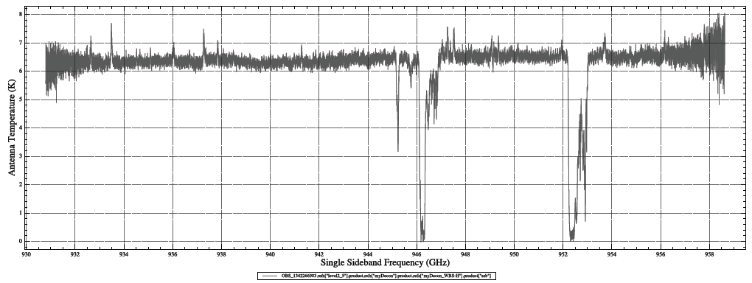
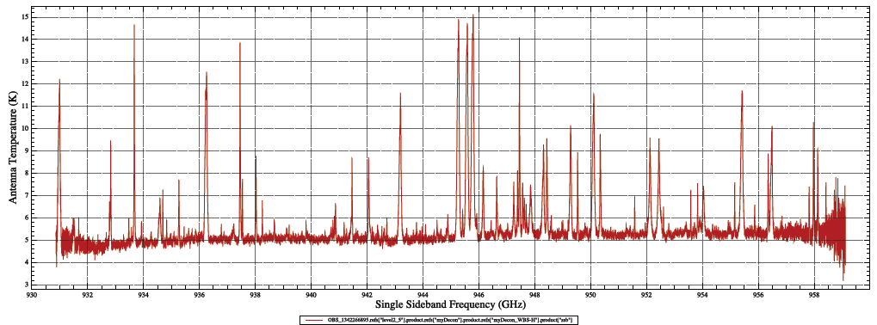
HIFI Level 2.5 deconvolved spectra
Standard Pipeline Products

Slide 11
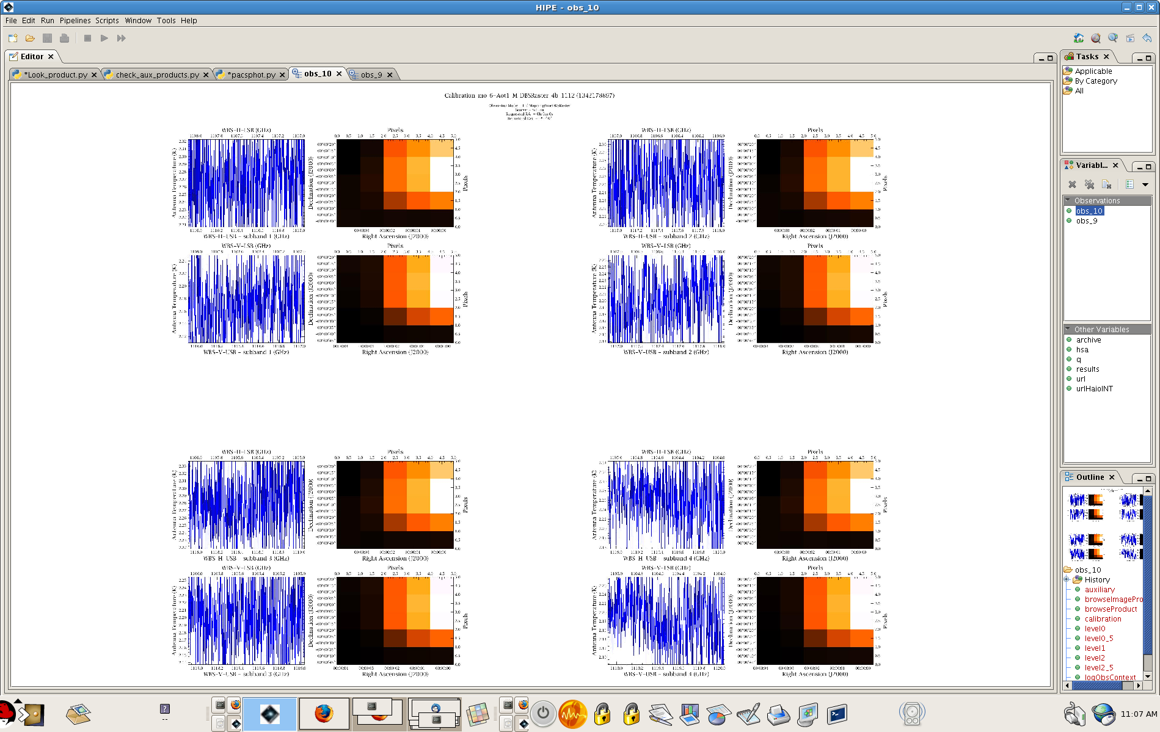
HIFI Browse Product
Standard Pipeline Products

Slide 12
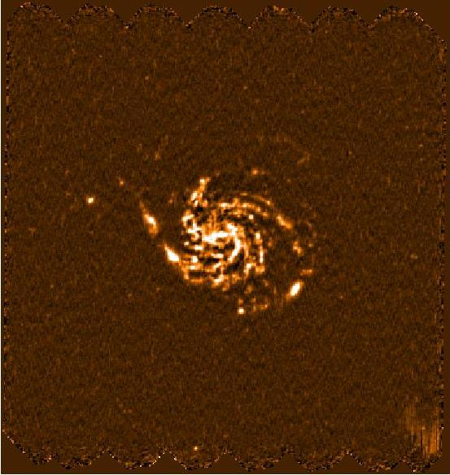
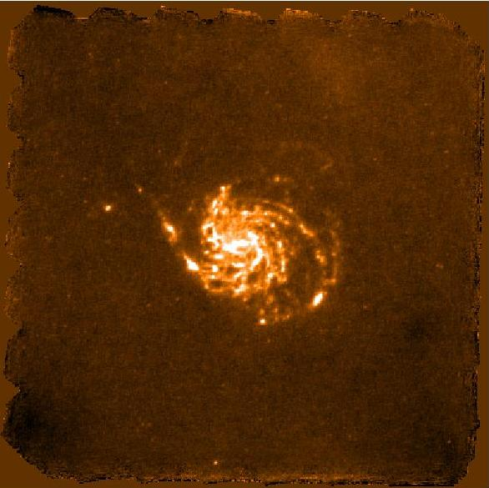
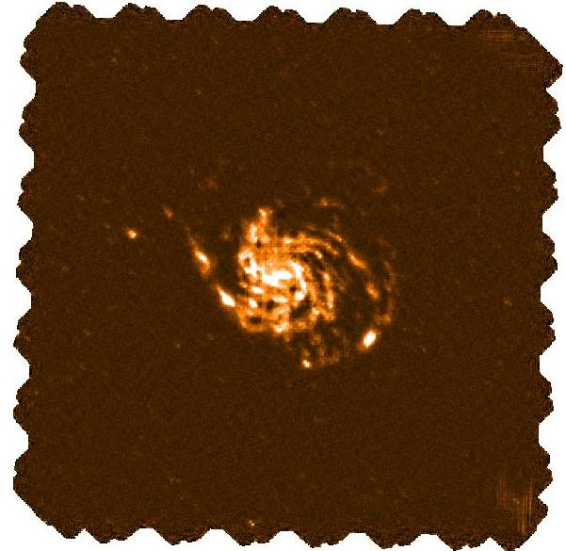
Standard Pipeline Products
Level 2 map
(1 scan)
Level 2.5 mosaic
(scan and crossscan)
PACS SPG mosaics
Level 3 mosaic
(2 scans and 2 crossscans)
Messier 101
(PI R. Kennicutt)

Slide 13
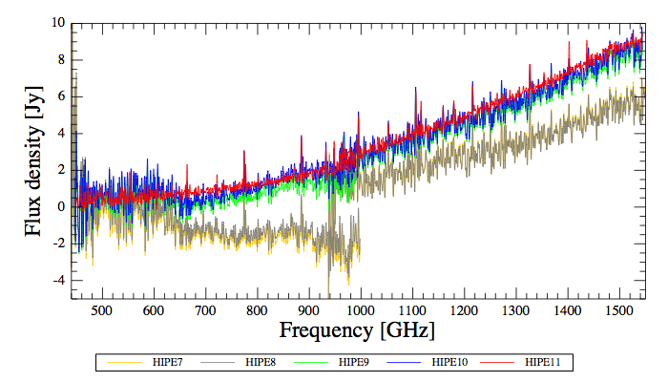
Standard Pipeline Products
a ‘good day’!
SPIRE FTS SPG Level 2
^
OD209: a ‘bad day’, awful shape, horrible noise
HIPE7 HIPE8
HIPE9 HIPE10
HIPE11!!
Mrk 231
Notes:
The HIPE 11 product will appear end of the year, up to then you can generate
this via on-demand processing

Slide 14
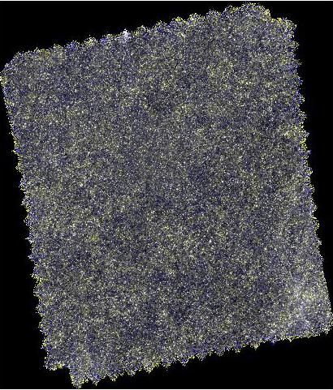
Standard Pipeline Products
SPIRE SPG Level 3 mosaic
ECDFS
Level 2.5
(PI S. Oliver)
Composite of 105 single
observations
Notes:
This is already available as level 2.5 product in previous HCSS versions

Slide 15
Standard Pipeline Products
SPIRE Level 3 mosaic. Standard Pipeline Product available after bulk reprocessing with HCSS 11 from the Herschel Science Archive
View of 90º of the Galactic Plane at 250 µm
Credits ESA/PACS & SPIRE Consortia, Sergio Molinari, Hi-GAL Project
Notes:
No Photoshop – this will come out of the archive!

Slide 16
Standard Pipeline Products
SPIRE Level 3 mosaic. Standard Pipeline Product available after bulk reprocessing with HCSS 11 from the Herschel Science Archive
View of 90º of the Galactic Plane at 250 µm
Credits ESA/PACS & SPIRE Consortia, Sergio Molinari, Hi-GAL Project
Notes:
This is the full product

Slide 17
Priorities for the next years
Most important are the archive products
Improvements of calibration, data reduction pipeline, pipeline processing environment, pointing and the generation and quality control of products have the highest priority
Evolve Herschel legacy in conjunction with the emergence of other major facilities (ALMA, SOFIA)
Enable Herschel archival research for astronomical community at large
The second highest priority is the maintenance of the interactive data processing system so that the astronomical community has the best means to exploit Herschel data in detail, and the experts from the HSC, ICCs and NHSC can continue to improve algorithms and calibration
Documentation is the third highest priority as the analysis software and data products need to be well described so that the best science results can be extracted
On a best efforts basis we will provide assistance to the long-term preservation of HIPE using virtual machines
Notes:
We can read CASA data Alma and Sofia data

Slide 18
Future Standard Pipeline Products
Standard SPIRE Pipeline
70 μm 160 μm 250 μm 350 μm 500 μm
SPIRE Super-Resolution Pipeline
(Orieux et al. 2011; Ayasso et al. 2012)

Slide 19
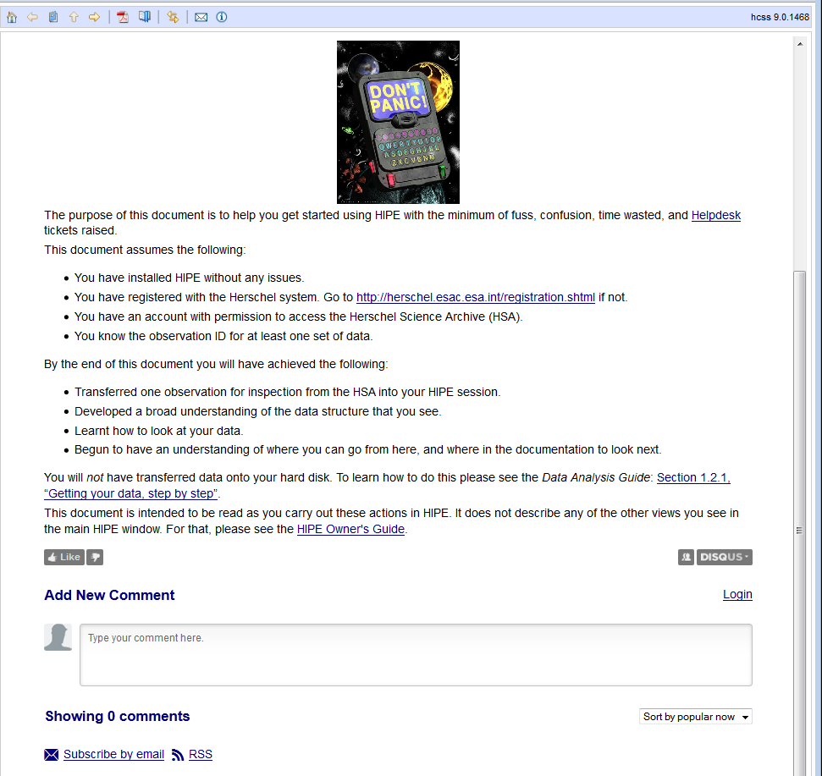
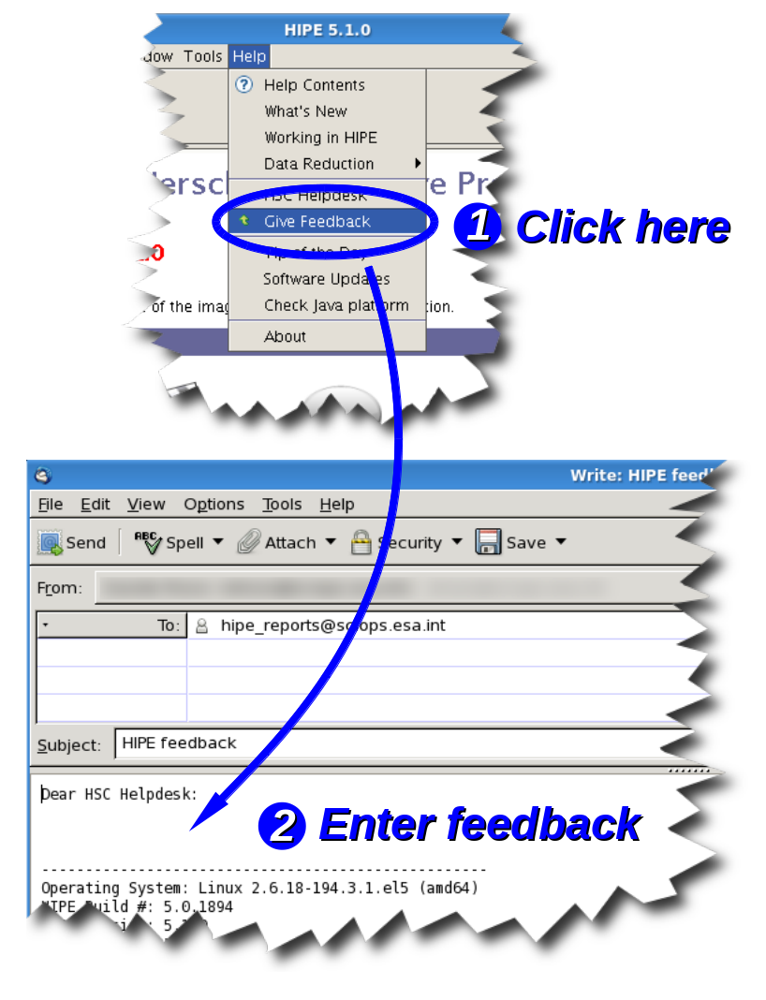
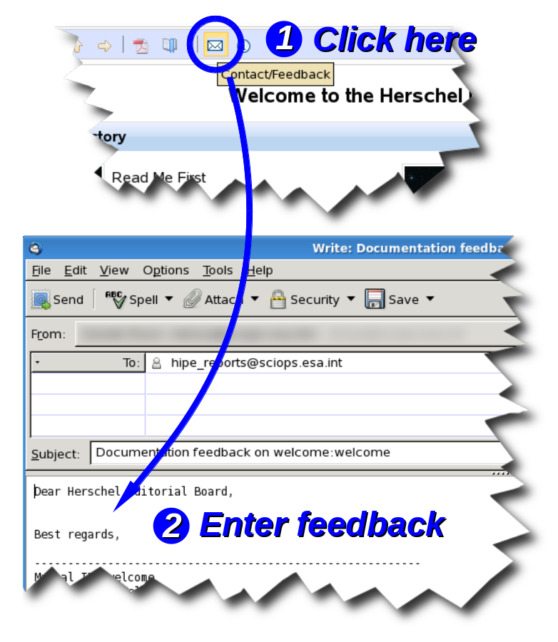
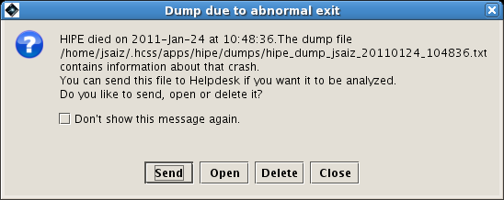
What you can do for Herschel
… on HIPE
… on HIPE hangs and crashes
… on documentation

Slide 20
Gateways into the Herschel treasure
Visit the Herschel Science Centres https://nhscsci.ipac.caltech.edu/sc/ and http://herschel.esac.esa.int/
Download HIPE from http://herschel.esac.esa.int/HIPE_download.shtml
Visit the HIPE homepage http://herschel.esac.esa.int/hipe
Visit the HIPE Community Wiki http://hipecommunity.wikispaces.com/
Access the Herschel Science Archive at http://herschel.esac.esa.int/Science_Archive.shtml
Download the apps to access Herschel Quick Look Products for iPhone https://itunes.apple.com/us/app/esa-hql/id476280092?mt=8 and Android https://play.google.com/store/apps/details?id=qv.android

Slide 21
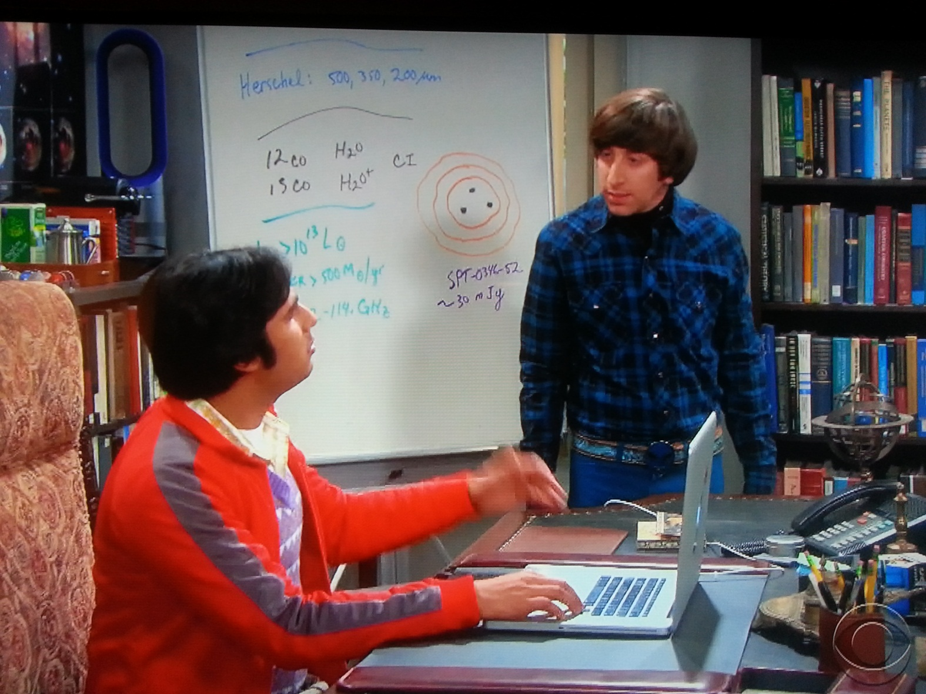
Herschel becomes famous in Big Bang Theory!

Slide 22
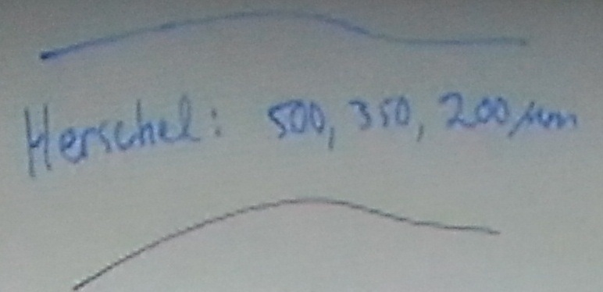
Herschel becomes famous in Big Bang Theory!

Slide 23
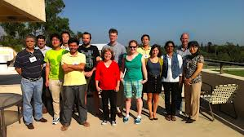
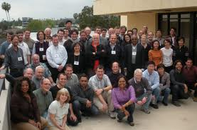
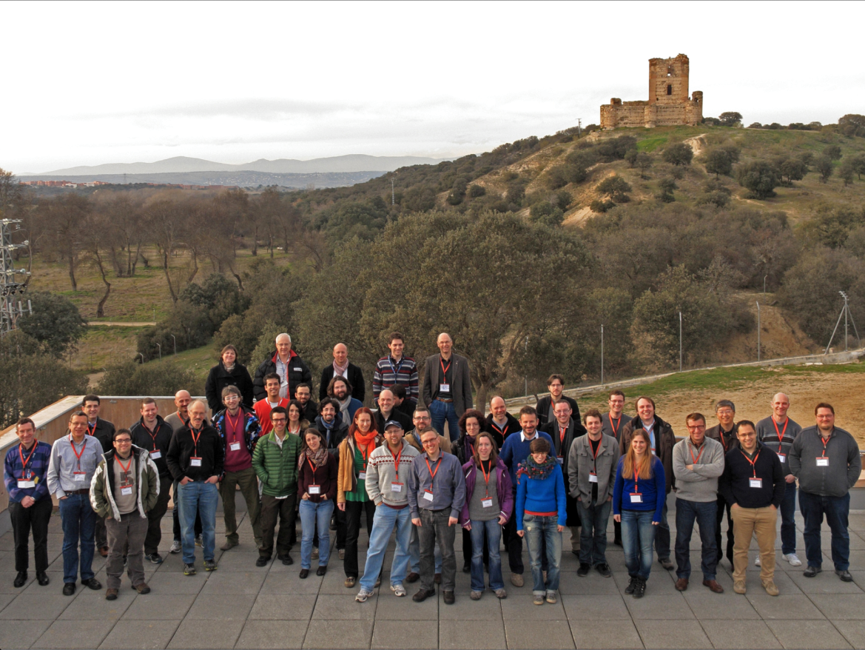
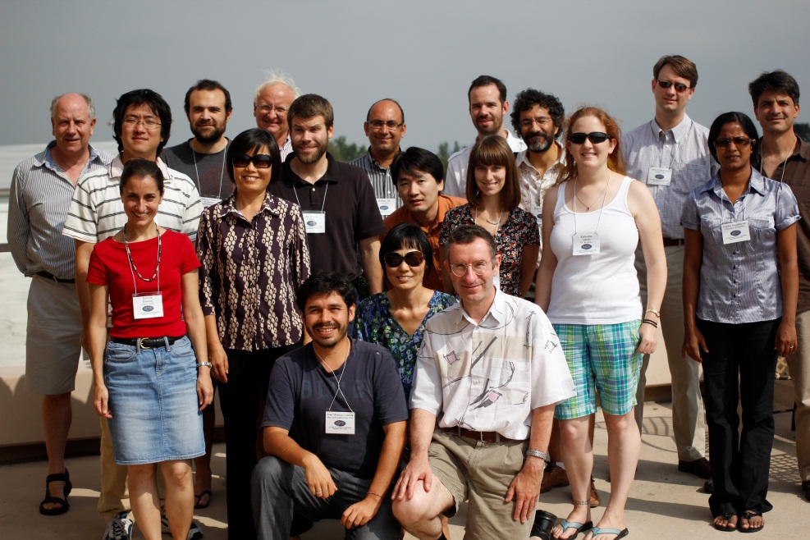
We can’t promise you a guest star role …
… but will do our best to further your research

Slide 24
E komo mai!

