Slide 1

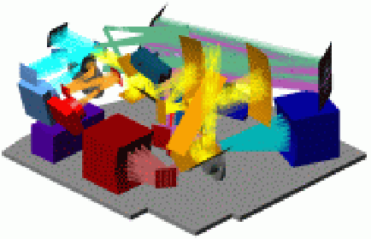
NHSC PACS
Introduction to
PACS archived products
Roberta Paladini
(NSHC/Caltech)
&
The NHSC PACS Team
With additional contributions from: Bruno Altieri & Roland Vavrek
R. Paladini NHSC Archive Data Workshop – August 26th – 30th 2013 PACS Intro

Slide 2
Outline of the Talk
Quick Instrument Overview: photometer & spectrometer
Photometer:
- What kind of data in the archive ?
- Archive Products Overview and Visualization in HIPE
Spectrometer:
- What kind of data in the archive ?
- Archive Products Overview and Visualization in HIPE
PACS Calibration
Herschel Pointing Error (→ particularly affecting PACS..)
Visualization outside HIPE: example with RGB image
Documentation
R. Paladini NHSC Archive Data Processing Workshop – August 26th – 30th 2013 PACS Intro

Slide 3
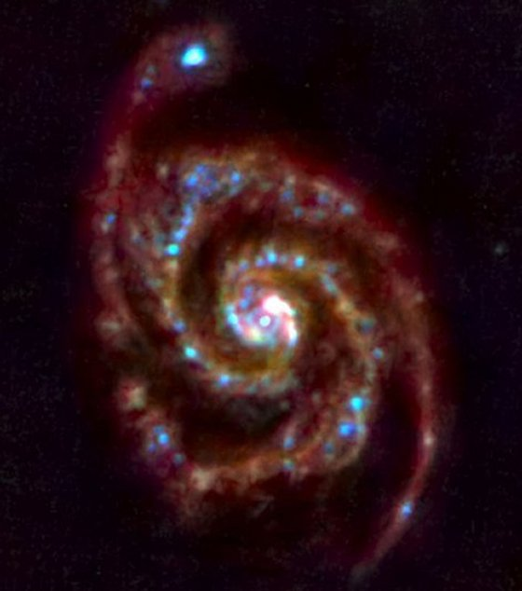
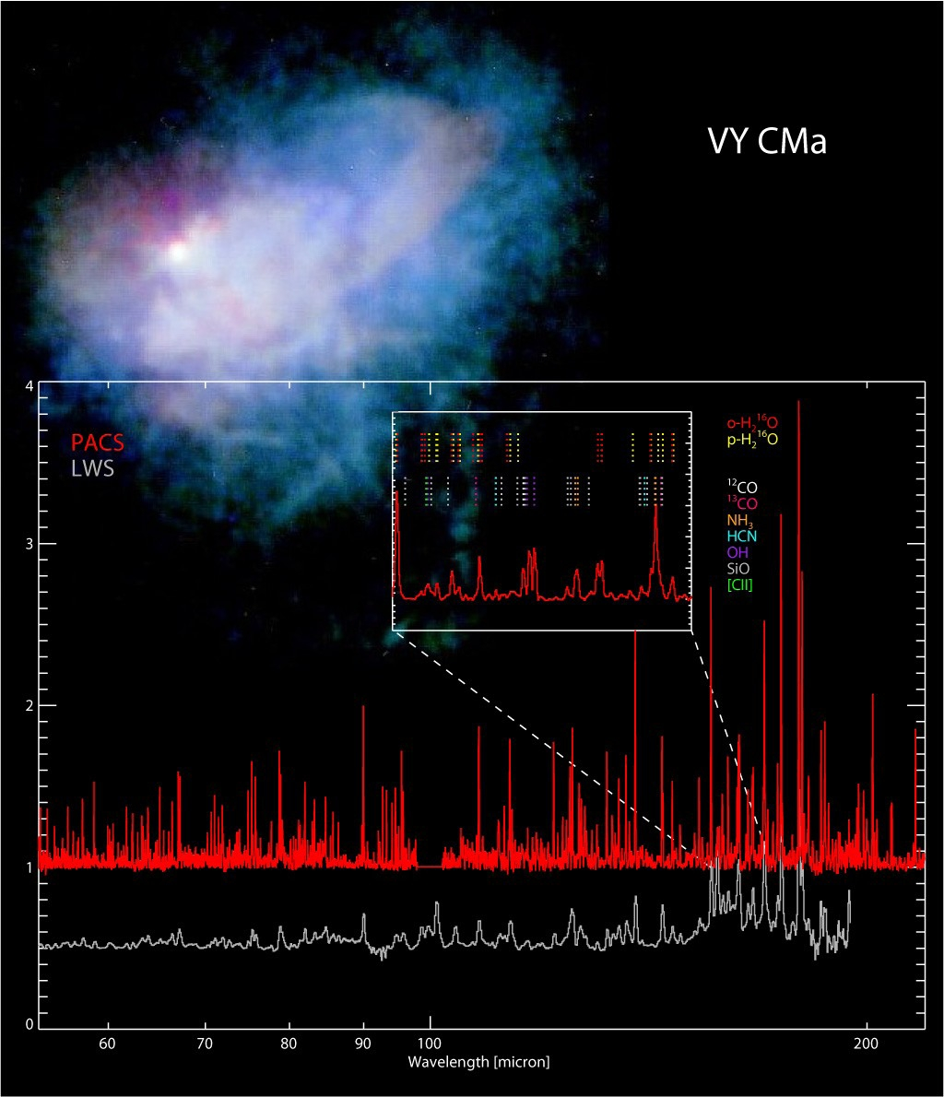
PACS Instrument Overview
PACS:
A Photodetector Array Camera & Spectrometer for Herschel
Image Credit: ESA and PACS Consortium
Image Credit: MESS Consortium
M51
Imaging bolometers Spectroscopy Ge:Ga array
R. Paladini NHSC Archive Data Processing Workshop – August 26th – 30th 2013 PACS Intro

Slide 4
PACS Instrument Overview
Wavelengths & Resolution
Imaging Photometer
“Integral Field” (IFU) Spectrometer
(3D-spectroscopy)
Simultaneous (→ same FOV) 60-85 μm or 85-130 μm and 130 – 210 μm imaging
FWHM: 5.5”, 6.7”, 11.5”
1.7’ X 3.5’ FOV with a 64 X 32 and
32 X 16 arrays
Point source detection limit: ~3mJy (5σ, 1h)
Simultaneous (→ same FOV) 57-105 μm (B3A, B2B) & 105-210 μm (R1) spectroscopy
FWHM from 9.4” to 13”
47” X 47” FOV re-arranged via an image slicer on two 16 X 25 arrays
λ/Δλ ~ 1500
Sensitivity: ~ 5 X 10⁻¹⁸ W/m²
(5σ, 1h)
R. Paladini NHSC Archive Data Processing Workshop – August 26th – 30th 2013 PACS Intro

Slide 5
PACS Photometer
PACS Photometer
R. Paladini NHSC Archive Data Processing Workshop – August 26th – 30th 2013 PACS Intro

Slide 6
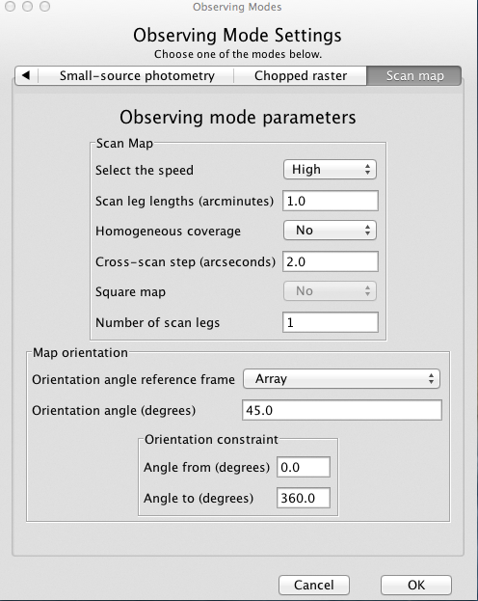
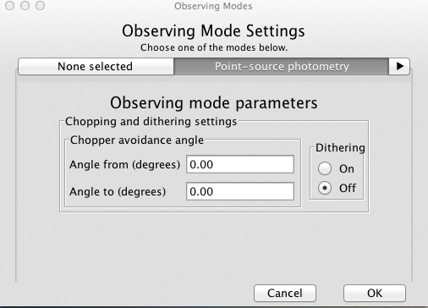
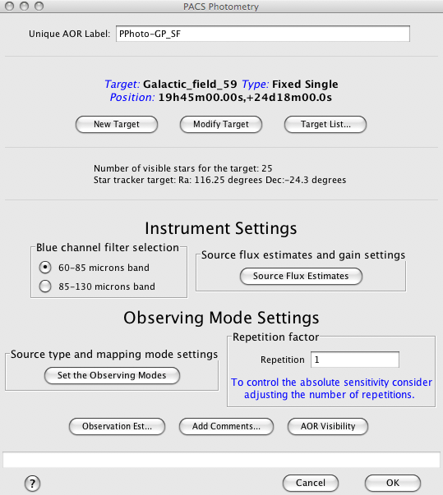
PACS Photometer
What kind of data in the archive ?
(from HSPOT: Herschel Observing Planning Tool)
Scan Map
Point-source
This mode was found to be less efficient than “scan map”, so it was not recommended for Cycle 1/Cycle 2 observations
R. Paladini NHSC Archive Data Processing Workshop – August 26th – 30th 2013 PACS Intro

Slide 7
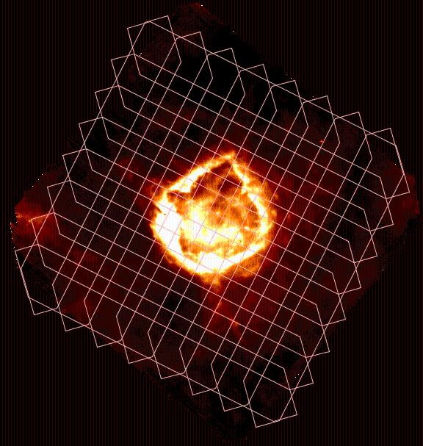
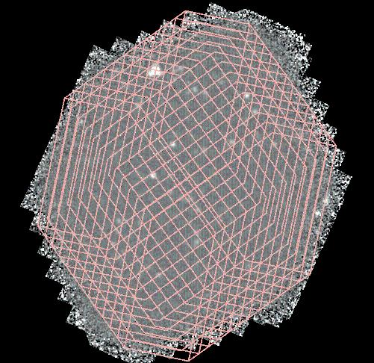
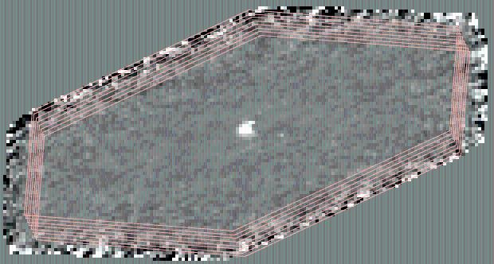
PACS Photometer
What kind of data in the archive ? – cont.
Scan Map
Large Galactic fields
Deep cosmological fields
Small fields centered on point-sources
R. Paladini NHSC Archive Data Processing Workshop – August 26th – 30th 2013 PACS Intro

Slide 8
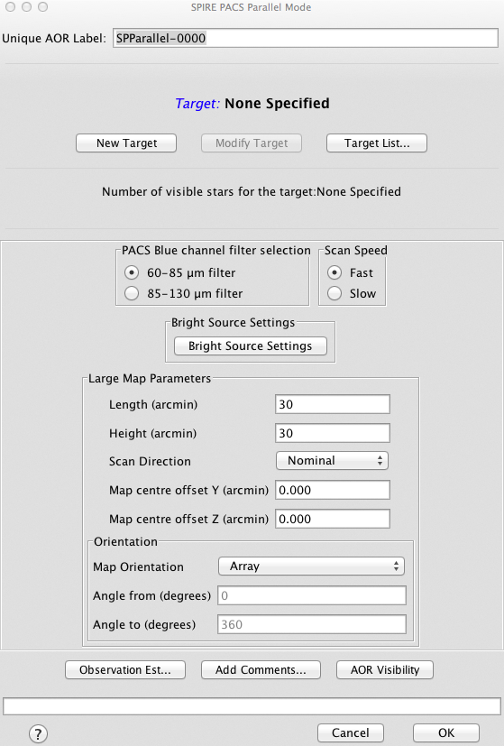
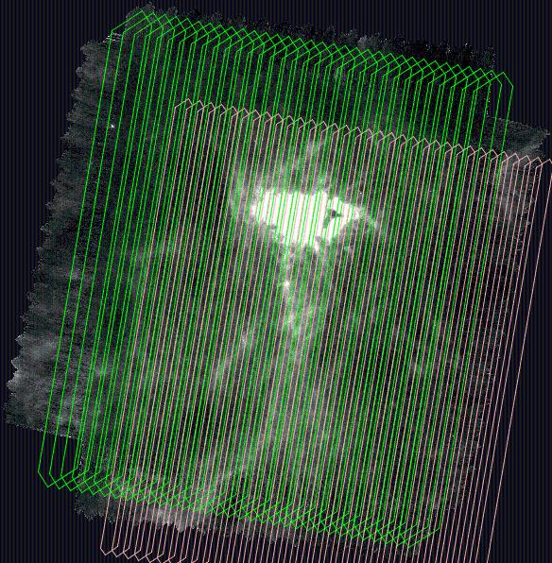
PACS Photometer
What kind of data in the archive ? – cont.
Parallel Mode: PACS & SPIRE
This mode is efficient for large maps, i.e. > 45 arcmin in size (PACS and SPIRE are separated by 21 arcmin on the focal plane)
R. Paladini NHSC Archive Data Processing Workshop – August 26th – 30th 2013 PACS Intro

Slide 9
PACS Photometer
PACS Photometer Archived Products
High-pass filtering
Good noise (cfr. 1/f) removal but extended/background emission is totally gone
YES
Source:
is it point-like ?
NO
MADMap
Preserves background (cfr. emission on all angular scales) but noise removal can be more problematic
R. Paladini NHSC Archive Data Processing Workshop – August 26th – 30th 2013 PACS Intro

Slide 10
PACS Photometer
Currently available from the HSA:
Level 0: raw data cubes
Level 1: data cubes calibrated in Jy/pixel, instrument effects removed and propagation of “flagged pixels” (cfr. masks). Astrometry (cfr. Pointing) attached
NOTE: Level 1 is the typical starting point for re-processing
Level 2: maps created by projecting high-pass filtered (HPF) data cube on a grid using pointing information
NOTE: one map per OBSID / extended emission is filtered out
Level 2.5 (AKA: extended pipeline): maps combining pairs (cfr. Scan/X-scan) of OBSIDs – Both MADMap and HPF maps
NOTE: MADMap preserves emission on all angular scales
Available from the HSA in SPG11:
Level 3: maps combining all observations of a given field from the same program – HPF and MADMap
R. Paladini NHSC Archive Data Processing Workshop – August 26th – 30th 2013 PACS Intro

Slide 11
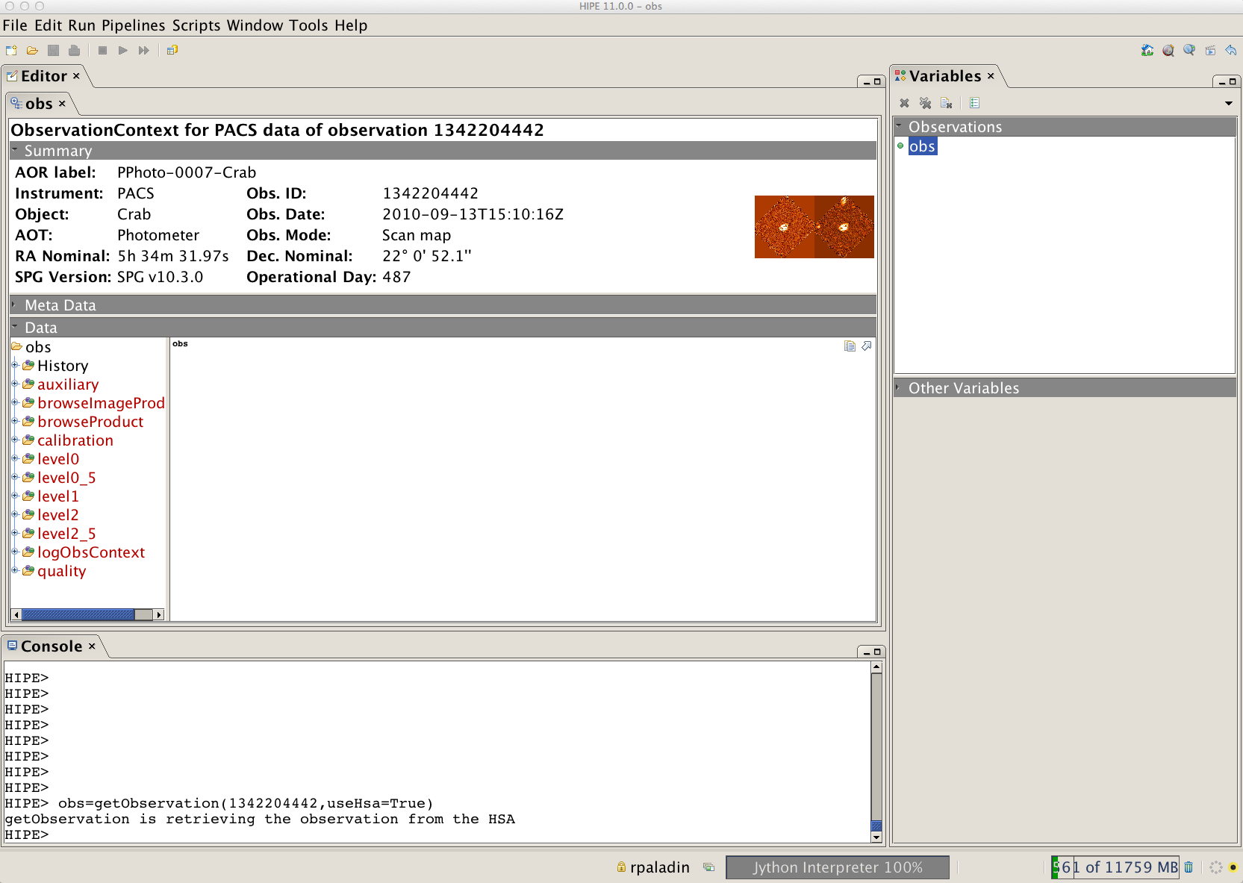
PACS Photometer
Example: Crab Nebula – OBSIDs: 1342204441/1342204442
3
2
1
Double click on the “obs” variable
R. Paladini NHSC Archive Data Processing Workshop – August 26th – 30th 2013 PACS Intro

Slide 12
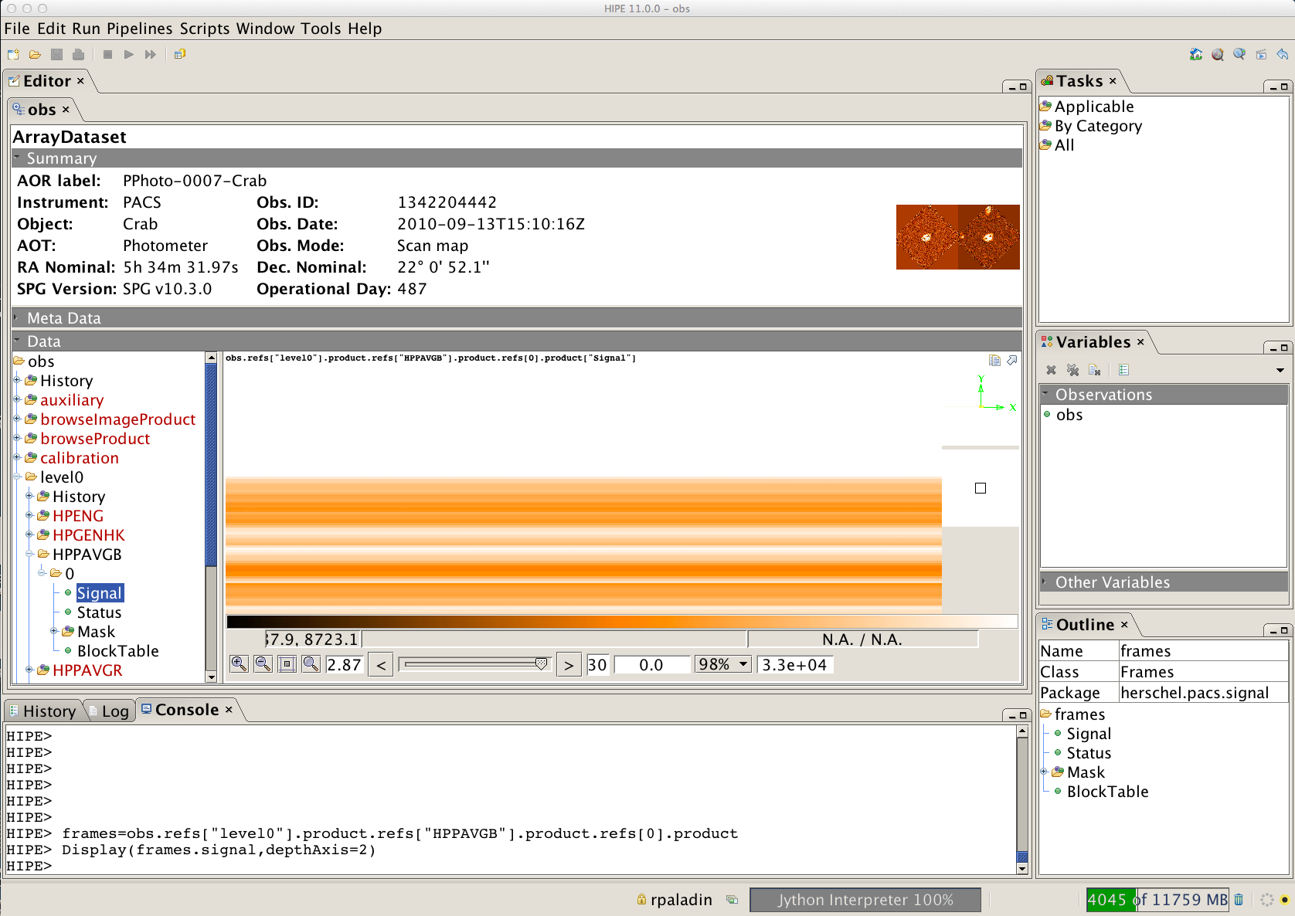
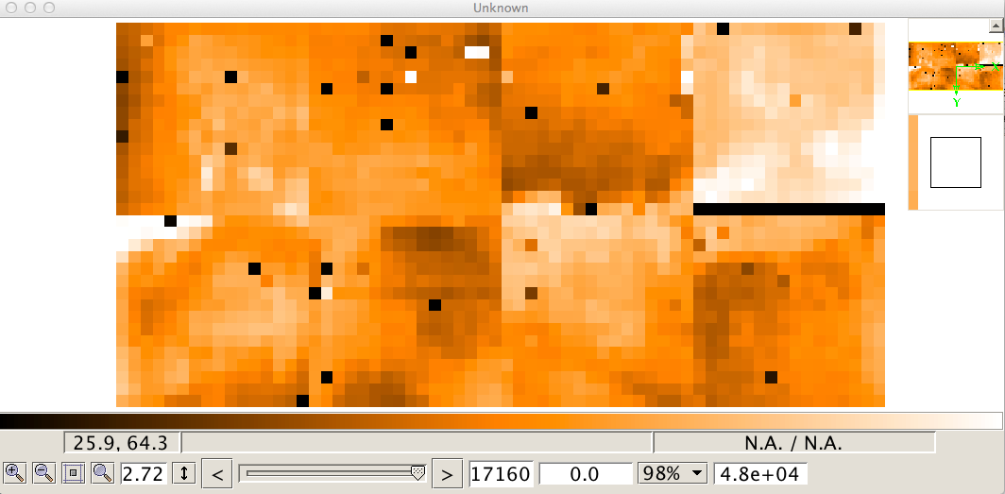
PACS Photometer
Level 0: raw data
You do not really need to look at these..
R. Paladini NHSC Archive Data Processing Workshop – August 26th – 30th 2013 PACS Intro

Slide 13
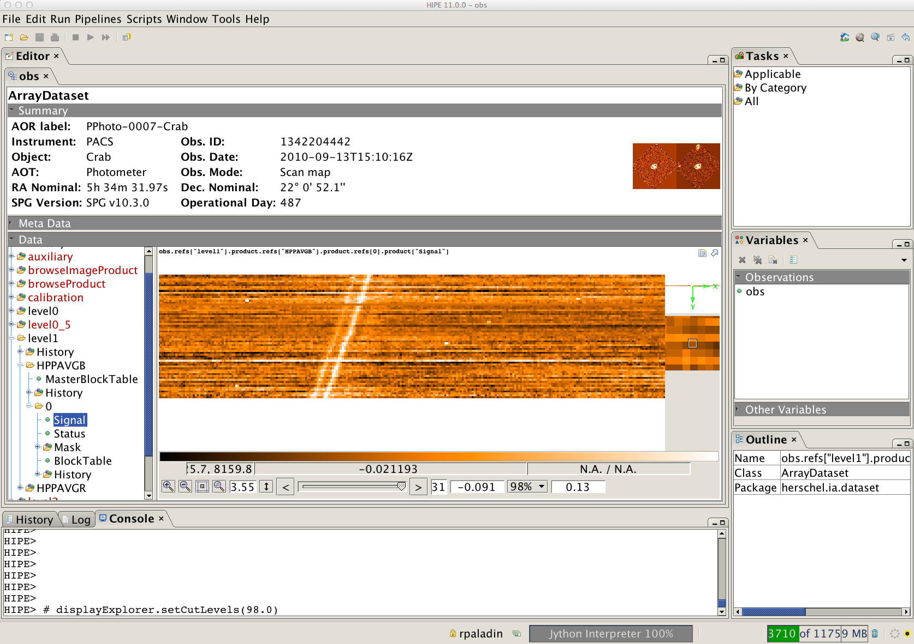
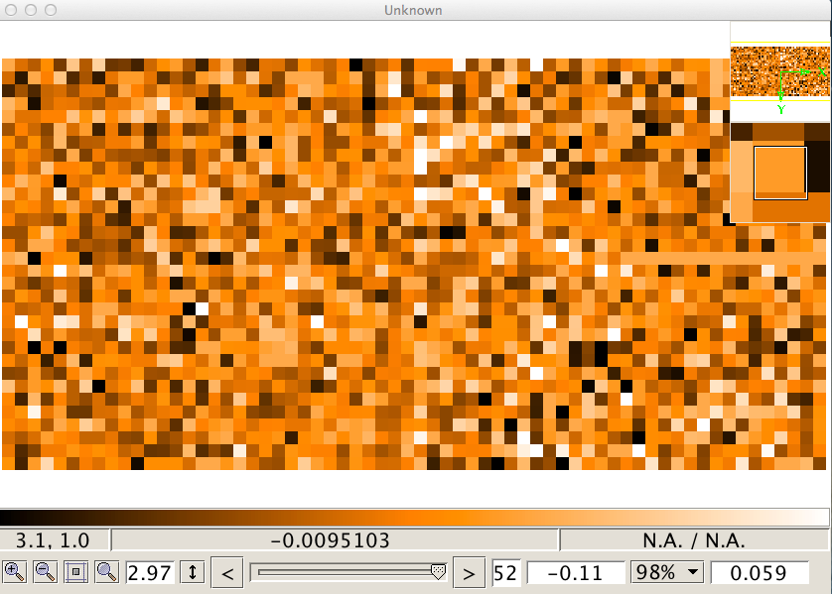
PACS Photometer
Level 1: calibrated frames
This is the starting point for reprocessing your data
R. Paladini NHSC Archive Data processing Workshop – August 26th – 30th 2013 PACS Intro

Slide 14
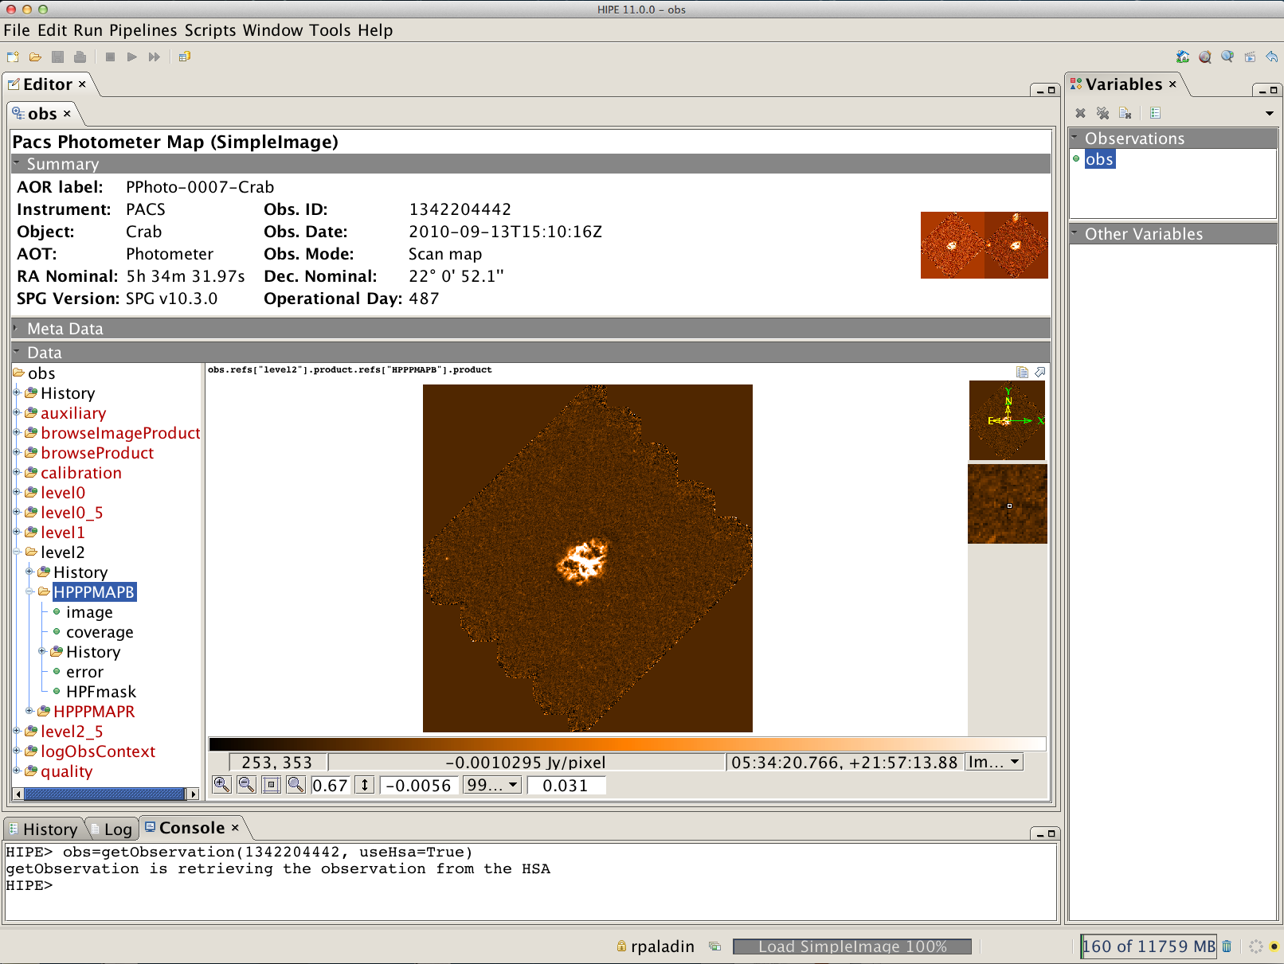
PACS Photometer
Level 2: per-scan maps
R. Paladini NHSC Archive Data Processing Workshop – August 26th – 30th 2013 PACS Intro

Slide 15
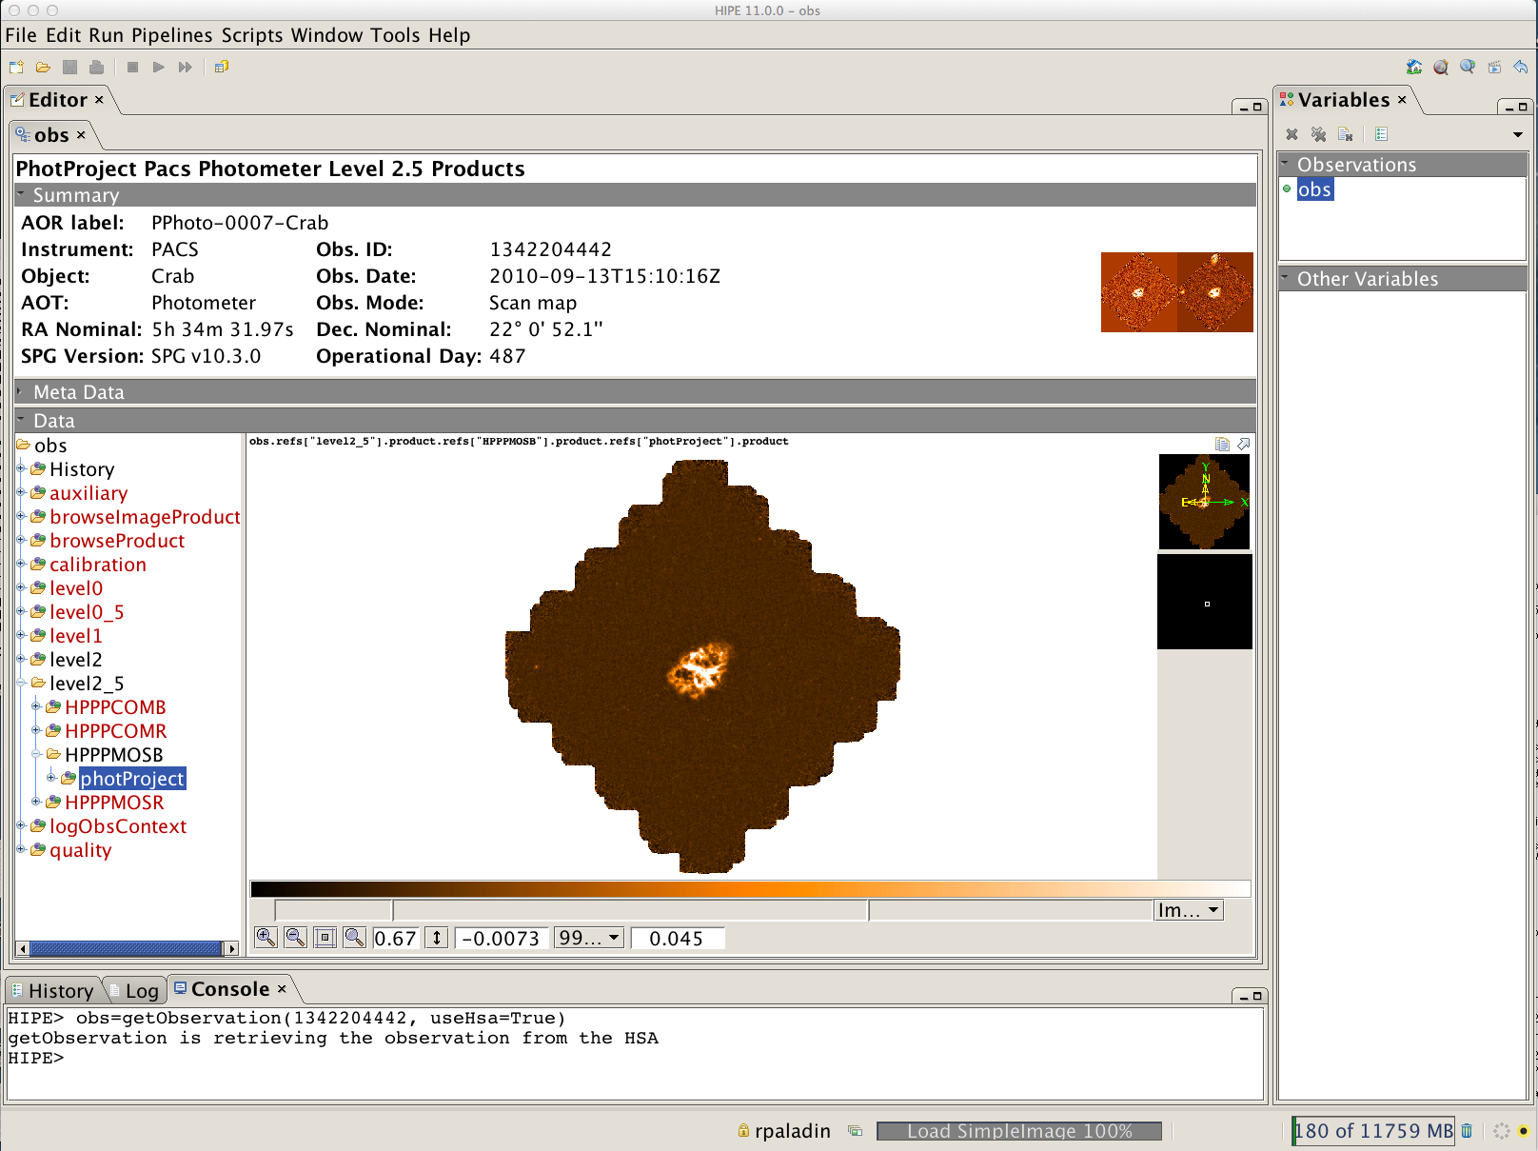
PACS Photometer
Level 2.5: scan/X-scan High-Pass Filtered maps
R. Paladini NHSC Archive Data Processing Workshop – August 26th – 30th 2013 PACS Intro

Slide 16
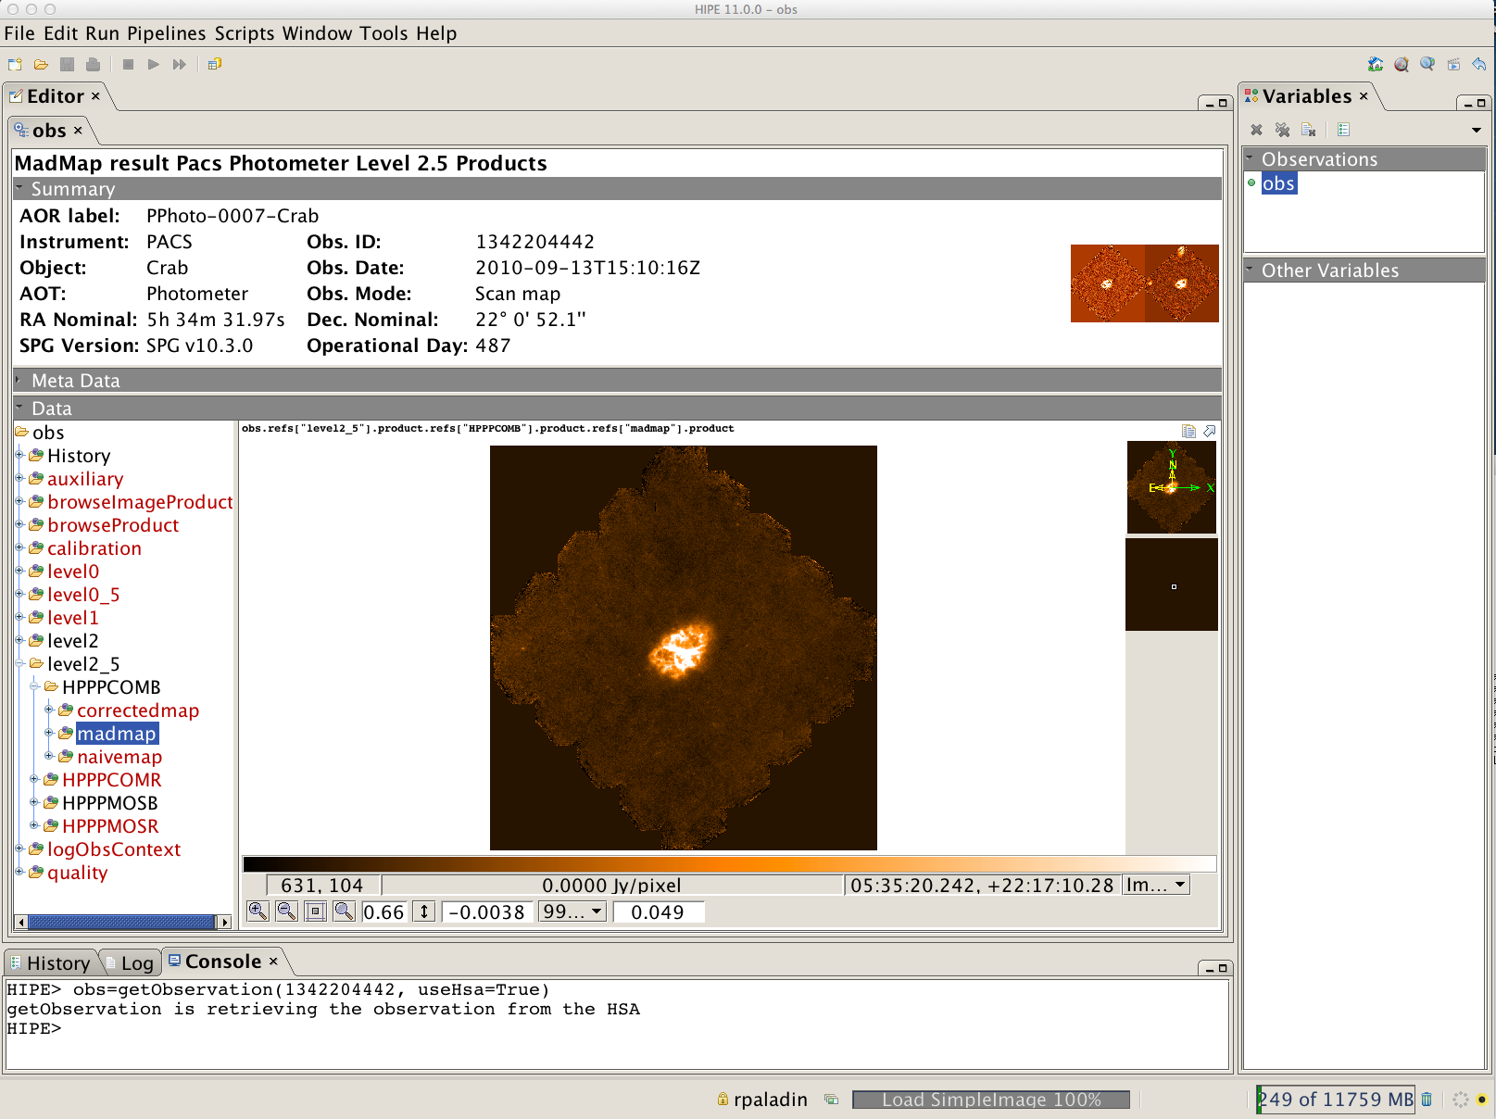
PACS Photometer
Level 2.5: scan/X-scan MADMap maps
R. Paladini NHSC Archive Data Processing Workshop – August 26th – 30th 2013 PACS Intro

Slide 17
PACS Photometer
Summary of PACS photometer archived products
(→ see Herschel Product Definition Document)
Level 0:
HPENG: engineering
HPGENHK: housekeeping
HPPAVGB/HPPAVGR: Herschel PACS Photometer Averaged Blue/Red Data (→ “Signal” in /0)
HPPDMCB/HPPDMCR: raw data (blue/red)
HPPHK: housekeeping
Level 1:
HPPAVGB/HPPAVGR: Herschel PACS Photometer Averaged Blue/Red Data (→ “Signal” in /0)
Level 2:
HPPPMAPB/HPPPMAPR: Herschel PACS Photometer Phot-project Map Blue/Red
(→ “image”, “error”, “coverage”)
Level 2.5:
HPPPCOMB/HPPPCOMR: Herschel PACS Photometer Combined MADMap Blue/Red
(→ “image”, “coverage”, “error” in /correctedmap, /madmap, /naivemap)
HPPPMOSB/HPPPMOSR: Herschel PACS Photometer Phot-project Mosaic Blur/Red
(→ “image”, “coverage”, “error” in /photProject)
R. Paladini NHSC Archive Data Processing Workshop – August 26th – 30th 2013 PACS Intro

Slide 18
PACS Photometer
PACS Photometer Data Volume
Data size in SPG 10 and onwards:
Level 1 frames: data cubes + pointing + HK
→ Blue channel: 700 MB/hour (prime), 350 MB/hour (parallel)
→ Red channel: 180 MB/hour (~ both prime/parallel)
credit: Bruno Altieri
R. Paladini NHSC Archive Data Processing Workshop – August 26th – 30th 2013 PACS Intro

Slide 19
PACS Spectrometer
PACS Spectrometer
R. Paladini NHSC Archive Data Processing Workshop – August 26th – 30th 2013 PACS Intro

Slide 20
PACS Spectrometer
What kind of data in the archive ?
Line Spectroscopy - short wavelength coverage, multiple lines: 1. chop-nod (pointed/raster); 2. un-chopped (pointed/raster)
Range Spectroscopy - broader wavelength coverage, multiple ranges: 1. chop-nod (pointed/raster); 2. un-chopped (pointed/raster)
R. Paladini NHSC Archive Data Processing Workshop – August 26th – 30th 2013 PACS Intro

Slide 21
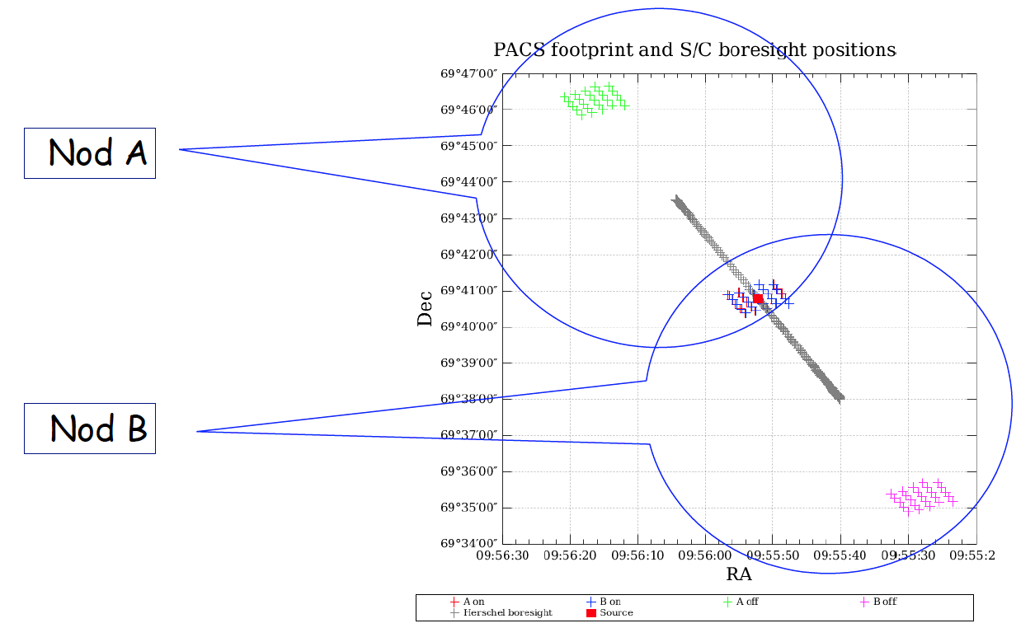
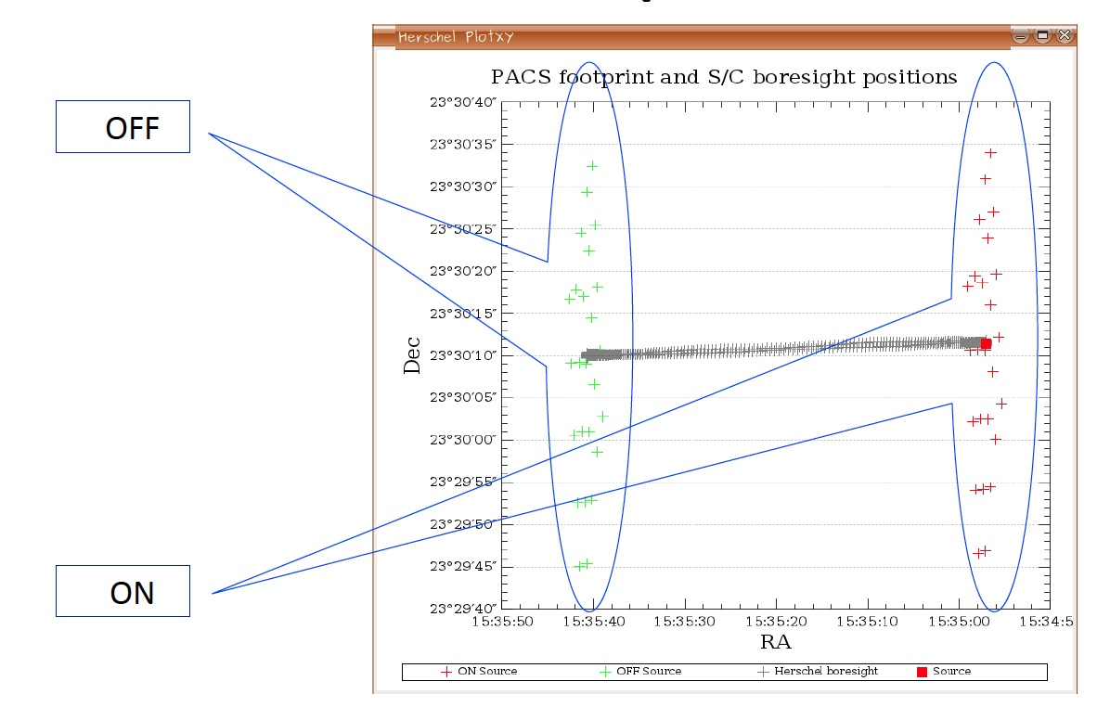
PACS Spectrometer
What kind of data in the archive ? - cont.
Both line and range observations can be chop-nod or unchop
Chop-nod
Un-chopped
R. Paladini NHSC Archive Data Processing Workshop – August 26th – 30th 2013 PACS Intro

Slide 22
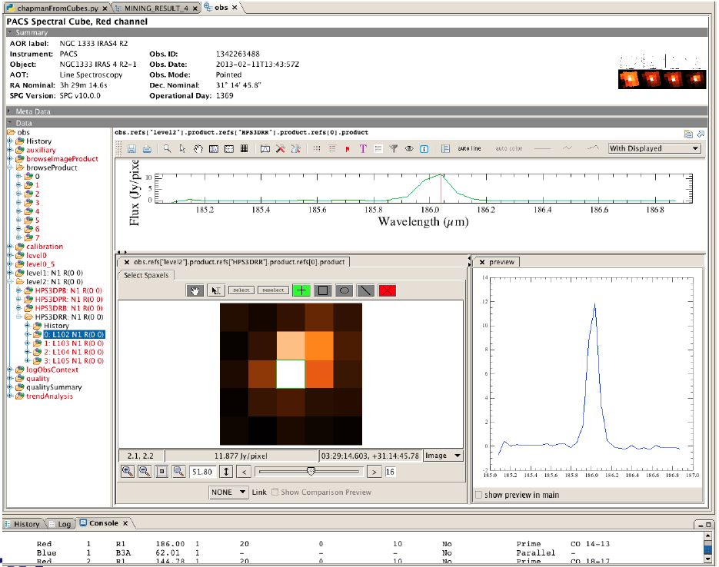
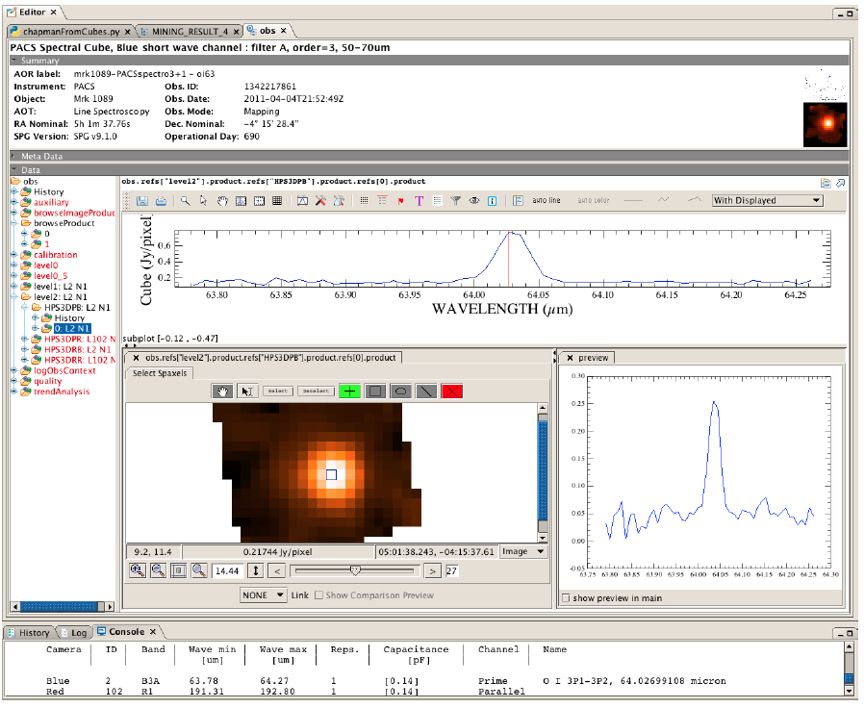
PACS Spectrometer
What kind of data in the archive ? – cont.
Both line and range observations can be pointed or raster
Pointed
Raster (→ mapping)
R. Paladini NHSC Archive Data Processing Workshop – August 26th – 30th 2013 PACS Intro

Slide 23
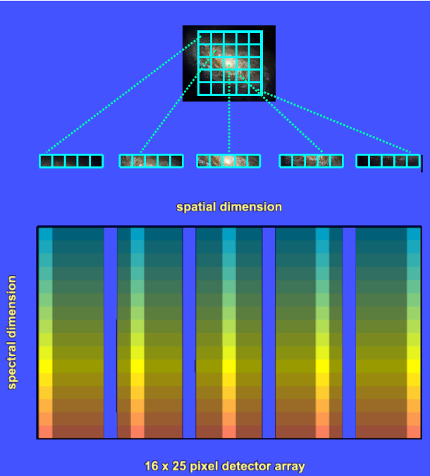
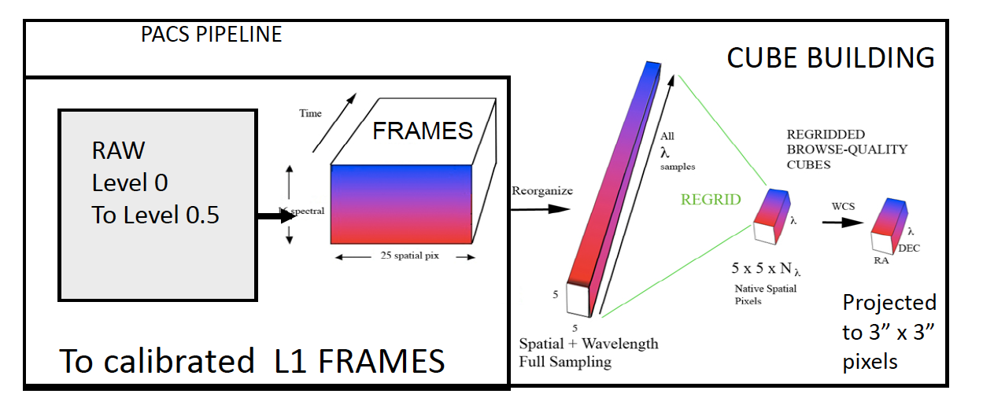
PACS Spectrometer
PACS Spectrometer Archived Products
L1 pacsFrames
L1 pacsCUBE
L2 rebinnedCUBE
L2 projectedCUBE
R. Paladini NHSC Archive Data Processing Workshop – August 26th – 30th 2013 PACS Intro

Slide 24
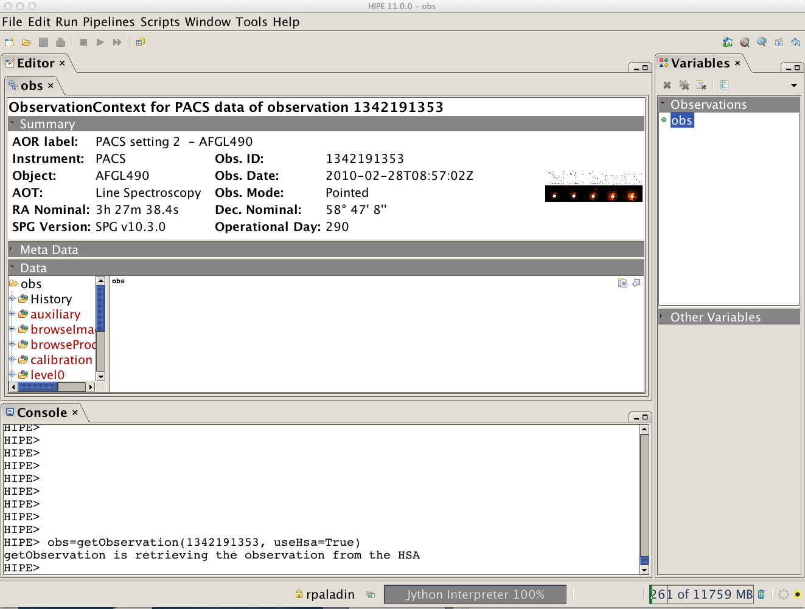
PACS Spectrometer
Example: AFGL490 – OBSID: 1342191353
3
2
1
Double click on the “obs” variable
R. Paladini NHSC Data Workshop – August 26th – 30th 2013 PACS Intro

Slide 25
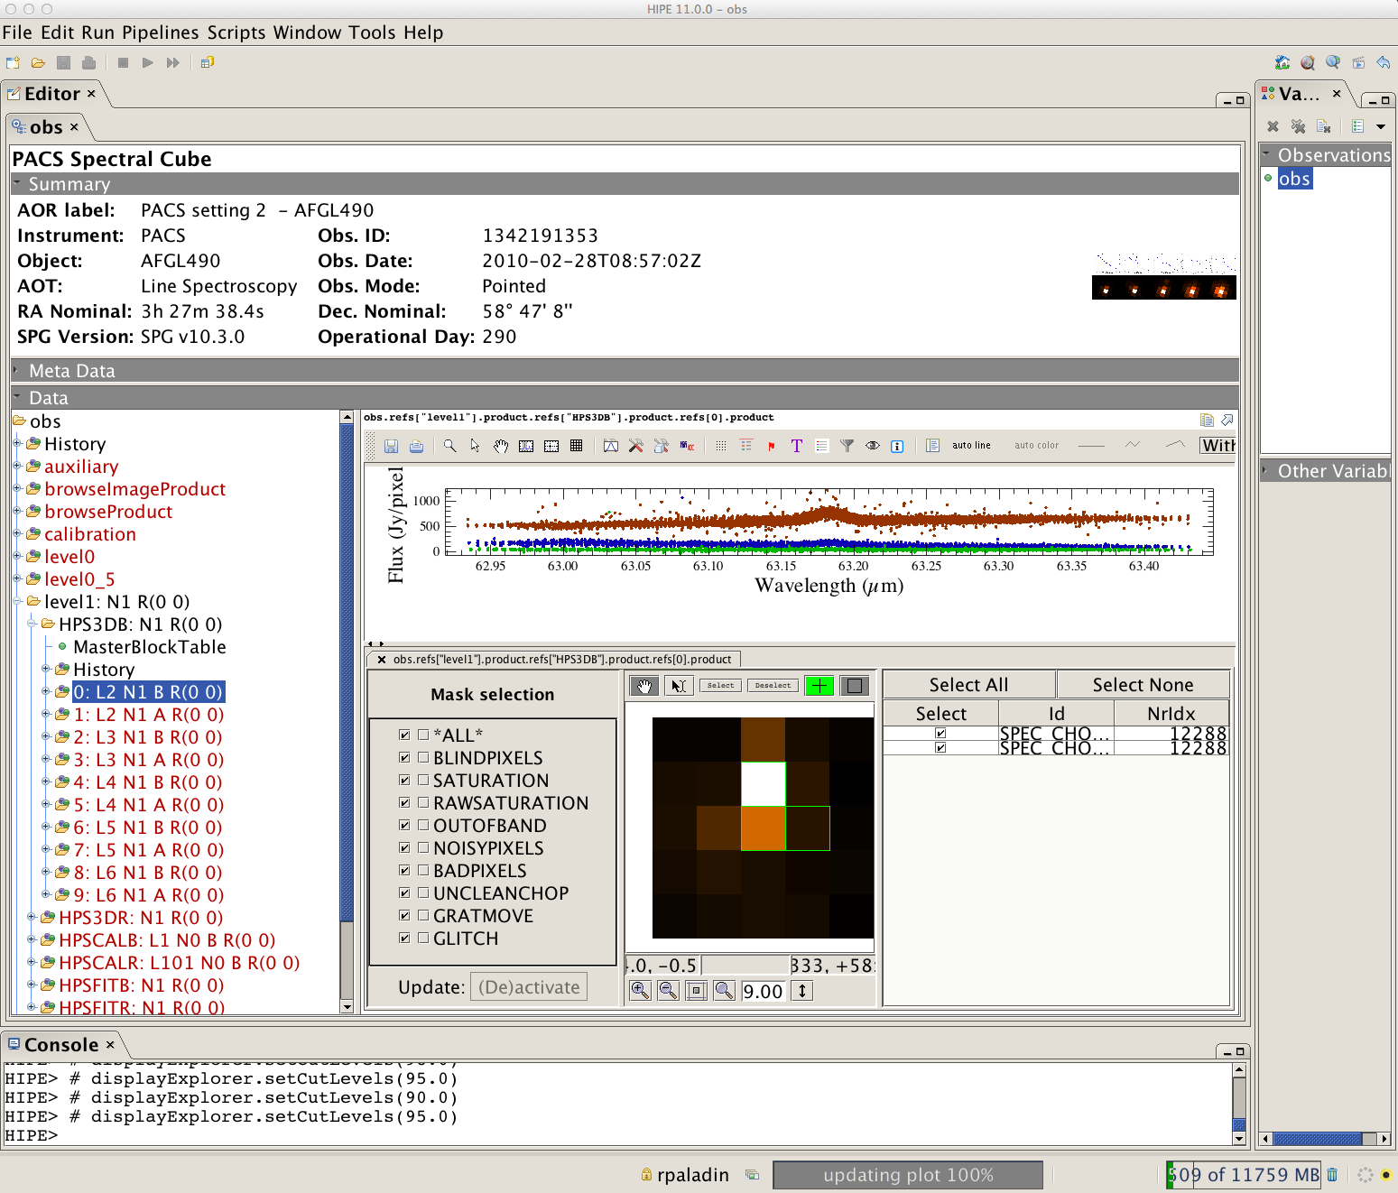
PACS Spectrometer
Level 1: PacsCube
Spectrum Explorer Tool
(common to all Herschel instruments)
R. Paladini NHSC Data Workshop – August 26th – 30th 2013 PACS Intro

Slide 26
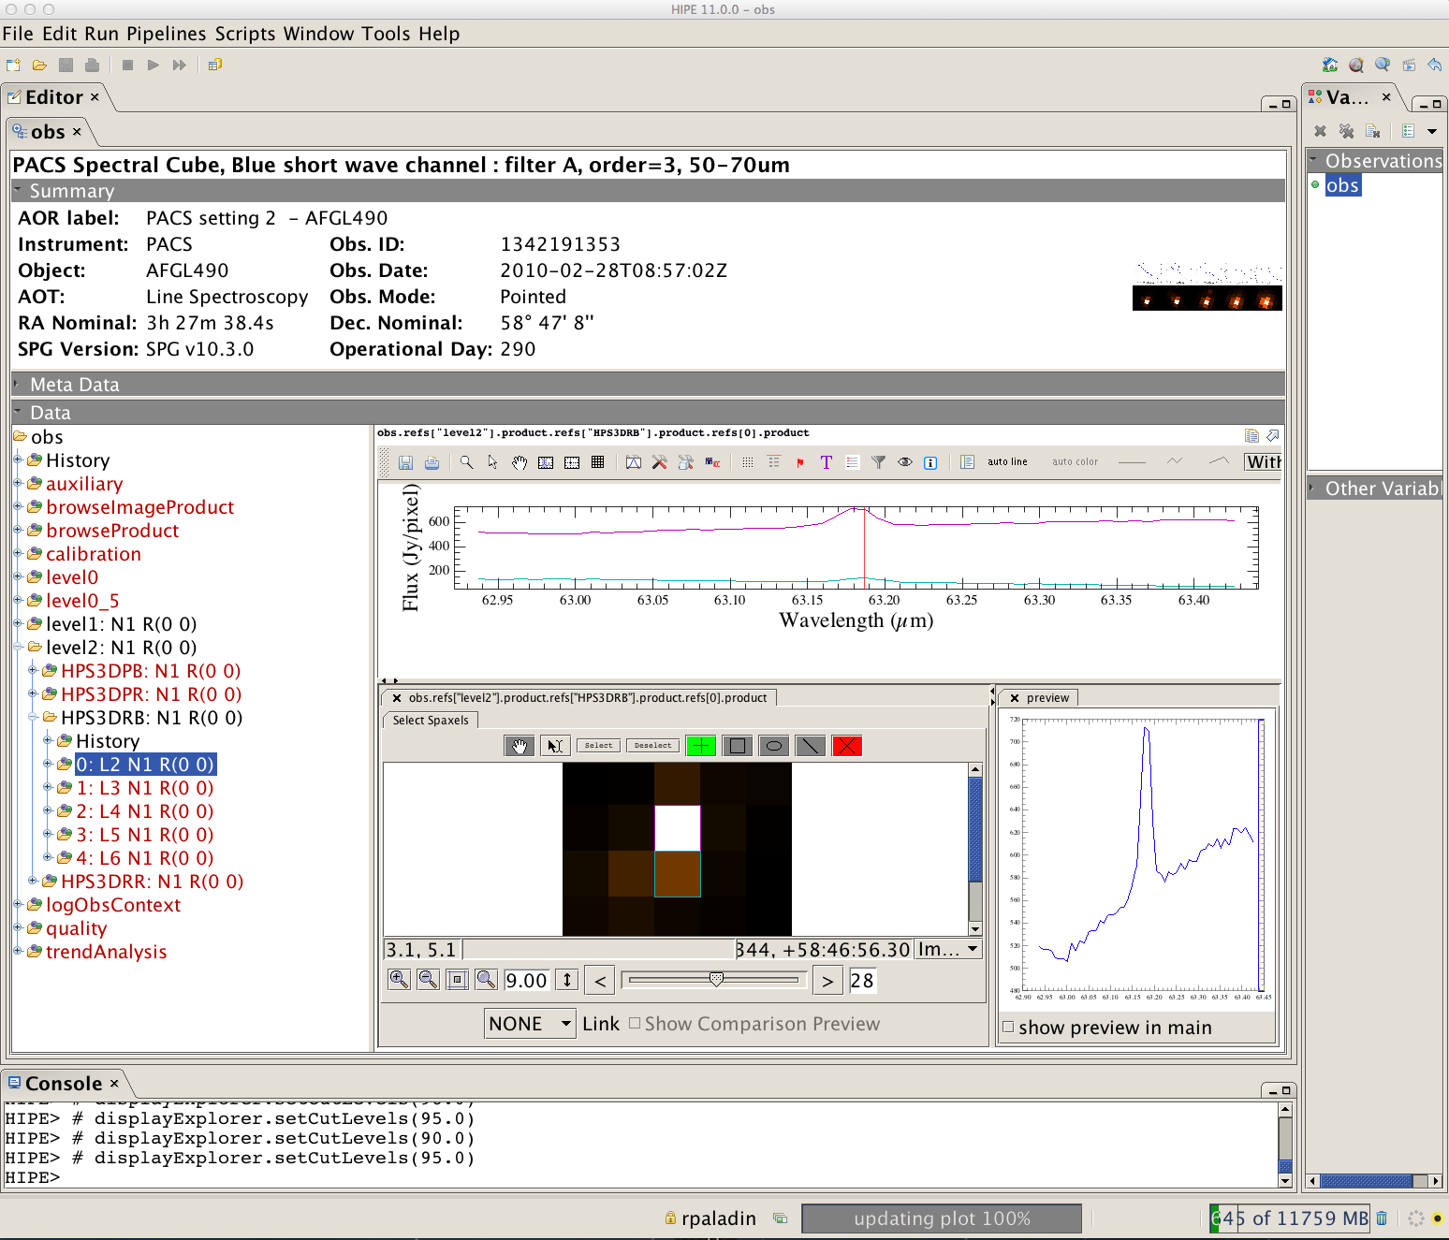
PACS Spectrometer
Level 2: Rebinned Cube
Spectrum Explorer Tool
(common to all Herschel instruments)
R. Paladini NHSC Data Workshop – August 26th – 30th 2013 PACS Intro

Slide 27
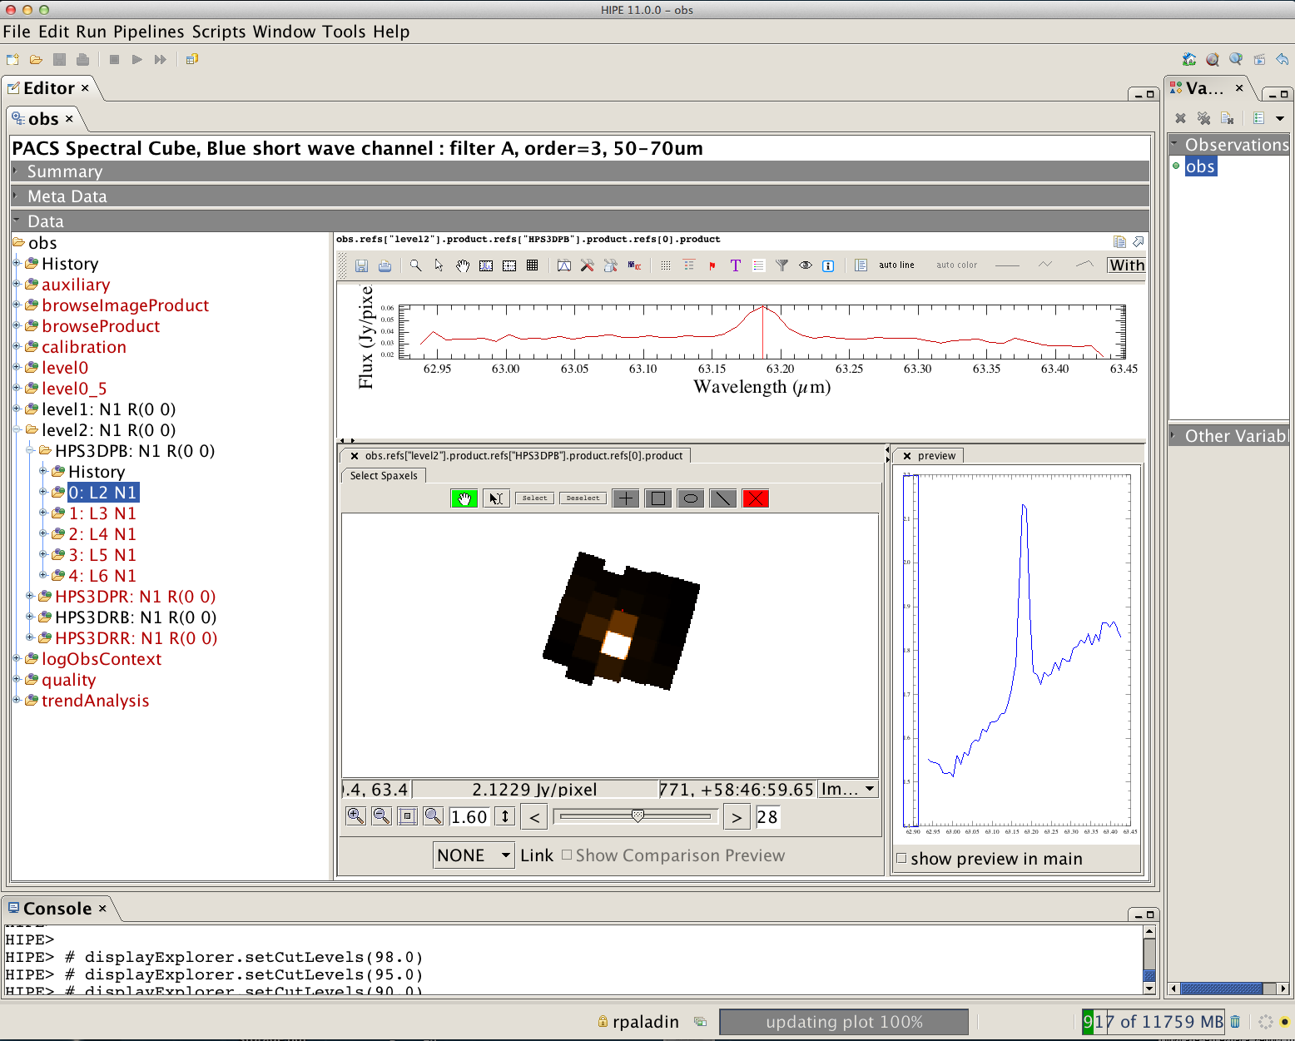
PACS Spectrometer
Level 2: Projected Cube
Spectrum Explorer Tool
(common to all Herschel instruments)
R. Paladini NHSC Data Workshop – August 26th – 30th 2013 PACS Intro

Slide 28
PACS Spectrometer
Summary of PACS spectrometer archived products
(→ see Herschel Product Definition Document)
Level 0:
HPENG: engineering
HPGENHK: housekeeping
HPSDMCB/HPSDMCR: raw DecMec (blue/red)
HPSFITB/HPSFITR: Herschel PACS Spectrometer Fitted Blue/Red (→ “Signal” in /0)
HPPHK: housekeeping
HPSRAWB/HPSRAWR: raw data (blue/red)
Level 1:
HPS3DB/HPS3DR: Herschel PACS Spectrometer 3D Spectral Cube Blue/Red
(→ “flux”, “wave”, “ra”, “dec” in, e.g., /0: L2 N1 B R(0 0))
HPSCALB/HPSCALR: calibration (response/dark)
HPSFITB/HPSFITR: fitted slopes
Level 2:
HPS3DPB/HPS3DPR: Herschel PACS Spectrometer 3D Projected Cube Blue/Red
(→ “image”, “coverage” in, e.g., /0: L2 N1 A R(0 0))
HPS3DRB/HPS3DRR: Herschel PACS Spectrometer 3D Rebinned Cube Blue/Red
(→ “image”, “ra”, “dec”, “stddev”, “exposure”, “wavegrid” in, e.g., /0: L2 N1 R(0 0)
R. Paladini NHSC Data Workshop – August 26th – 30th 2013 PACS Intro

Slide 29
PACS Spectrometer
PACS Spectrometer Data Volume
Data size in SPG 10 and onwards:
Level 0 frames: data cubes + pointing + HK
→ Blue/red channel: ~ 1.5 GB/hour
R. Paladini NHSC Data Workshop – August 26th – 30th 2013 PACS Intro

Slide 30
PACS General
PACS Calibration
Photometer:
Point-source flux calibration is estimated from a set of 5 fiducial stars (primary calibrators). Additionally, a set of asteroids and planets is also used (secondary calibrators);
Based on this set of calibrators, the point-source flux calibration error is ~5% in all bands, with 1-2% reproducibility;
Spectrometer:
Flux calibration is estimated from a set of ~30 absolute flux sky calibrators (fiducial stars, asteroids and planets);
Based in this set of calibrators (and using the 3X3 calibration block scheme), the flux calibration error is ~7% in all bands, with 3-4% reproducibility
http://herschel.esac.esa.int/twiki/bin/view/Public/PacsCalibrationWeb
R. Paladini NHSC Data Workshop – August 26th – 30th 2013 PACS Intro

Slide 31
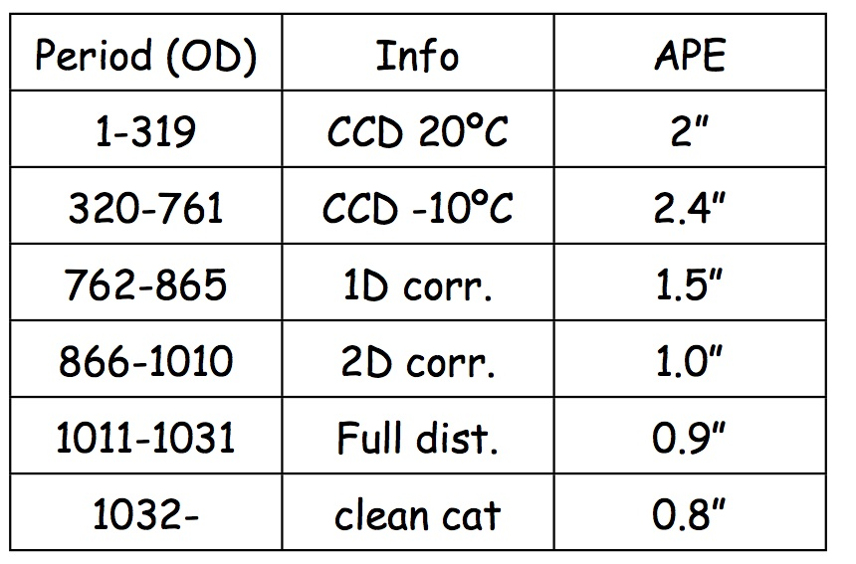
PACS General
Herschel Pointing Error
The spacecraft attitude is controlled by the Star Tracker (STR) and the gyroscopes (GYR). The STR provides the absolute reference but with limited accuracy, while GYRs are accurate but only on short timescales. In normal operations, the GYRs attitude is calibrated using the information from the STR (“filtered attitude”).
Absolute Pointing Error (APE): this has been continuously improving over the mission. It is now of the order of 0.8”. The Herschel archive data are currently being processed with this updated APE.
Spatial Relative Pointing Error (SRPE, or relative pointing accuracy):
only measured for small raster maps; it
is of the order of 1.02”
Relative Pointing Error (RPE, or pointing stability over ~ 1 minute periods): the PACS Instrument Team is currently working on a refined pointing scheme which will allow us to reach an RPE ~ 0.3”
Herschel APE History
http://herschel.esac.esa.int/twiki/bin/view/Public/SummaryPointing
R. Paladini NHSC Data Workshop – August 26th – 30th 2013 PACS Intro

Slide 32
PACS Products: Visualization outside HIPE
Question:
I am writing e.g. an ALMA proposal and want to generate a RGB image using archival Herschel data. I do not want/do not have time for HIPE.
What shall I do ??
NOTE: visualization of products is relatively simple for photometer data, not so much for spectrometer data.
R. Paladini NHSC Data Workshop – August 26th – 30th 2013 PACS Intro

Slide 33
PACS Products: Visualization outside HIPE
Example: RCW 49 – 70 μm & 160 μm
Observation Summary: 2 cross-scan observations in PACS scan-map mode. Each scan
observation is contained in an OBSID, i.e. 1342249134 and 1342249135.
download the tarball from the HSA: rpaladin171072676.tar
“extract” the Level 2.5 map (need to unzip the .fits file):
→ rpaladin171072676/1342249134/level2_5/HPPPCOMB/correctedmap/hpacs_25HPPMADB_156.08_m57.75_v1.0_17900737138902856.fits
(blue → 70, MADMap, corrected map)
→ rpaladin171072676/1342249134/level2_5/HPPPCOMR/correctedmap/hpacs_25HPPMADR_156.08_m57.75_v1.0_17900744102158856.fits
(red, MADMap, corrected map)
NOTE: RCW 49 is an extended source, so I want to use the MADMap archived products, rather than the photProject ones.
R. Paladini NHSC Data Workshop – August 26th – 30th 2013 PACS Intro

Slide 34
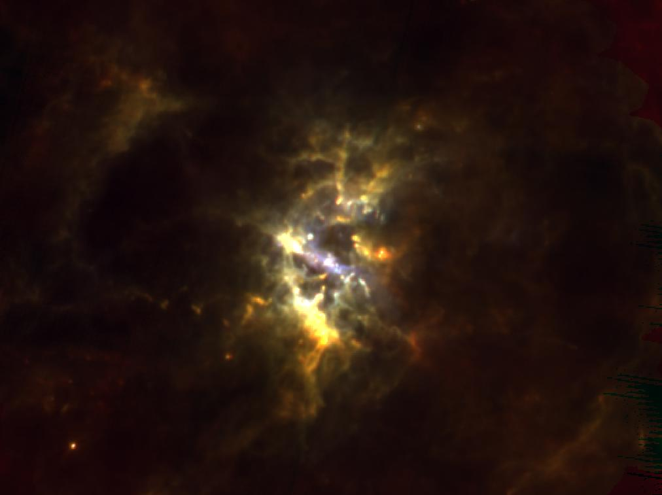
PACS Products: Visualization outside HIPE
RCW 49 has also ancillary SPIRE observations @ 250, 350 and 500 μm
The SPIRE observations are also 2 cross-scans, in OBSIDs 1342247254 & 1342247255.
We extract the 250 μm observation:
→ rpaladin171072676/1342247254/level2_5/PSW/hspirepsw_25pmp_1024_m5746_19642974044400856.fits
… and now we build our 3-color
image in ds9:
RED: SPIRE 250 μm
GREEN: PACS 160 μm
BLUE: PACS 70 μm
R. Paladini NHSC Data Workshop – August 26th – 30th 2013 PACS Intro

Slide 35
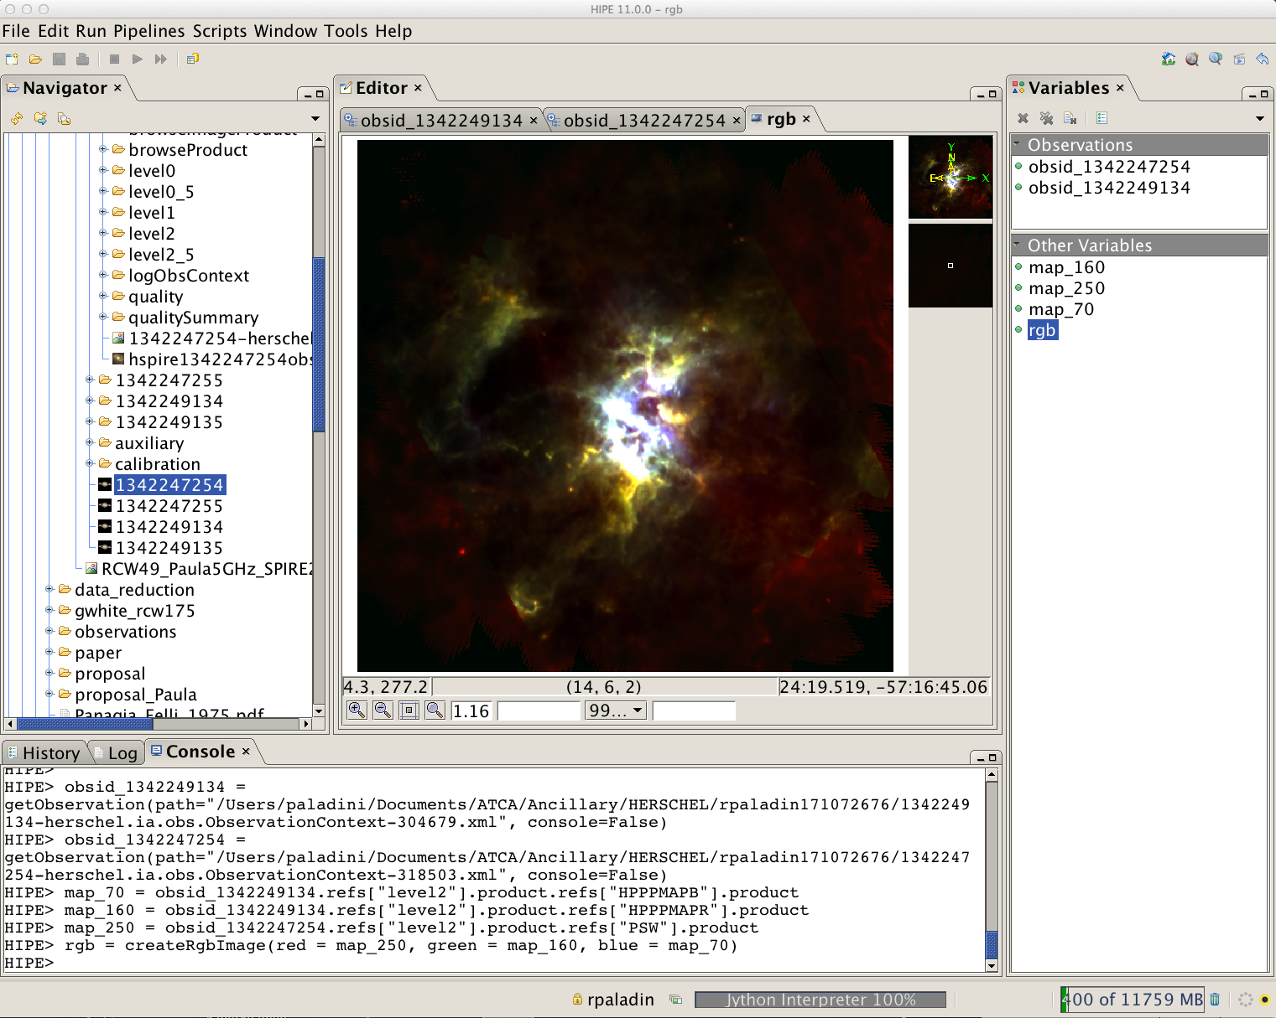
PACS Products: Visualization outside HIPE
… we could have created a 3-color image in HIPE
Use HIPE task:
createRgbImage
R. Paladini NHSC Data Workshop – August 26th – 30th 2013 PACS Intro

Slide 36
PACS Documentation
PACS Documentation
(updated in June – July ‘13)
Herschel Product Definition Document
http://herschel.esac.esa.int/hcss-doc-11.0/print/pdd/pdd.pdf
PACS Observer’s Manual
http://herschel.esac.esa.int/Docs/PACS/pdf/pacs_om.pdf
PACS Data Reduction Guide: Photometer
http://127.0.0.1:8082/print/pacs_phot/pacs_phot.pdf#pacs_phot
PACS Data Reduction Guide: Spectrometer
http://127.0.0.1:8082/print/pacs_spec/pacs_spec.pdf#pacs_spec
PACS User’s Reference Manual (Section 4.1.- PACS Observation Products):
http://127.0.0.1:8082/print/pacs_urm/pacs_urm.pdf#pacs_urm
R. Paladini NHSC Data Workshop – August 26th – 30th 2013 PACS Intro

Slide 37
PACS Documentation
PACS @ NHSC
Roberta Paladini (Lead)
Babar Ali (calibration scientist, photometer)
Dario Fadda (calibration scientist, spectrometer)
Jeff Jacobsen (developer, spectrometer)
Cate Liu (developer, photometer)
Steve Lord (calibration scientist, spectrometer)
Yi Mei (system engineer, photometer & spectrometer)
For any questions and help with your PACS data, contact the NHSC Help Desk:
http://nhsc.ipac.caltech.edu/helpdesk/index.php
R. Paladini NHSC Data Workshop – August 26th – 30th 2013 PACS Intro

Slide 38
Thank you !
R. Paladini NHSC Data Workshop – August 26th – 30th 2013 PACS Intro

Slide 39
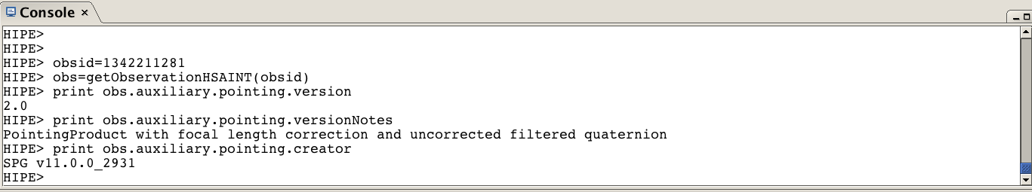
PACS General
How do I check the status of
the pointing products for my data ?
HIPE> obs = getObservation(1342204441, useHsa=True)
HIPE> print obs.auxiliary.pointing.version
HIPE> 2.0
HIPE > print obs.auxiliary.pointing.versionNotes
HIPE> PointingProduct with focal length correction and uncorrected filtered quaternion
R. Paladini NHSC Data Workshop – August 26th – 30th 2013 PACS Intro

