Slide 1
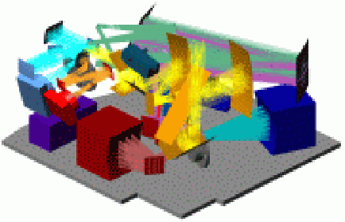
NHSC PACS
PACS Photometry and Errors Estimate
Roberta Paladini
(NSHC/Caltech)
R. Paladini NHSC Archive Data Processing Workshop – August 26th – 30th 2013 PACS Phot

Slide 2
How this talk is organized:
1st part: how to do photometry and estimate errors
2nd part (Dave Shupe’s talk): demo on SIMPLE (Simplified Interface Making PACS Look Easy)
R. Paladini NHSC Archive Data Processing Workshop – August 26th – 30th 2013 PACS Phot

Slide 3
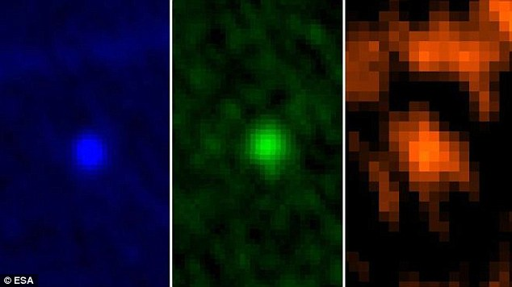
The question we address is:
How do I do photometry on PACS data ?
70 μm
100 μm
160 μm
Which PACS archive products shall I use ? And do I need to re-process my data ?
Which photometry tools shall I use ?
How do I estimate the errors ?
R. Paladini NHSC Archive Data Processing Workshop – August 26th – 30th 2013 PACS Phot

Slide 4
Q1: Which PACS archive products ?
R. Paladini NHSC Archive Data Processing Workshop – August 26th – 30th 2013 PACS Phot

Slide 5
PACS Archived Products
..from yesterday’s talk:
High-pass filtering
Good noise (cfr. 1/f) removal but extended/background emission is totally gone
YES
Source:
is it point-like ?
NO
MADMap
Preserves background (cfr. emission on all angular scales) but noise removal can be more problematic
R. Paladini NHSC Archive Data Processing Workshop – August 26th – 30th 2013 PACS Phot

Slide 6
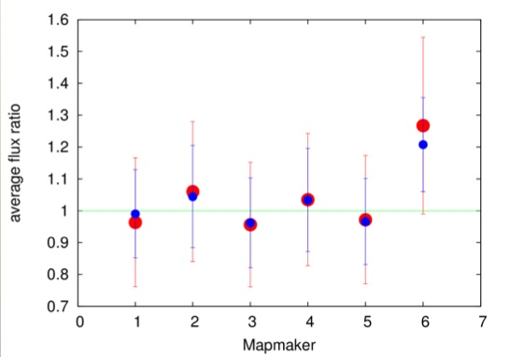
PACS Archived Products
Both HPF and MADMap products provide reliable point-source photometry
R = 12”, 160 μm
Scanamorphos
Jscanam
UNIMAP
Tamasis
MADMap
SANEPIC
credit: Zoltan Balog
MADMap aperture photometry (..and Scanamorphos, UNIMAP, etc..) is within ~5% from HPF
R. Paladini NHSC Archive Data Processing Workshop – August 26th – 30th 2013 PACS Phot

Slide 7
What this talk will focus on
High-Pass Filter products
→ appropriate for fields with isolated point sources
→ iterative processing to mask the sources
aperture photometry (..but we will also mention PSF fitting photometry)
see Babar Ali’s talk for MADMap products
R. Paladini NHSC Archive Data Processing Workshop – August 26th – 30th 2013 PACS Phot

Slide 8
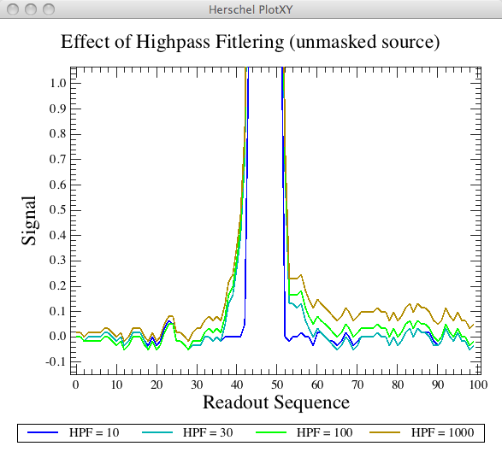
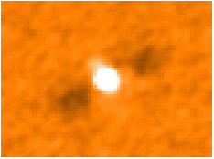
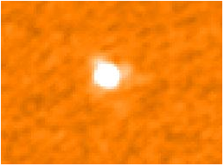
PACS Archived Products
The High-Pass Filter Concept
Slide a median-filter on individual pixel timelines to remove 1/f noise (→ main source of noise)
Problem:
When a bright source enters the filter box, it alters the estimate of the median
Unmasked High-pass Filtering
Solution:
Mask the source before median-filtering
Masked High-pass Filtering
R. Paladini NHSC Archive Data Processing Workshop – August 26th – 30th 2013 PACS Phot

Slide 9
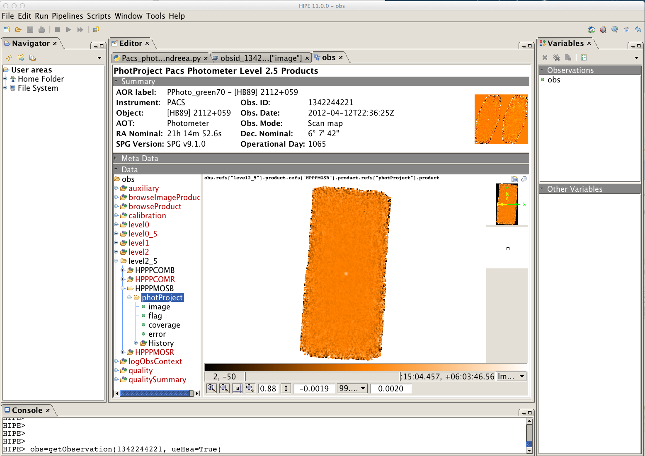
PACS Archived Products
… if I do not need to re-process the data, I can use the archived Level 2, 2.5 (or 3) HPF products
..from yesterday’s talk:
R. Paladini NHSC Data Workshop – August 26th – 30th 2013 PACS Phot

Slide 10
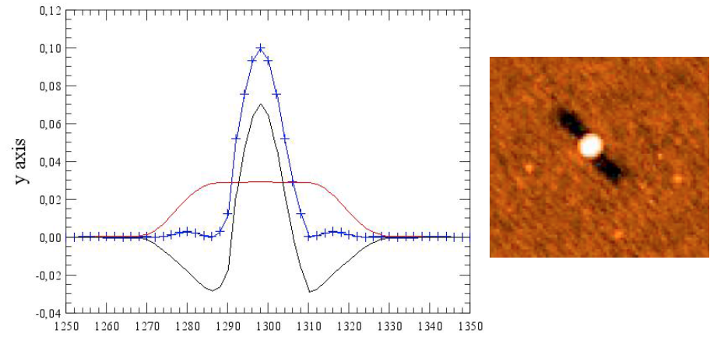
PACS Archived Products
Signs I need to re-process my data before doing photometry…
credit: Bruno Altieri
NOTE: another good reason to re-process your data is to use the latest version of calibration files…
R. Paladini NHSC Archive Data Processing Workshop – August 26th – 30th 2013 PACS Phot

Slide 11
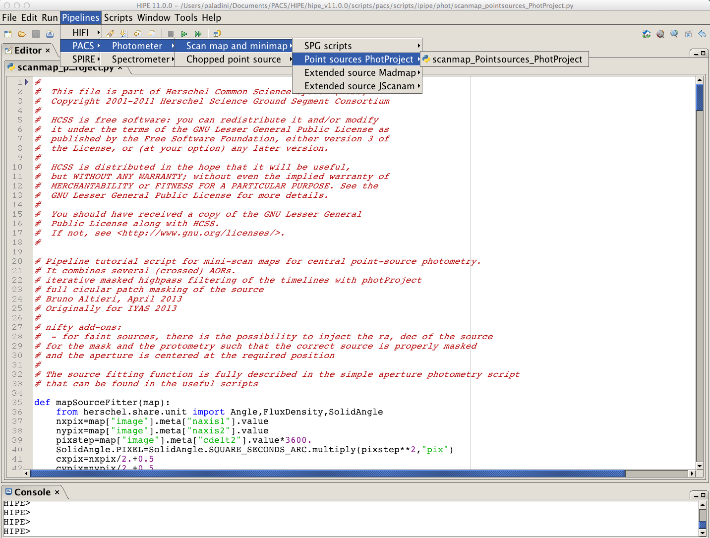
PACS Archived Products
If I need to re-process the data, I will use the following ipipe (i.e “interactive pipeline”) script :
NOTE: the documentation has not yet been updated. If you look up the PACS Data Reduction Guide, it will mention the following scripts:
Deep survey maps
Bright point source Maps
Extended source PhotProject
In HIPE 11, these 3 scripts have been combined into 1 (→ shown in the slide)
R. Paladini NHSC Archive Data Processing Workshop – August 26th – 30th 2013 PACS Phot

Slide 12
PACS Archived Products
What to tweak in the pipeline…
1. high-pass filter radius:
* default values: blue = 15 (i.e. 30”), red = 25 (i.e. 50”)
mask radius:
* option 1: source coordinates are known
* option 2: input source catalog
* option 3: blind masking
deglitching
* 2nd level deglitching (→ exploits spatial redundancy, good for bright sources )
* MMT deglitching (→ works in the timelines, good for faint sources)
R. Paladini NHSC Archive Data Processing Workshop – August 26th – 30th 2013 PACS Phot

Slide 13
PACS Photometry Tools
Q2: Which tools shall I use to do photometry ?
R. Paladini NHSC Archive Data Processing Workshop – August 26th – 30th 2013 PACS Phot

Slide 14
PACS Photometry Tools
Aperture Photometry in HIPE
CASE 1: I have my .fits file and only need to do
aperture photometry
CASE 2: I need to re-process my data and do
aperture photometry
R. Paladini NHSC Archive Data Processing Workshop – August 26th – 30th 2013 PACS Phot

Slide 15
PACS Photometry Tools
CASE 1: I have my .fits file and only need to do aperture photometry
Task in HIPE !
annularSkyAperturePhotometry()
annular or rectangular (rectangularSkyAperturePhotometry) sky aperture
user can provide fixed sky value (fixedSkyAperturePhotometry)
5 algorithms to estimate sky: average, median, mean-median, mode, daophot
both GUI and command line versions
R. Paladini NHSC Archive Data Processing Workshop – August 26th – 30th 2013 PACS Phot

Slide 16
PACS Photometry Tools
… now I need to apply aperture corrections
Task in HIPE !
photApertureCorrectionPointSource()
output from
annularSkyAperturPhotometry task
calTree version
blue, green, red
R. Paladini NHSC Archive Data Processing Workshop – August 26th – 30th 2013 PACS Phot

Slide 17
PACS Photometry Tools
Aperture corrections are also contained in calTree
HIPE > calTree=getCalTree()
HIPE > apCorr = calTree.refs[“photometer”].product.refs[“apertureCorrection”].product
HIPE > apCorr_r = apCorr[“fm7ApertureRadius”].data
HIPE > apCorr70 = apCorr[“fm7BandBlue”].data
HIPE > apCorr100 = apCorr[“fm7BandGreen”].data
HIPE > apCorr160 = apCorr[“fm7BandRed”].data
If you want to apply aperture corrections outside of HIPE, you find them at (PACS Calibration web page):
http://herschel.esac.esa.int/twiki/pub/Public/PacsCalibrationWeb/bolopsf_20.pdf
NOTE: aperture corrections are provided in terms of Encircled Energy Fraction (EEF) !
R. Paladini NHSC Archive Data Processing Workshop – August 26th – 30th 2013 PACS Phot

Slide 18
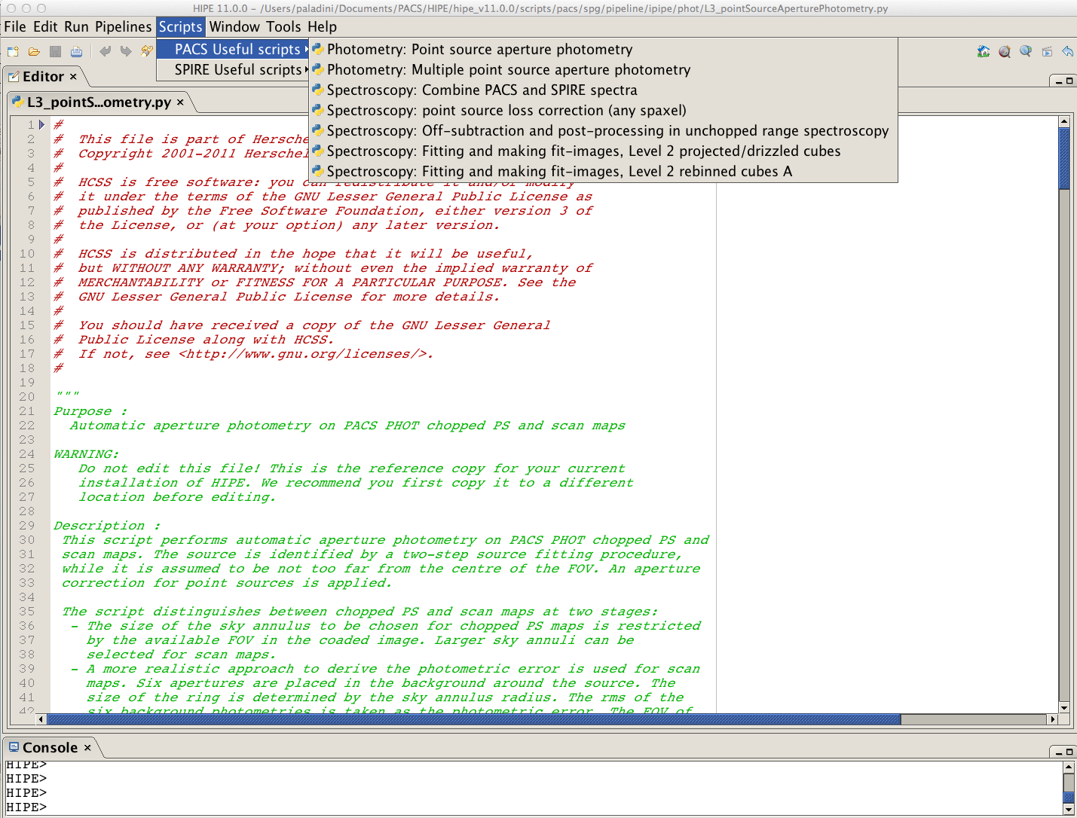
PACS Photometry Tools
1. since HIPE 11, new script available !
The script:
performs aperture photometry
applies aperture corrections
identifies position of the source through fitting procedure (BUT: source assumed near FOV center)
It works on:
Level 2, Level 2.5 or Level 3 images
NOTE: the script is also available in HIPE 10 but it works on Level 2 only. Also, it contains small bugs
R. Paladini NHSC Archive Data Processing Workshop – August 26th – 30th 2013 PACS Phot

Slide 19
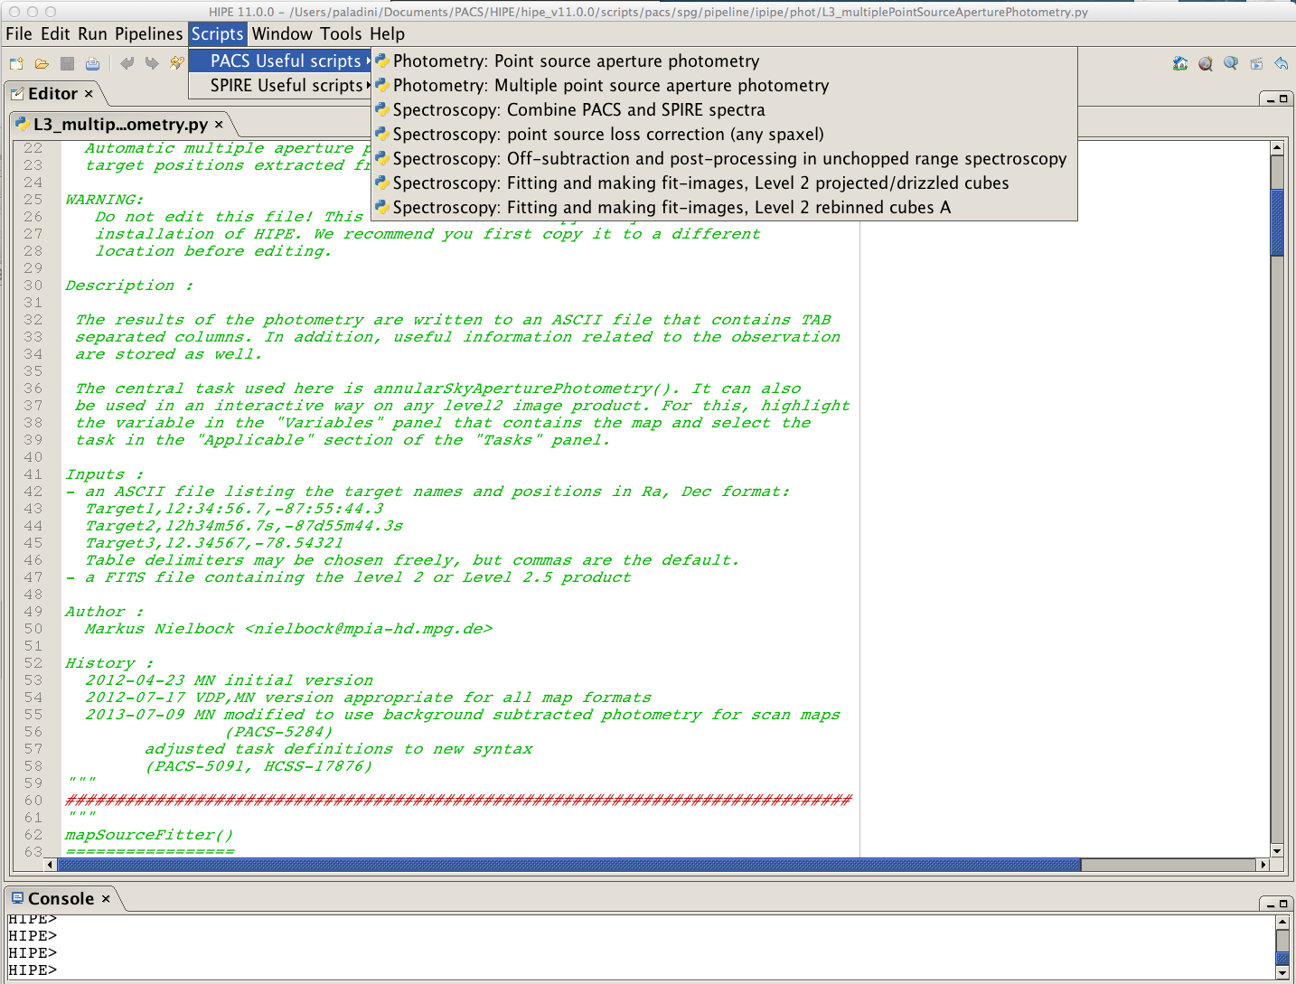
PACS Photometry Tools
2. Also available is a script for multiple point-source photometry !
The script:
performs aperture photometry
applies aperture corrections
the position (RA/DEC) of the sources is provided in an input ASCII file
It works on:
Level 2, Level 2.5 or Level 3 images
R. Paladini NHSC Archive Data Processing Workshop – August 26th – 30th 2013 PACS Phot

Slide 20
PACS Photometry Tools
CASE 2: I need to reprocess and do aperture photometry
Use the same script for the HPF reprocessing !
The script:
allows to reprocess PACS photometer data (using HPF)
performs aperture photometry
applies aperture corrections
identifies position of the source through iterative procedure
for faint sources, position can be supplied by providing RA, DEC
R. Paladini NHSC Archive Data Processing Workshop – August 26th – 30th 2013 PACS Phot

Slide 21
PACS Photometry Errors
Aperture Photometry outside of HIPE
NOTE: PACS Level 2, Level 2.5 and Level 3 maps are .fits files. So you can always export them into another environment, i.e. outside of HIPE !
Example: α-Boo @ 70 μm
download the tarball from the HSA: rpaladin176460473.tar
“extract” the Level 2 map (need to unzip the .fits file):
→ rpaladin176460473/1342211280/level2/HPPPMAPB/hpacs1342211280_20hpppmapb_1374160924489.fits
in IDL:
IDL > mosaic = mrdfits(‘hpacs1342211280_20hpppmapb_1374160924489.fits’,1,h)
MRDFITS: Image array (342,489) Type=Real*
IDL > aper,mosaic,x_{c},y_{c}, flux, eflux, sky,skyerr, 1, [2],[4,6], -1,/exact,/flux
Star X Y Sky Fluxes
0 170.00 243.50 0.00 1.2 +- 1.1
R. Paladini NHSC Archive Data Processing Workshop – August 26th – 30th 2013 PACS Phot

Slide 22
PACS Photometry Tools
Source Detection and PSF Fitting
inside & outside HIPE
In HIPE:
two detection algorithms which work with both PACS and SPIRE data:
sourceExtractorDaophot()
sourceExtractorSussextractor()
Outside HIPE:
Sextractor
StarFinder (used by many teams: PEP, HOPS, etc..)
R. Paladini NHSC Archive Data Processing Workshop – August 26th – 30th 2013 PACS Phot

Slide 23
PACS Photometry Tools
NOTE: Several Galactic programs developed their own detection/extraction tools
Publicly Available Tools:
getSources: (→ Gould Belt Survey)
http://www.herschel.fr/cea/gouldbelt/en/getsources
CUTEX (→ Hi-GAL survey)
http://herschel.asdc.asi.it/index.php?page=cutex.html
boloSource(): (see Gabor Marton’s talk on Friday)
http://herschel.esac.esa.int/2013Mapmaking.shtml
R. Paladini NHSC Archive Data Processing Workshop – August 26th – 30th 2013 PACS Phot

Slide 24
PACS Photometry Errors
Q3: How do I estimate the errors ?
R. Paladini NHSC Archive Data Processing Workshop – August 26th – 30th 2013 PACS Phot

Slide 25
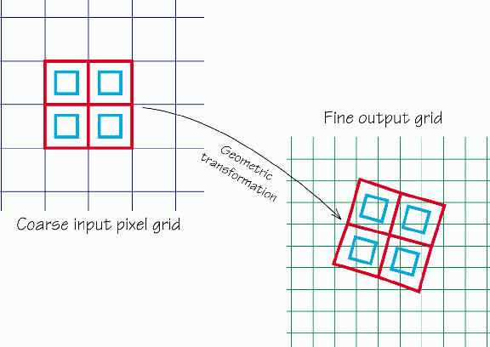
PACS Photometry Errors
There are several sources of error one needs to consider:
PhotProject: map projection with drizzling
calibration errors
uncorrelated noise per pixel
cross-correlated noise (→ residual 1/f + + map projection)
NOTE: in principle, one has to add in quadrature also the error associated to background subtraction. However, if HPF is applied to the data, the background is basically zero, and this error can be neglected.
R. Paladini NHSC Archive Data Processing Workshop – August 26th – 30th 2013 PACS Phot

Slide 26
PACS Photometry Errors
Calibration Errors
PACS photometer flux calibration is based on the observations of
5 fiducial stars (β And, α Cent, α Tau, α Boo, γ Dra)
These primary calibrators are complemented with a set of secondary calibrators, namely 18 large main-belt asteroids
Observation of these calibrators leads to a PACS calibration accuracy of the order of ~5% in all bands (→ NOTE: this figure is model-uncertanties dominated)
R. Paladini NHSC Archive Data Processing Workshop – August 26th – 30th 2013 PACS Phot

Slide 27
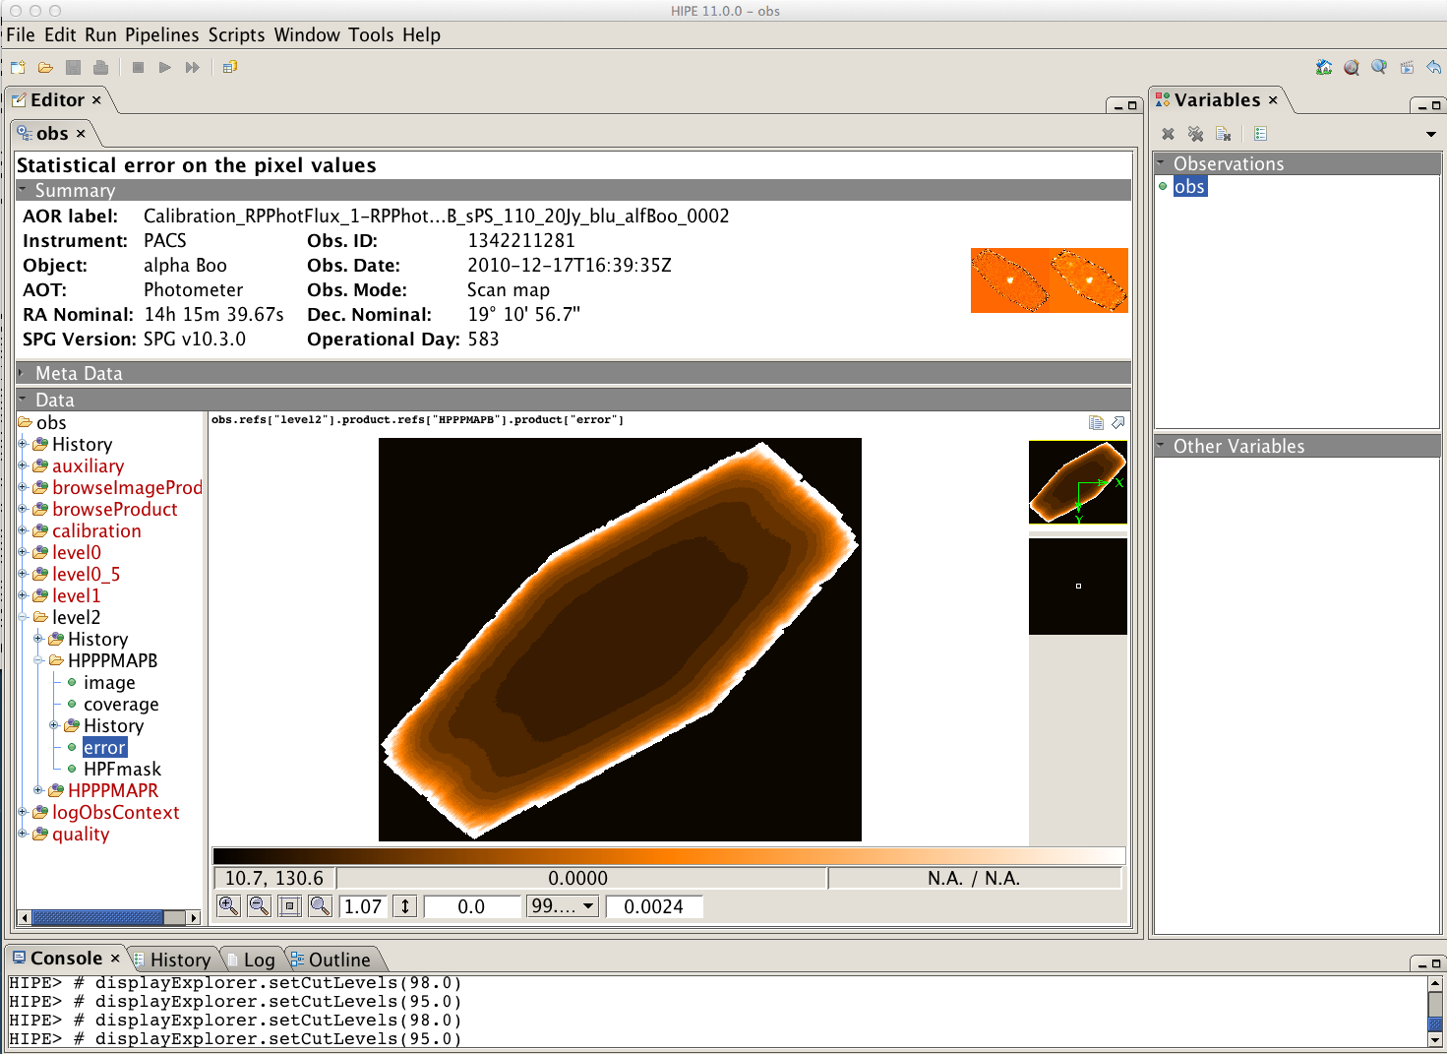
PACS Photometry Errors
PACS photometer (HPF) archived error map
This error map does not take into account the cross-correlated noise term, i.e. the effect of HPF and map projection.
→In practice, this error map is meaningless
R. Paladini NHSC Archive Data Processing Workshop – August 26th – 30th 2013 PACS Phot

Slide 28
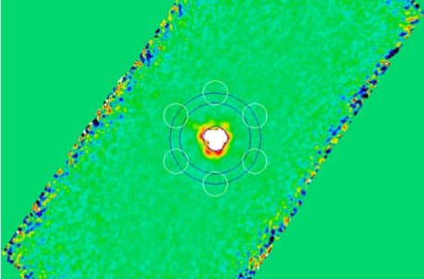
PACS Photometry Errors
How the error map is computed in the ipipe scripts:
CASE 1: aperture photometry only
The photometric error is estimated from the r.m.s of the background and derived from multiple sky apertures placed in relatively empty regions of the map
R. Paladini NHSC Archive Data Processing Workshop – August 26th – 30th 2013 PACS Phot

Slide 29
PACS Photometry Errors
How the error map is computed in the ipipe scripts
CASE 2: HPF reprocessing and aperture photometry
Same as before:
the photometric error is estimated from the r.m.s of the background and derived from multiple sky apertures placed in relatively empty regions of the map
R. Paladini NHSC Archive Data Processing Workshop – August 26th – 30th 2013 PACS Phot

Slide 30
PACS Photometry Errors
New (since HIPE 10) task to estimate error
(Popesso et al. 2013, submitted to A&A)
photCoverage2Noise()
Description:
the error map is generated by performing a polynomial fit of the coverage map as a function of the HPF radius, output pixel size and pixfrac (→ the free parameters for map projection via the photProj task)
the method is calibrated on PACS scan map data with very high-redundancy and obtained at medium/fast scan speed.
R. Paladini NHSC Archive Data Processing Workshop – August 26th – 30th 2013 PACS Phot

Slide 31
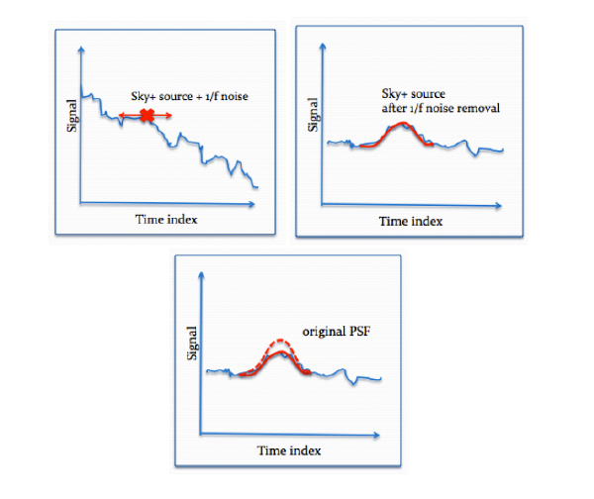
PACS Photometry Errors
A word of caution about HPF
HPF induces a flux loss even after properly masking the sources
Popesso et al. 2013, submitted to A&A
R. Paladini NHSC Archive Data Processing Workshop – August 26th – 30th 2013 PACS Phot

Slide 32
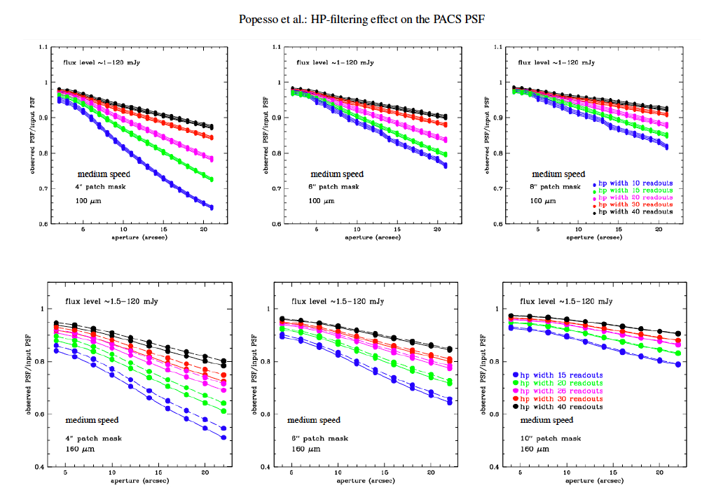
PACS Photometry Errors
So how to proceed ?
Section 7 – Popesso et al. 2013
choose panel in Fig 19 which is appropriate for the considered combination of HPF radius and mask radius;
measure source flux within an aperture, r_{ap};
identify correction factor, corr_{HPF}(r_{ap}), from panel in Fig 19;
determine aperture correction, corr_{ap}(r_{ap});
apply both corrections, i.e.:
Fig. 19 from Popesso et al. 2013, submitted to A&A
flux_{true} = flux_{ap}/(corr_{HPF}(r_{ap})*corr_{ap}(r_{ap}))
R. Paladini NHSC Archive Data Processing Workshop – August 26th – 30th 2013 PACS Phot

Slide 33
PACS Photometry Errors
Documentation
ipipe script for HPF re-processing (→ not yet updated for HIPE 11):
* PACS Photometer Data Reduction Guide (June 2013, Section 3.2)
* NHSC Tutorials: https://nhscsci.ipac.caltech.edu/sc/index.php/Pacs/DataProcessing
Aperture photometry and aperture corrections:
* Herschel Data Analysis Guide (July 2013, Section 4.21)
* NHSC Webinars: https://nhscsci.ipac.caltech.edu/pacs/docs/Webinars/2012-07-13/Paladini.pdf
* PACS technical note (EEF, Table 15):
http://herschel.esac.esa.int/twiki/pub/Public/PacsCalibrationWeb/pacs_bolo_fluxcal_report_v1.pdf
* NHSC PACS pages: https://nhscsci.ipac.caltech.edu/sc/index.php/Pacs/ApertureCorrections
Calibration:
* PACS Calibration page: http://herschel.esac.esa.int/twiki/bin/view/Public/PacsCalibrationWeb
* NHSC PACS pages: https://nhscsci.ipac.caltech.edu/sc/index.php/Pacs/AbsoluteCalibration
Errors:
* PACS Photometer Data Reduction Guide: (June 2013, Section 4.10)
* Popesso et al. 2013, submitted to A&A, astro-ph/12114257
R. Paladini NHSC Archive Data Processing Workshop – August 26th – 30th 2013 PACS Phot

Slide 34
Backup Slides

Slide 35
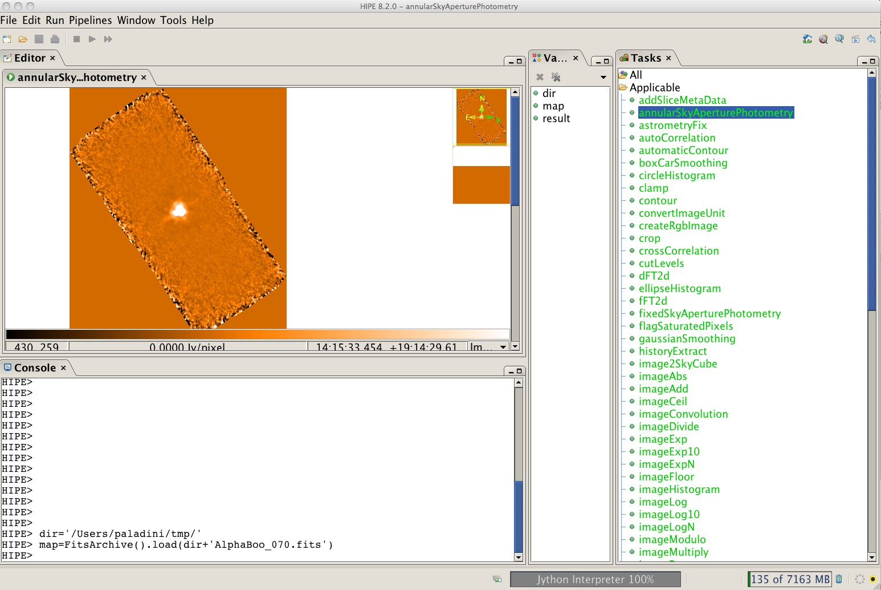
PACS Photometry Tools
3 The image appears in a new tab within the “Editor” view
2 Click on “Applicable” and “annularSkyAperturePhotometry”
1 Load .fits file
R. Paladini NHSC Data Workshop – August 26th – 30th 2013 PACS Phot

Slide 36
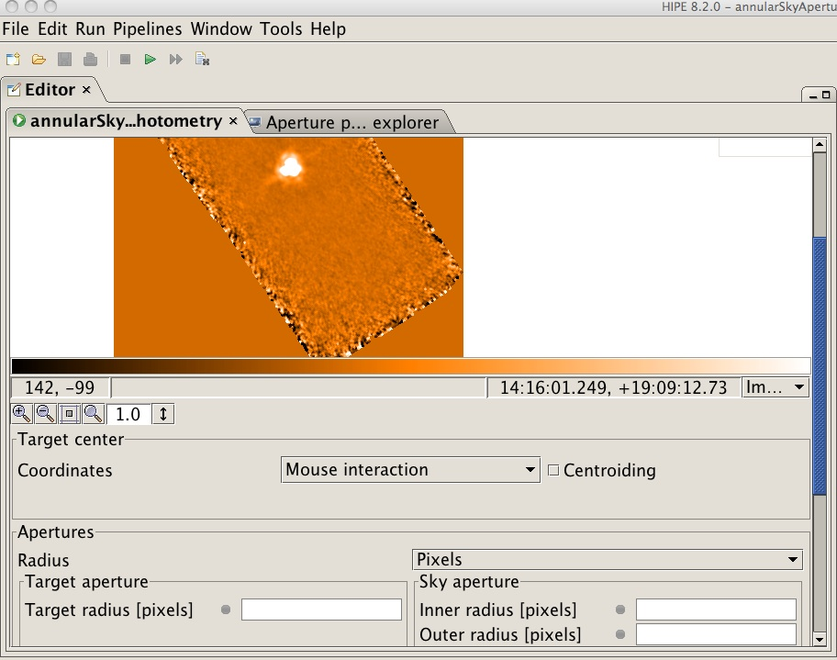
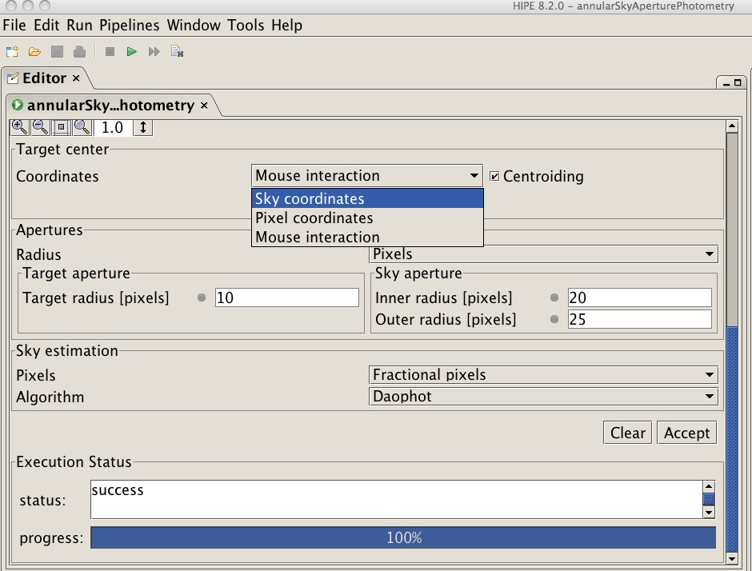
PACS Photometry Tools
4. Scroll down : you will find an interface to enter task options
5. Set: source center coordinates, source and sky radius. Then click “Accept”
3 ways to identify the source
By clicking with the mouse
By entering X e Y center pixel coordinates
By entering sky coordinates (RA and DEC)
R. Paladini NHSC Data Workshop – August 26th – 30th 2013 PACS Phot

Slide 37
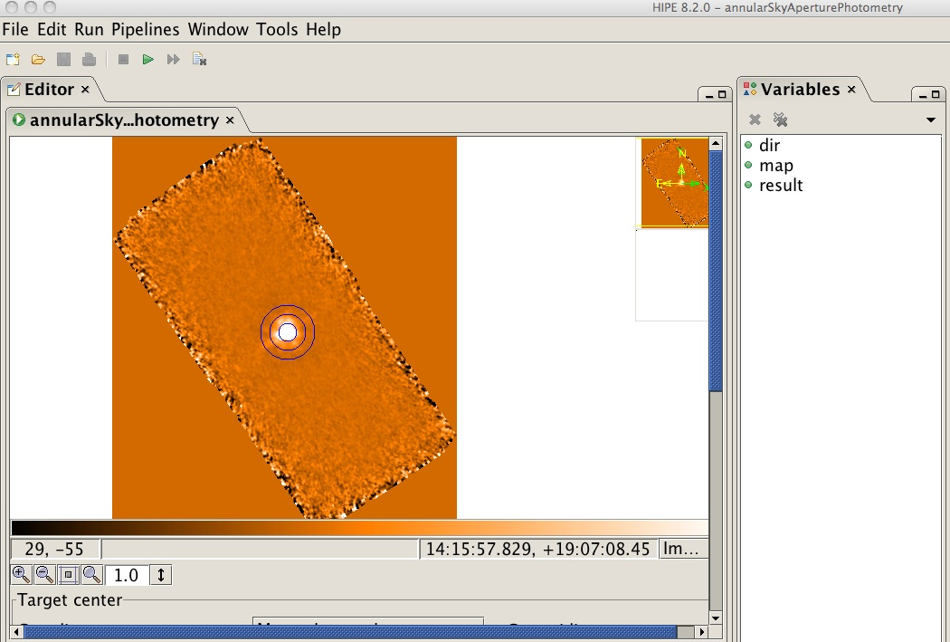
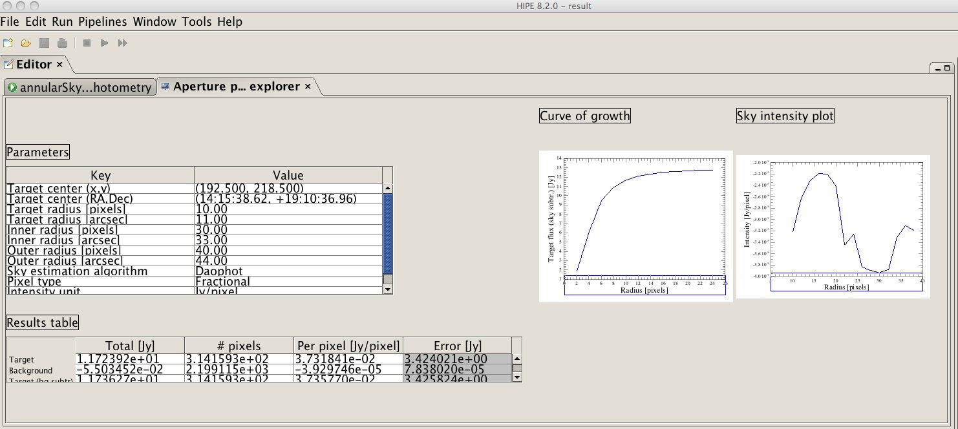
PACS Photometry Tools
6. The source and sky apertures are shown in the image
7. Click on “result” . A table will open in the “Editor” view
R. Paladini NHSC Data Workshop – August 26th – 30th 2013 PACS Phot

