Slide 1
Intro to HIPE PACS Spectroscopy: Getting Fluxes and Maps
(via the analysis of PACS Data Cubes)
Steve Lord, PACS/NHSC

Slide 2
We will stay in the safety of Level 2, out of the deep water
Level 2.5
Level 2
Level 1
Level 0

Slide 3
We will assume the automatic processing worked well….
But the subsequent talks will go deeper…..

Slide 4
PACS Fundamentals
The PACS spectrograph is an IFU with a field of view of approximately 47”x47” covered with an 5 x 5 array. The pixels are fixed at 9.4” sampling.
The spectrograph covers wavelengths from 55 to 210μm
The spatial image is sliced in 5 rows and each is dispersed along an array of 16 spectral pixels.
Observations are executed by moving the grating in overlapping increments to scan the requested wavelength range, leading to a high degree of redundancy.
A region of sky may be covered in multiple footprints yielding a raster map.
Reduced data are arranged into cubes of two spatial dimensions and
one wavelength dimension for visualization and analysis.

Slide 5
Spectral Resolution vs. Wavelength
A Herschel resolution vs. wavelength comparison

Slide 6
Spectral Resolution vs. Lambda
Herschel
Spitzer

Slide 7
Spatial Resolution vs. Lambda When interpreting maps, consider: Source Size, Instrument Resolution, and Pixel Size
PACS Spectrometer Beam Point Spread Function
Pixel Size = 9.4"
Adjacent Pixels fully sample images, and over-sample long wavelength images
PACS Observer Manual Fig 4.2

Slide 8
PACS Spectroscopy Observing Modes
Calibration: Chopped or Unchopped
Mapping: Single Point, Dithered, or Rastered
Bandwidth: Lines, Small Ranges, Large Ranges

Slide 9
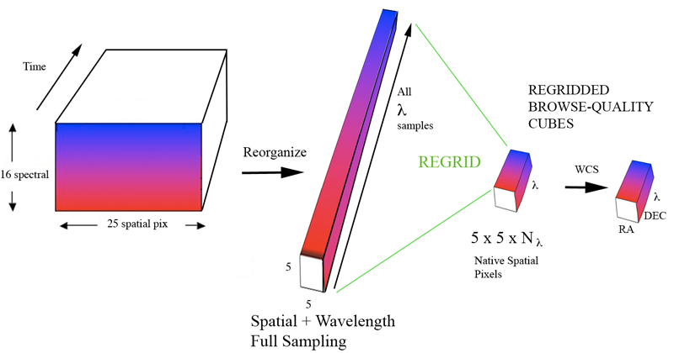
Cube Types Reflect the Processing
“PACS Cubes”
“Projected Cubes”
“Frame” Arrays
“Rebinned Cubes”
Level 2…….
Frame Arrays: Data are observed as (25 x 16) frames resulting in (25 x 16 x Nframes ) arrays.
PACS Cubes: The pipeline reorganizes data into a cube with two spatial and one λ dimension.
LEVEL 2:
Rebinned Cubes: (5 x 5 x λ ) cube is rebinned into a (5 x5 x Nλ) cube; one per pointing.
Projected Cubes: (Nx x Ny x Nλ ) data are projected on a spatial Nx x Ny RA-Dec grid.
Notes:
LABEL!!!! Say the ma has made from multi inputs

Slide 10
Important Initial Analysis Decision: Deciding whether to use *Rebinned Cubes* or *Projected Cubes*

Slide 11
Why does it matter?
You want to use the correct final product for your fluxes and spectra – depending on the observation, the correct final product is either a Rebinned Cube or a Projected Cube.
Both cube types are present in each data set. You must know how to decide which you need and where to find it. You want to spend your time working with the right cube to cull out specific measurements.

Slide 12
"When to Use Which Cube" GUIDE
Rebinned Cubes:
The PACS 5x5 Spatial Footprint x a Wavelength Axis.
Projected Cube:
One or more Rebinned Cubes
that has been Projected (Mosaicked) together onto RA & Dec Coordinates.
λ
λ
λ
y
3" pixels typically
Dec
λ
z
RA
9.4" pixels
Extended Sources
Point Sources
 | All Point Sources | Single Pointing, Not Dithered | Single RARE Pointing, Dithered | Raster Well- Sampled | Raster Poorly- Sampled
Rebinned Cube: | Use This | Use This |  |  | Use This
Projected Cube: |  |  | Use This | Use This
Pixels: | (5x5) 9.4" | (5x5) 9.4" | (n x n) 0.5" | (n x n) 3." | (n x n) 3."

Slide 13
For Sampling Quality – Consider Overlap
Under Sampled
Poorly Sampled
> Nyquist Sampled

Slide 14
The Actual Footprint (the centers) This is the Rebined Cube-face on the sky
Red and Blue Array
Poglitch et al. 2010 A&A 518 L2
There is no excellent beauty that hath not some strangeness in the proportion.” – Francis Bacon

Slide 15
4 source footprints on Galaxy Arm

Slide 16
PACS Footprint Viewer Script (very simple – 4 lines)
# Bring in an Image with a valid FITS WCS (RA Dec)
M82_image = fitsReader(file = '/Users/lord/Desktop/NGC_3034-I-Ha-kab2003.fits')
# Start up the application by loading the image in
footprintApi = pacsSpectralFootprint(input=M82_image)
# grab a rebinned cube of interest (can ve dragged from the level list to the variable list)
pacsrebinnedcube = obs99.refs["level2"].product.refs["HPS3DRB"].product.refs[0].product
# Overlay the outline of the footprint pixels
footprintApi.addFootprint(pacsrebinnedcube) # rt. click to zoom

Slide 17
Where to Find Spectrum Explorer Documentation
PACS Data Reduction Guide: Spectroscopy Sect 8.5 (a meager amount of content)
Best: The Data Analysis Guide:
Chapter 6: The Spectrum Explorer
Chapter 7: Line Fitting
(It’s all there….)

Slide 18
Some Things that Spectrum Explorer Can Do
Visualize w/Three Panels: Select, Preview, and Display
Crop Spatially
Crop Spectrally
Fit Lines
Fit Multi-Gaussians
Fit the Entire Cube
Make Continuum Maps
Make Moment Maps
(e.g., velocity)
View Residuals
Average Cube regions
Produce Basic Products
Unit Conversion (indirectly)

Slide 19
Projected and Rebinned Cubes
Herschel PACS Spec. 3 D Data Projected Red
Herschel PACS Spec. 3 D Data Rebinned Red
Click for Spectrum Explorer

Slide 20
Rebinned Cube
Zoom Controls
Wavelength Slide

Slide 21
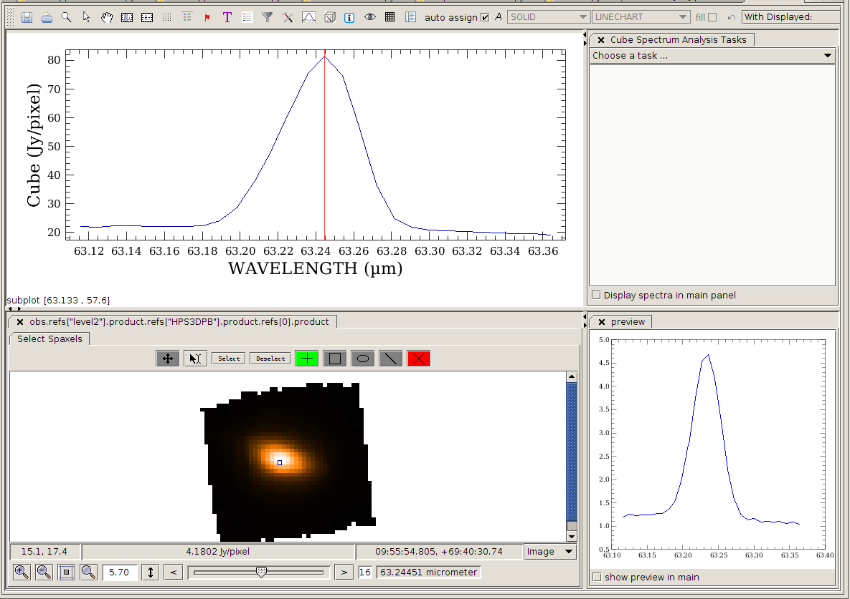
Projected Cube
Organization of the Spectrum Explorer Image Display Panel, Preview Panel,
Spectral Display, additional tasks panel…….

Slide 22
Projected Cube
Mosaic Spectra

Slide 23
Spaxel Thumbnail Array

Slide 24
Spectral Display of Many Spaxels

Slide 25
Multi-line Fitting with Spectral Fitter GUI

Slide 26
Saving Integrated Intensity Maps - I
First: Make Model Component Cubes with Multi-Fit option of Spectrum Fitted GUI
Multi-fit makes model component cubes

Slide 27
Saving Integrated Intensity Maps - II
Second Step: Integrate Model-Component Cube with Cube Spectral Analysis Task
We have integrated a model component (the redshifted Gaussian) over a wavelength range to produce a 2-d integrated flux map shown. It may be saved to FITS.

Slide 28
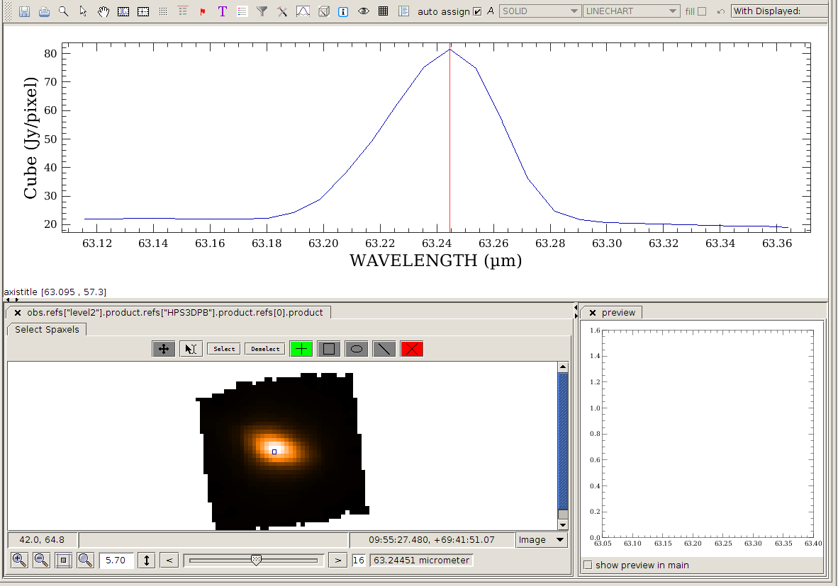
Making a Velocity Map - 1
First of all, let display the cube with SE and click on a pixel

Slide 29
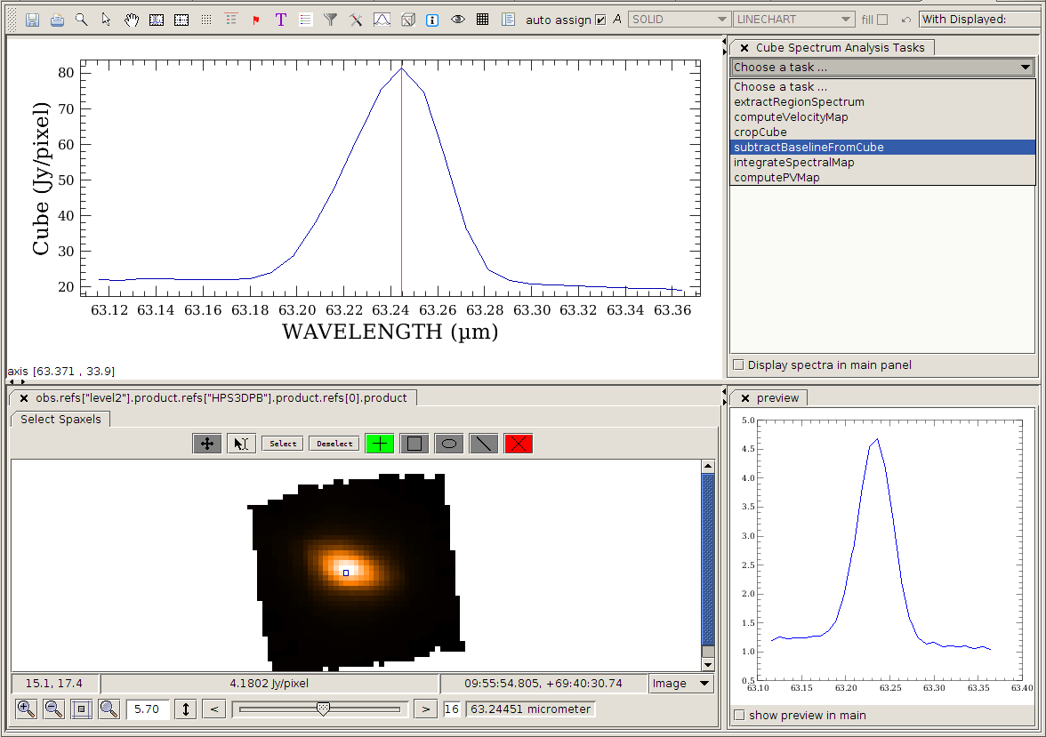
Making a Velocity Map - 2
Then, from the menu panel, we select “subtractBaseline” ...

Slide 30
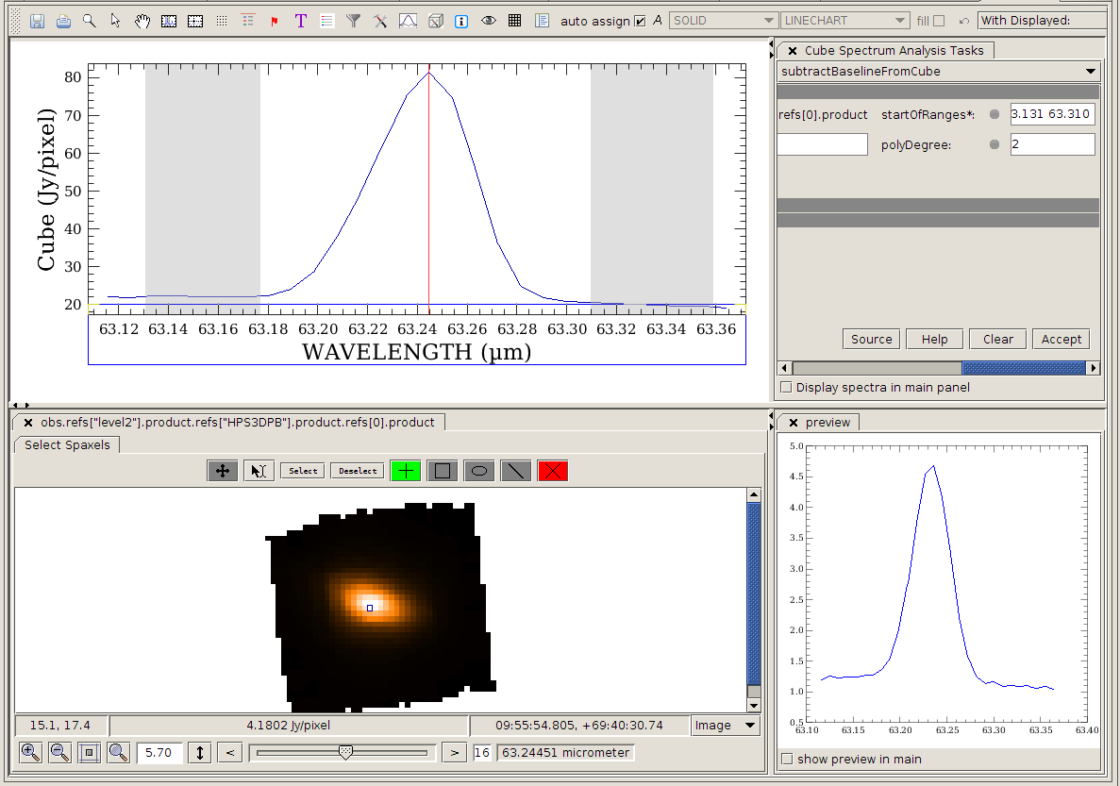
Select ranges
Making a Velocity Map - 3
Click on the icon and, with click and drag, select two ranges ...

Slide 31
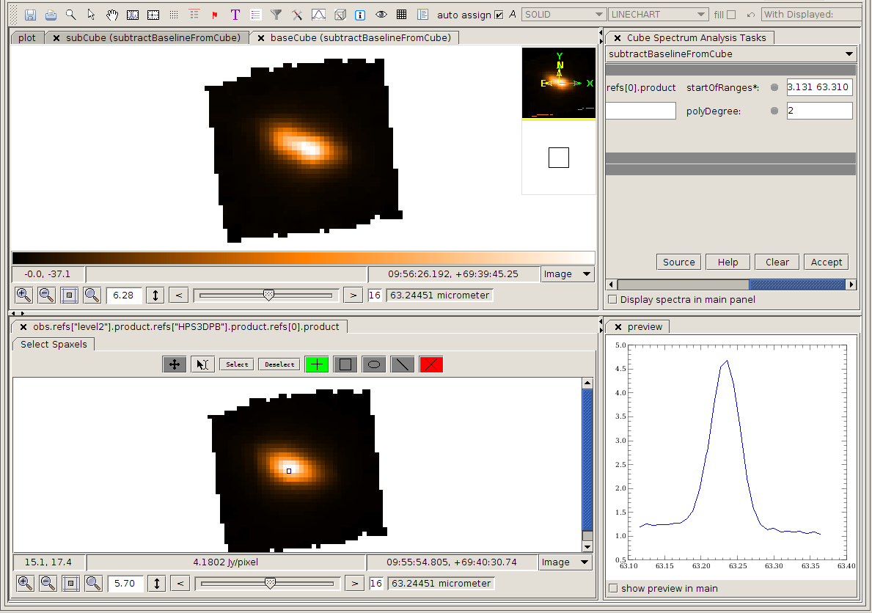
Making a Velocity Map - 4
Press “Accept” and two new cubes will appear (sub & base) ….

Slide 32
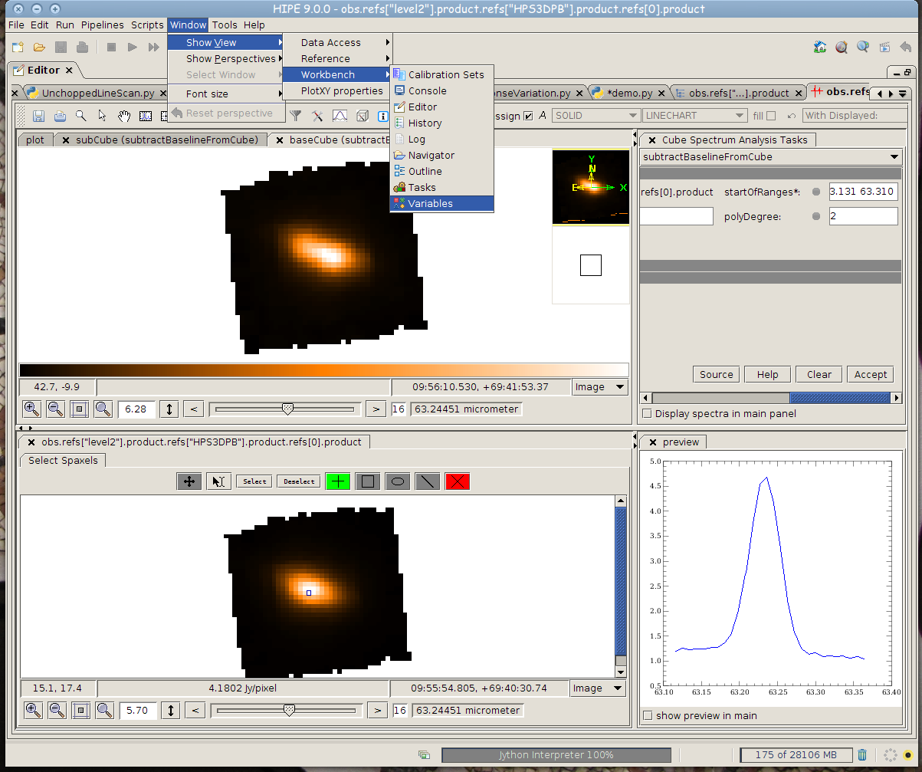
Making a Velocity Map - 5
We will go back to “Variables” to select the subCube ….

Slide 33
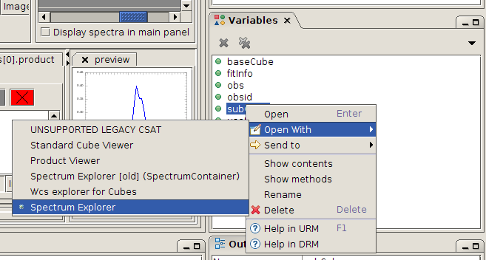
Making a Velocity Map - 6
Then, we will select the subCube by right-clicking on its
name to open it with Spectrum Explorer.

Slide 34
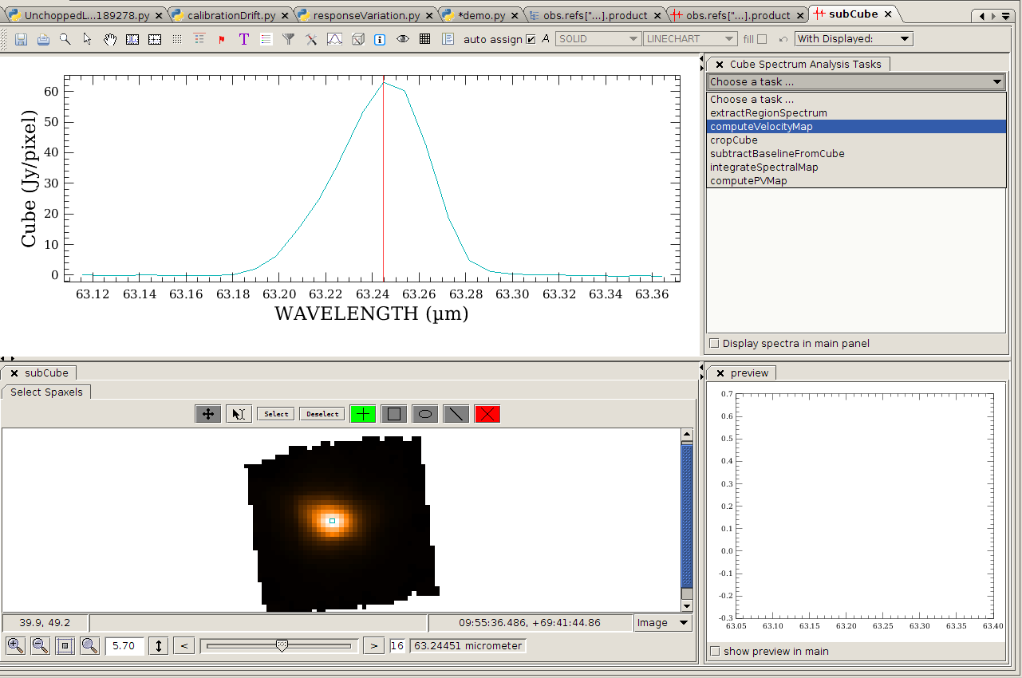
Making a Velocity Map - 7
Open SE again and select “computeVelocityMap” ….

Slide 35
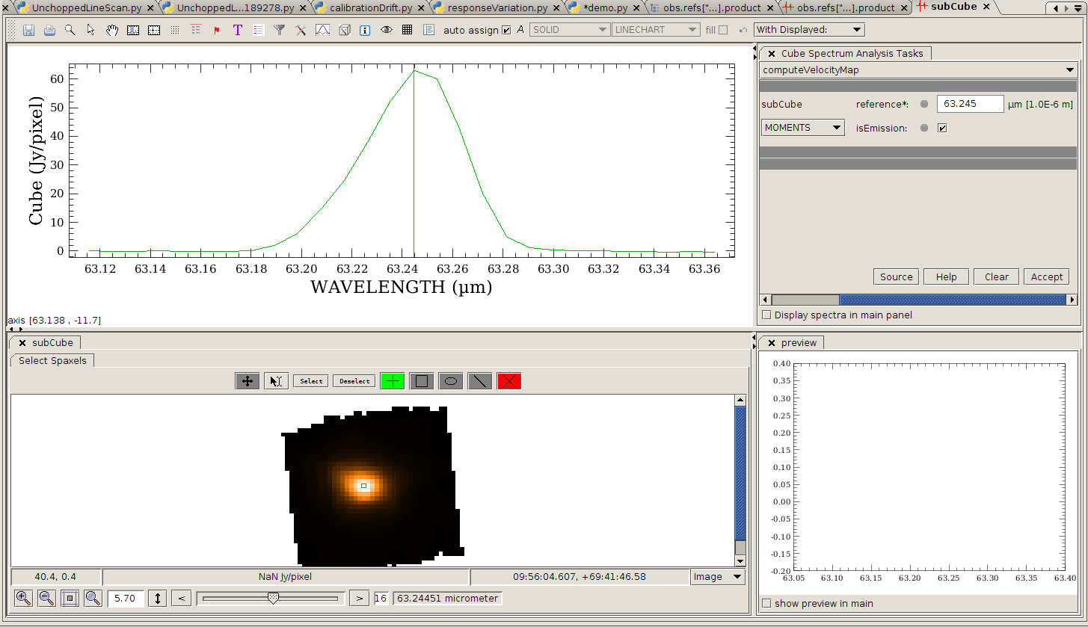
Making a Velocity Map - 8
Select MOMENTS, write the reference wavelength and Accept !

Slide 36
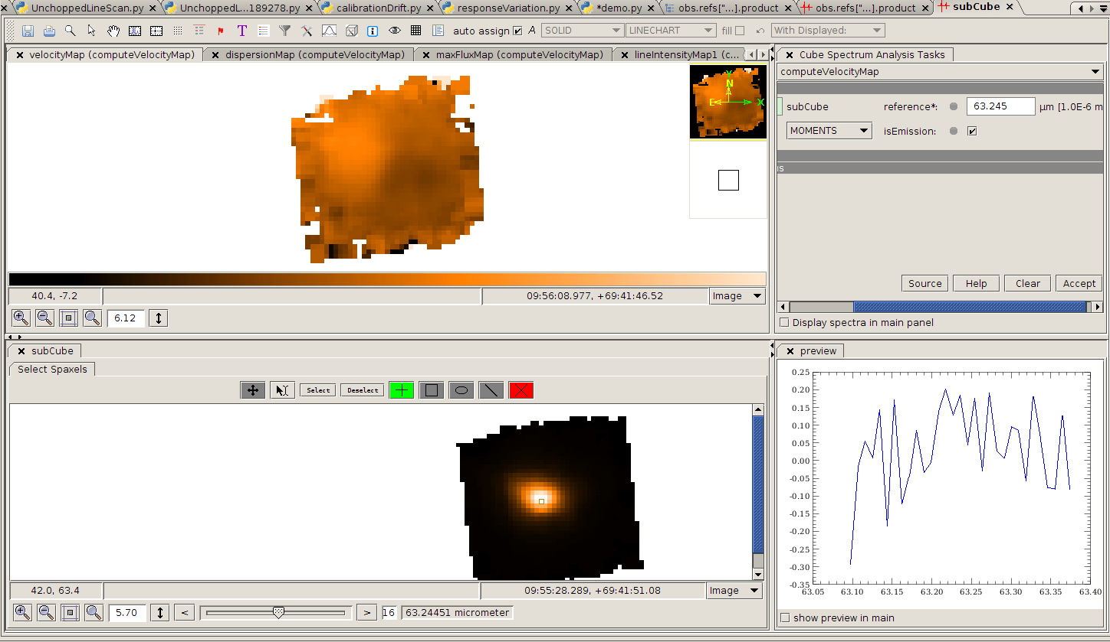
Making a Velocity Map - 9
A series of new cubes is created, including the velocity map ...

Slide 37
Making a Velocity Map - 10
Output the”SimpleImage “ Velocity Map to aFIX Export in Fits as SimpleImage -

Slide 38
Alternative Spatial Projections: “Drizzled Cubes” Drizzled cubes are not yet a standard archive product – but they likely will become one in the future.

Slide 39
Why Drizzling?
The alternative, specProject allows the wavelength grid and outlier detection to occur before the projection task. It gives a quick and basically correct answer
Drizzle goes back to the pacsCubes before wavelength binning and thus captures the spectral information before binning
It also captures the spatial information present in each wavelength before rebinning
Likewise it handles the Two nod position’s spatial variations in its processing
Finally by “shrinking” the detector flux – the so called “droplets of the drizzle, it minimizes the effect of each spaxels footprint that typically underfills the beam point spread function

Slide 40
When Drizzle Helps....
This spatial projection method (like specProject) combines the data from overlapping points of a raster map, placing emission onto a uniform spatial grid in a World Coordinates System.
The method is appropriate for spatially oversampled observations. (Consider the 9.4” “native” sampling and the resolution at the line wavelength for this determination).
The method always requires large memory and is computationally intensive.
It can be applies only over narrow wavelength ranges (line or small range spectroscopy modes) over a few microns or less.
Yet it is the preferred method projection method when all of the above requirements are met.

Slide 41
Droplets
The flux is shrunk to the inner squares (“drops”) and then drizzled down in smaller quantities (“droplets”) to the output pixels below.

Slide 42
The pacsCubes are used for the drizzling. This bypasses the wavelength binning typically done to make rebinned cubes
PACS PIPELINE
CUBE BUILDING
SINGS
background
RAW
Level 0
To Level 0.5
Projected
to 3” x 3”
pixels
To calibrated L1 FRAMES
CALIBRATED PACSCUBE
Level 1 data data

Slide 43
Setting the parameters
The 1st 4 parameters are integer.
oversampleWave – the wavelength binsize in units of the spectral resolution element. overSample=2 is Nyquist sampling.
upsampleWave – The number of bins per binsize. E. g., upsample=2 implies doubling the number of bins through overlapping them. (examples follow)
overSampleSpace – this is in units of the telescope resolution. overSampleSpace=2 is Nyquist Sampling
upSampleSpace – this is the 2d spatial analog of upSample wave
picFrac – this is the spatial “shrinking” factor of the flux on the originating pixel to spatially limit the flux origin to an area smaller than the pixel footprint

Slide 44
Example Code
# DRIZZLING
# Drizzling is new from hipe 10.0. It works from the not-rebinned PacsCubes
### CREATE WAVELENGTH AND SPATIAL GRIDS
# For an explanation of the parameters of wavelengthGrid, spatialGrid and drizzle,
# see the PACS spectroscopy data reduction guide
# Recommended values for oversampleSpace and upsampleSpace are 3 and 2 respectively
# Recommended value for pixFrac is >= 0.3 for oversampled rasters, and >= 0.6 for Nyquist sampled rasters
# The raster step sizes can be found in meta data entries 'lineStep' and 'pointStep'
oversampleWave = 2
upsampleWave = 3
waveGrid = wavelengthGrid(slicedCubes, oversample=oversampleWave, upsample=upsampleWave, calTree = calTree)
oversampleSpace = 3
upsampleSpace = 2
pixFrac = 0.6
spaceGrid = spatialGrid(slicedCubes, wavelengthGrid=waveGrid, oversample=oversampleSpace, upsample=upsampleSpace, pixfrac=pixFrac, calTree=calTree)
### DRIZZLE
slicedDrizzledCubes = drizzle(slicedCubes, wavelengthGrid=waveGrid, spatialGrid=spaceGrid)
# Save drizzled cubes to pool
# name = "OBSID_"+str(obsid)+"_"+camera+"_slicedDrizzledCubes"
# saveSlicedCopy(slicedDrizzledCubes,name)
# if updateObservationContext: obs = updateObservation(obs, camera, "2", slicedRebinnedCubes=slicedFinalCubes, projectedCube=slicedDrizzledCubes)
Method of saving Drizzle Products

Slide 45
Resources for PACS Spectral Analysis
Videos:
Webinars (recorded)
Manuals: PACS Spec, Data Reduction Guide Sect 6.4
Also see –
the General Data Analysis Guide Chapters 6 and 7
Tutorials: https://nhscsci.ipac.caltech.edu/sc/index.php/Pacs/DataProcessing
https://nhscsci.ipac.caltech.edu/sc/index.php/Pacs/DataProcessing

Slide 46
- fin-

Slide 47
Extra Slides

Slide 48
Wavelength Offsets due to pointing Errors or Offsets (From the PACS Observers Manual, in partial answer to a User Question in the Webinar)

Slide 49
Extending a PACS SED through to SPIRE
A resolution vs. wavelength guide
At 200 um, PACS and SPIRE overlap a little, and also have similar spectral resolution. Further, 3x3 PACS Spaxels are about the size of one SPIRE Pixel. Stitching SEDs is however hampered by the PACS order leak at 190-220 um, making calibration difficult to Achieve.

