Slide 1
The PACS Spectrometer: Overview and Products
Roberta Paladini
NHSC/IPAC

Slide 2
PACS Spectrometer @ NHSC
Roberta Paladini (PACS Team Lead)
Dario Fadda (calibration scientist, spectrometer)
Jeff Jacobsen (developer, spectrometer)
Phil Appleton (NHSC Project Scientist & Task Lead)
For any questions and help with your PACS data, contact the NHSC Help Desk:
http://nhsc.ipac.caltech.edu/helpdesk/index.php

Slide 4
Pixel Size = 9.4"

Slide 5
Herschel
Spitzer

Slide 6
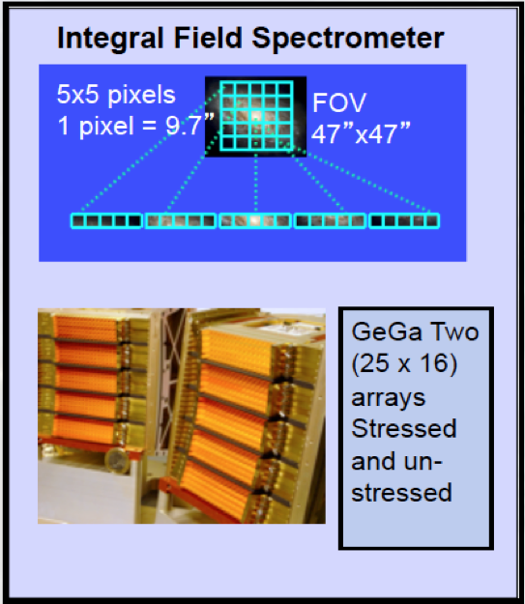

Slide 7
PACS Spectrometer Observing Modes
There are 2 PACS spectrometer observing modes:
Chop-Nod mode
Un-chopped mode

Slide 8
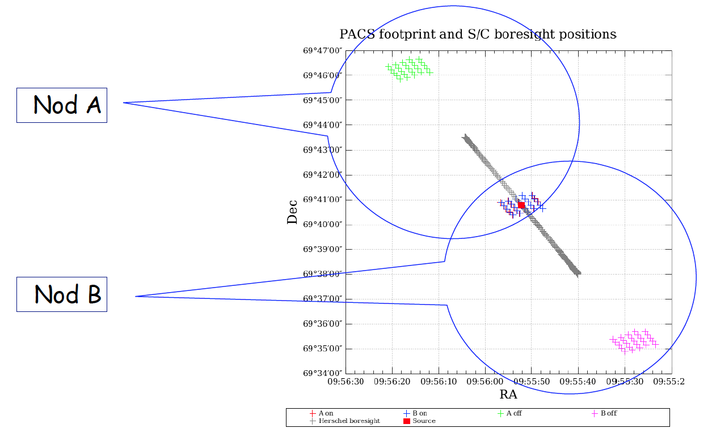
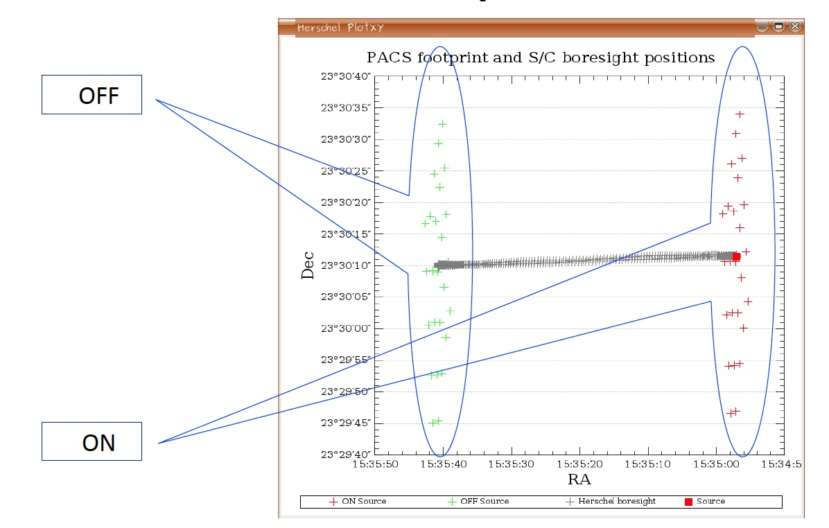
Chop-nod
Un-chopped
(no “clean” sky within 6’)

Slide 9
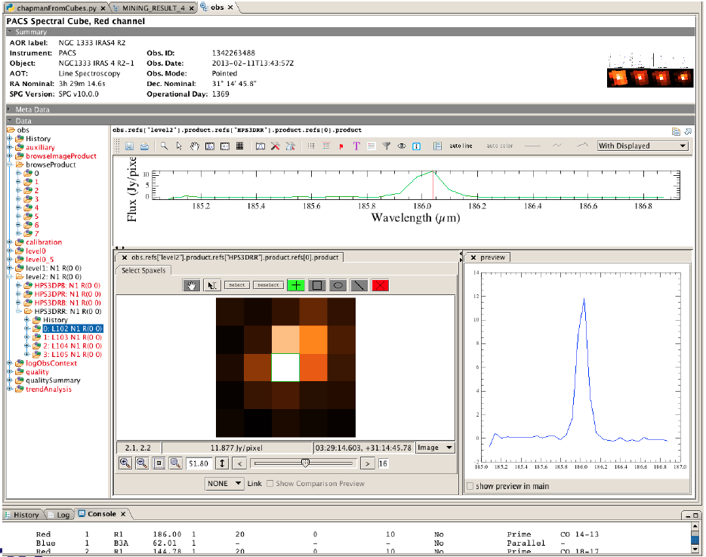
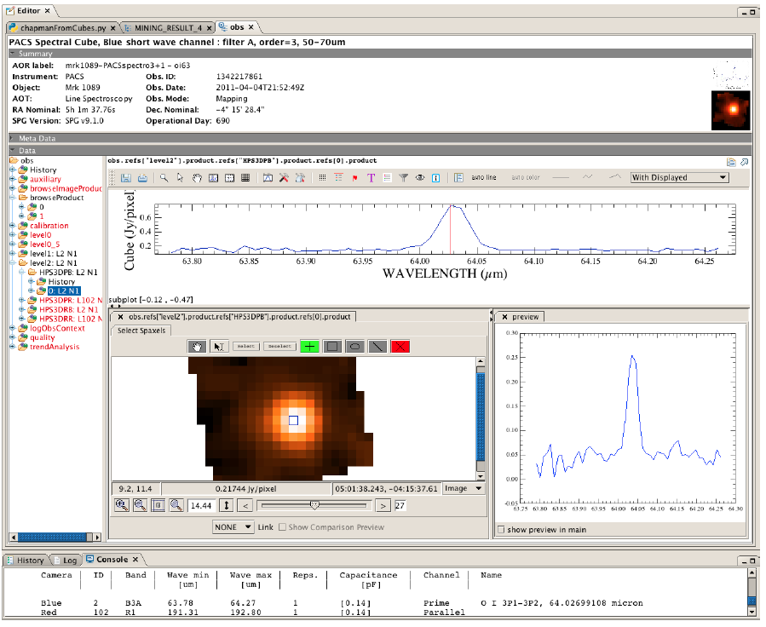
Both chop and un-chopped observations can be pointed or mapping
Pointed
Mapping

Slide 10
Both chop-nod and un-chopped observations can be line or range
Line Spectroscopy - short wavelength coverage, multiple lines
Range Spectroscopy - broader wavelength coverage, multiple ranges

Slide 11
In Summary:
A PACS spectrometer observation can be any combination of the following:
→ line/range, chop/un-chopped, pointed/mapping

Slide 12
Science Highlights

Slide 15
PACS Spectrometer Data & Products
(or: how do I get the data I need and…where are the spectral cubes ?)

Slide 16
How do I find the PACS data I need ?
Each PACS data set (photometer or spectrometer) is uniquely associated with a 10 digit number, i.e. an OBSID. Ex: 1342191353
Therefore, we always first need to identify the OBSID or list of OBSIDs which correspond to the data set we are interested in
To this end, we go to the Herschel Science Archive (HSA)

Slide 17
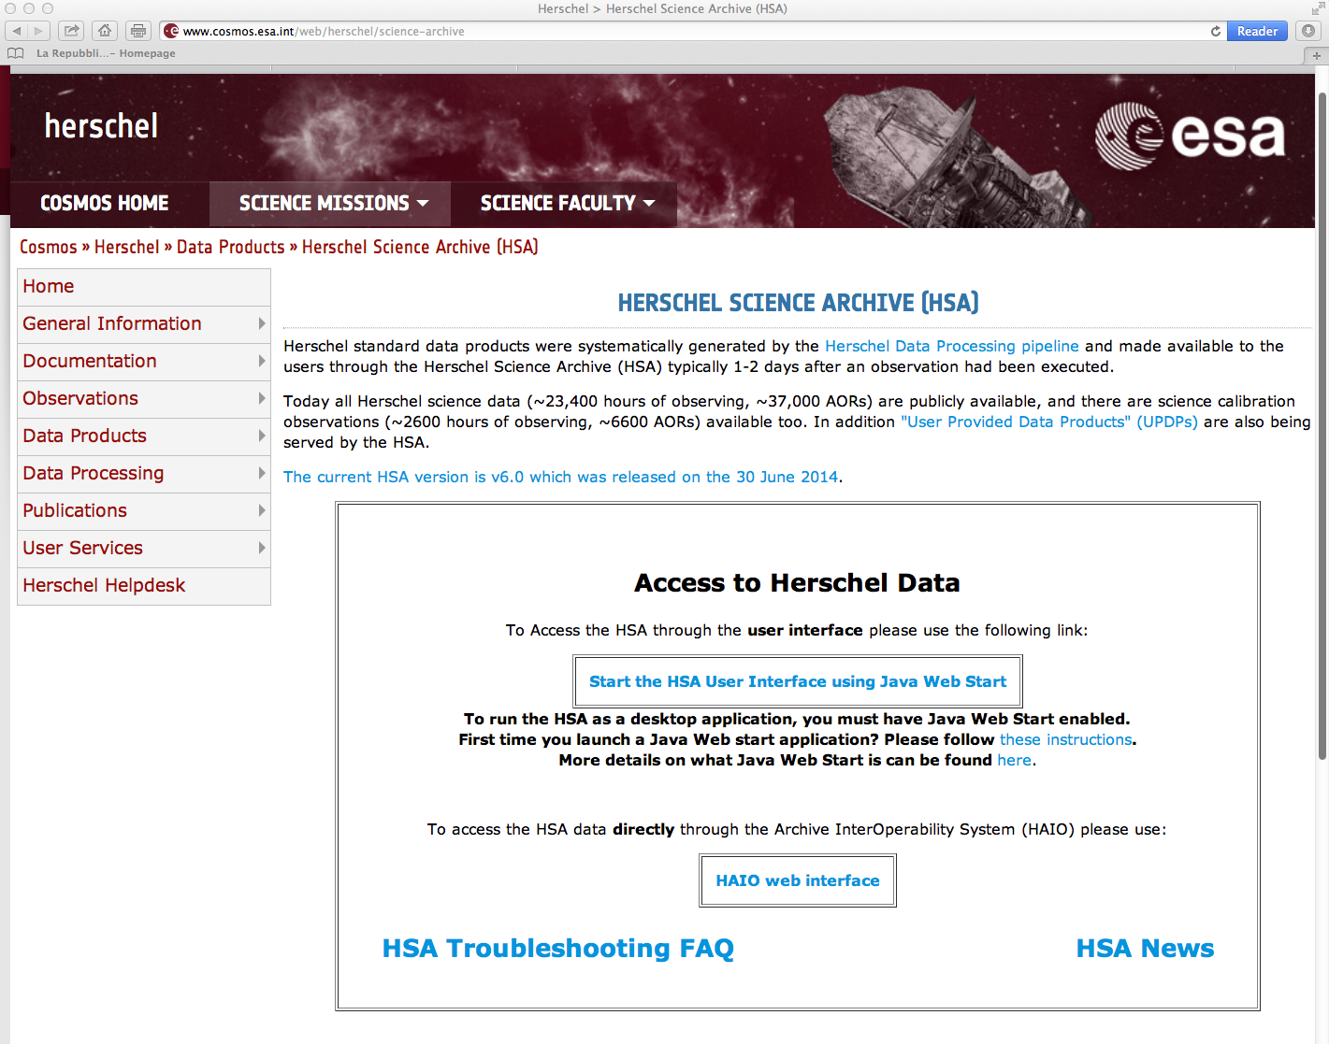
Click here to start the HSA interface

Slide 18
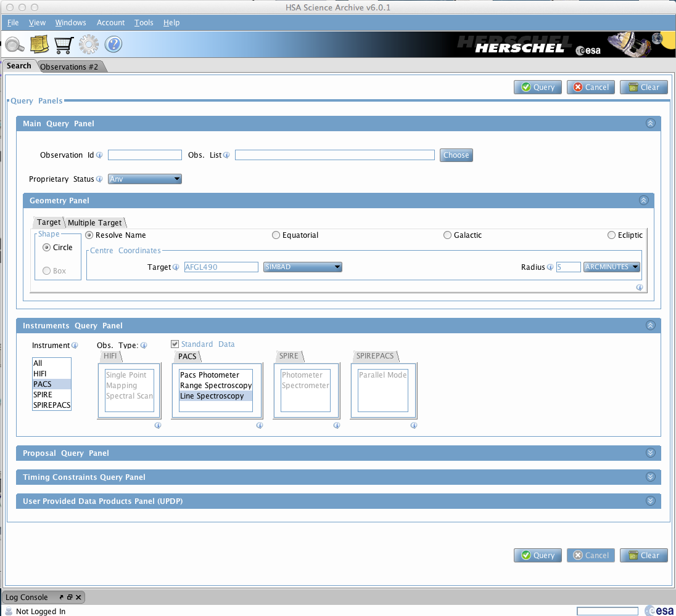
Ex:
Search in the HSA for PACS spectrometer data for AFGL490 within a 5’ radius

Slide 19
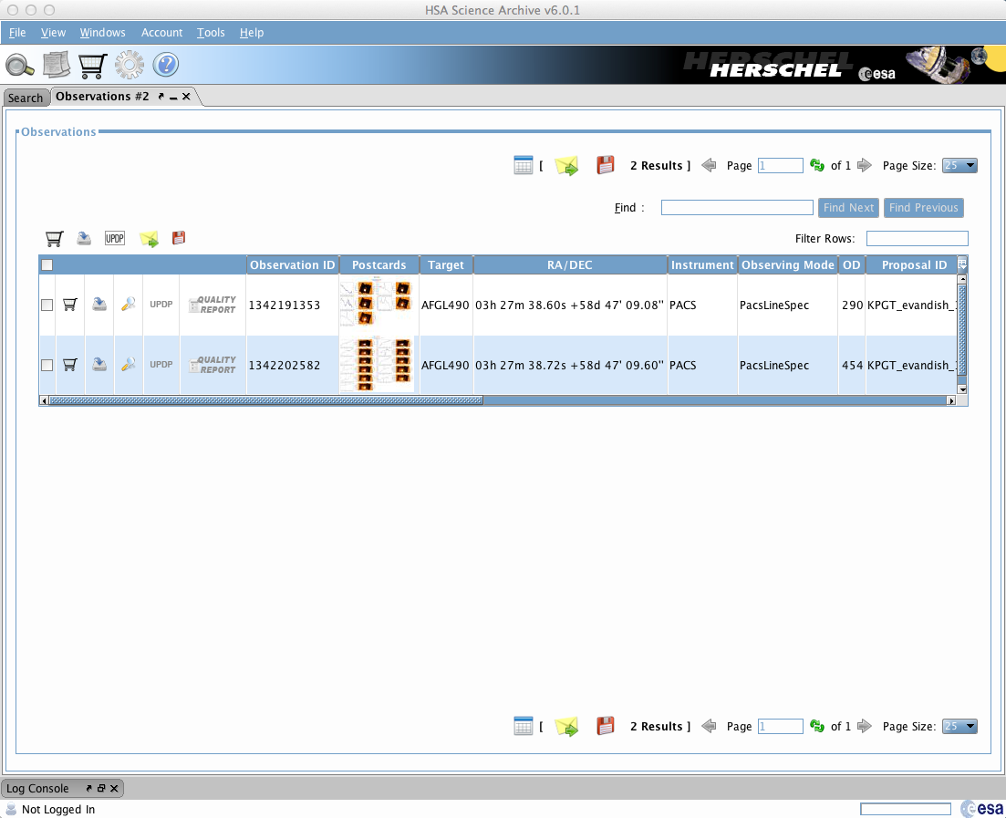
Result of the query:

Slide 20
How do I visualize the PACS data
I have found in the HSA ?
The best way to visualize the data in HIPE

Slide 21
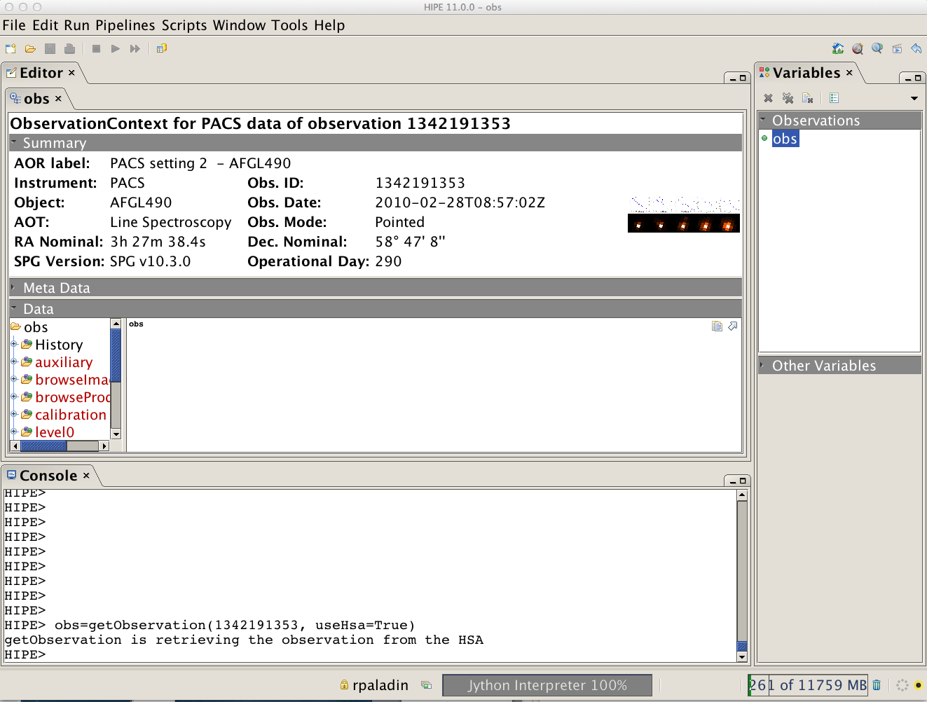
Example: AFGL490 – OBSID: 1342191353
3
2
Double click on the “obs” variable
1

Slide 22
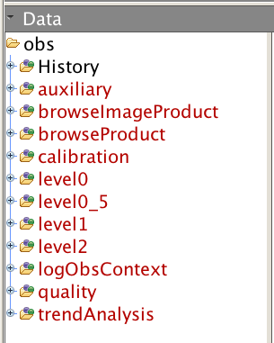
What is the meaning of level0, level 0_5, etc. ?
}
These are different levels of processing: the higher the level, the more advanced the processing

Slide 23
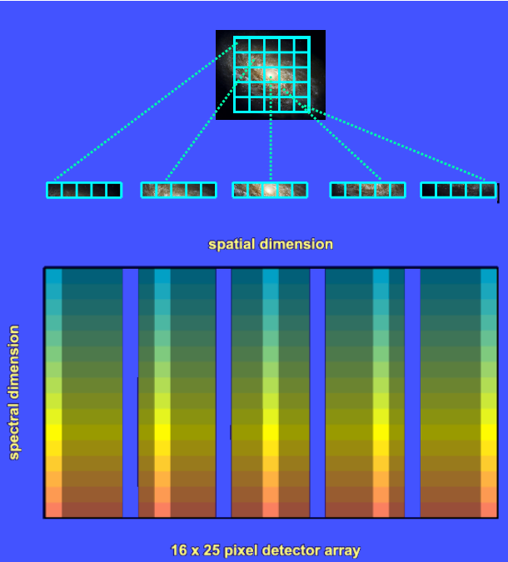
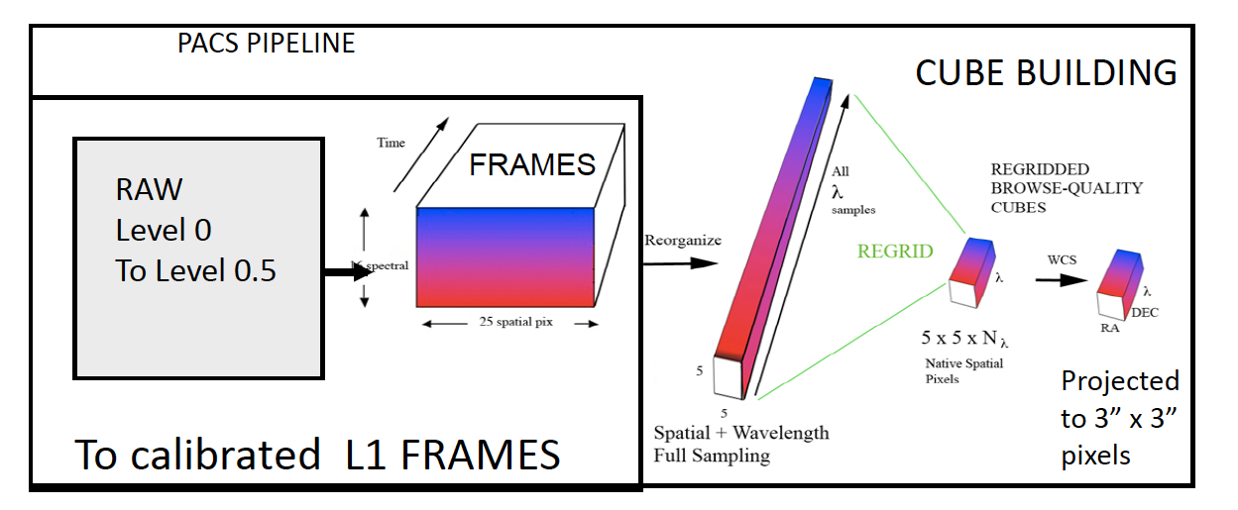
PACS Spectrometer Archived Products
L1 pacsFrames
L1 pacsCUBE
L2 rebinnedCUBE
L2 projectedCUBE

Slide 24
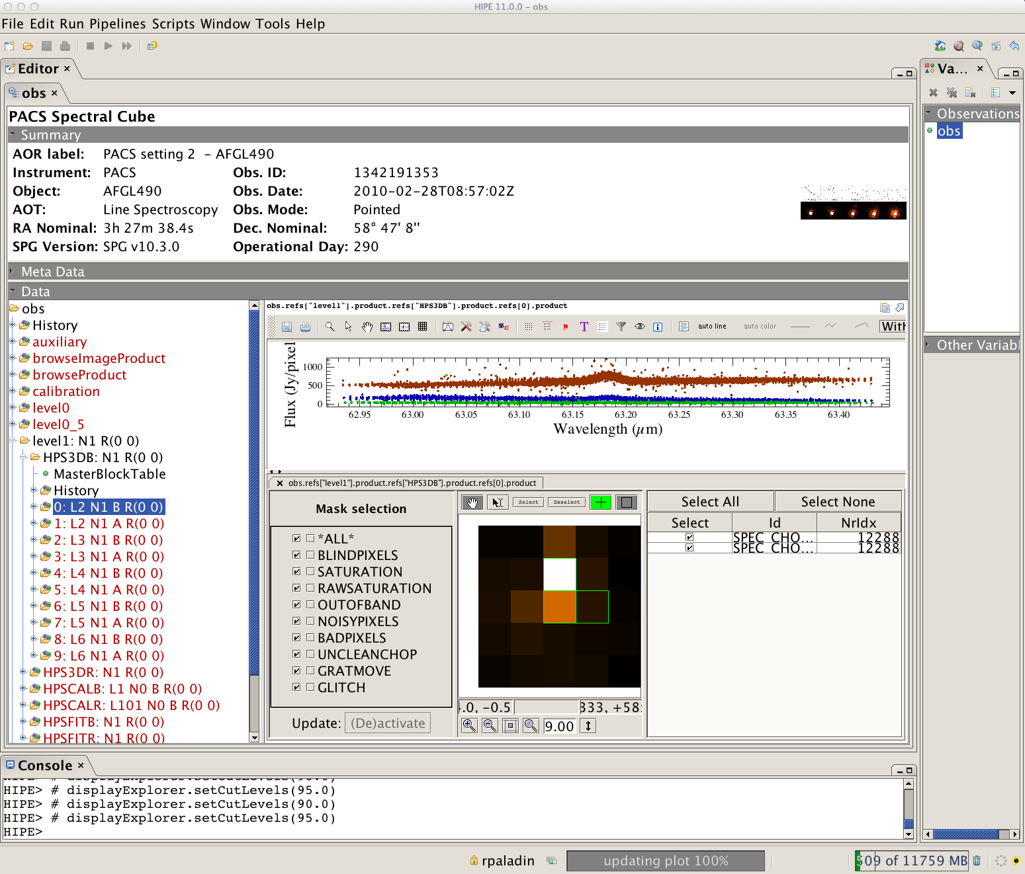
Level 1: PacsCube
Spectrum Explorer Tool
(common to all Herschel instruments)
NHSC PACS Webinars – July 2014

Slide 25
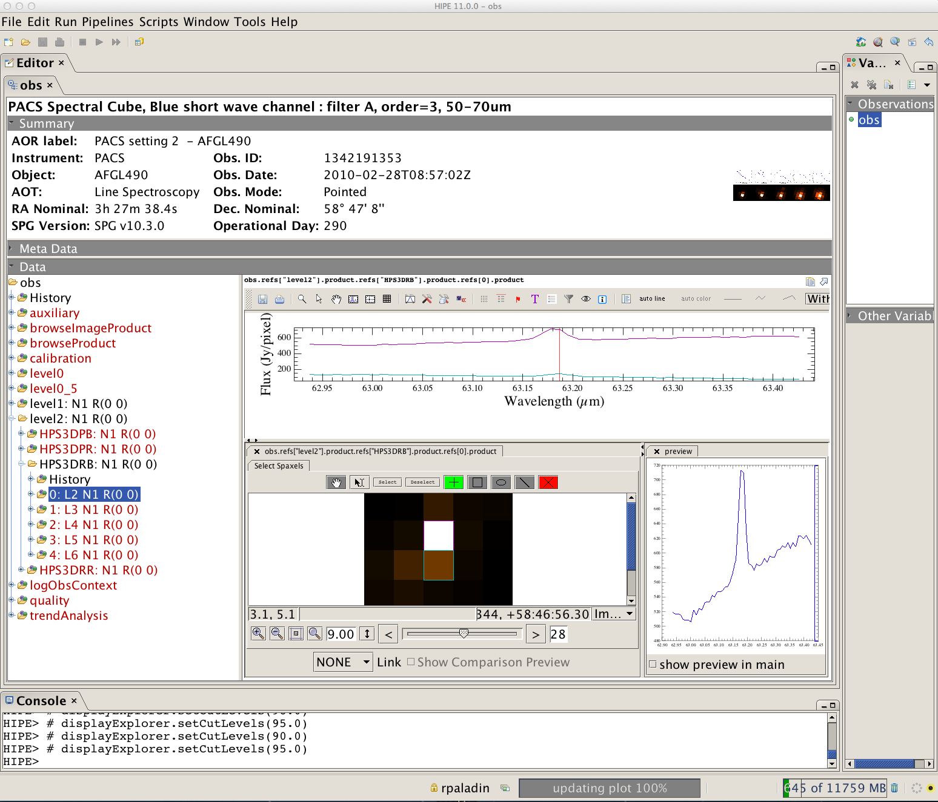
Level 2: Rebinned Cube
Spectrum Explorer Tool
(common to all Herschel instruments)

Slide 26
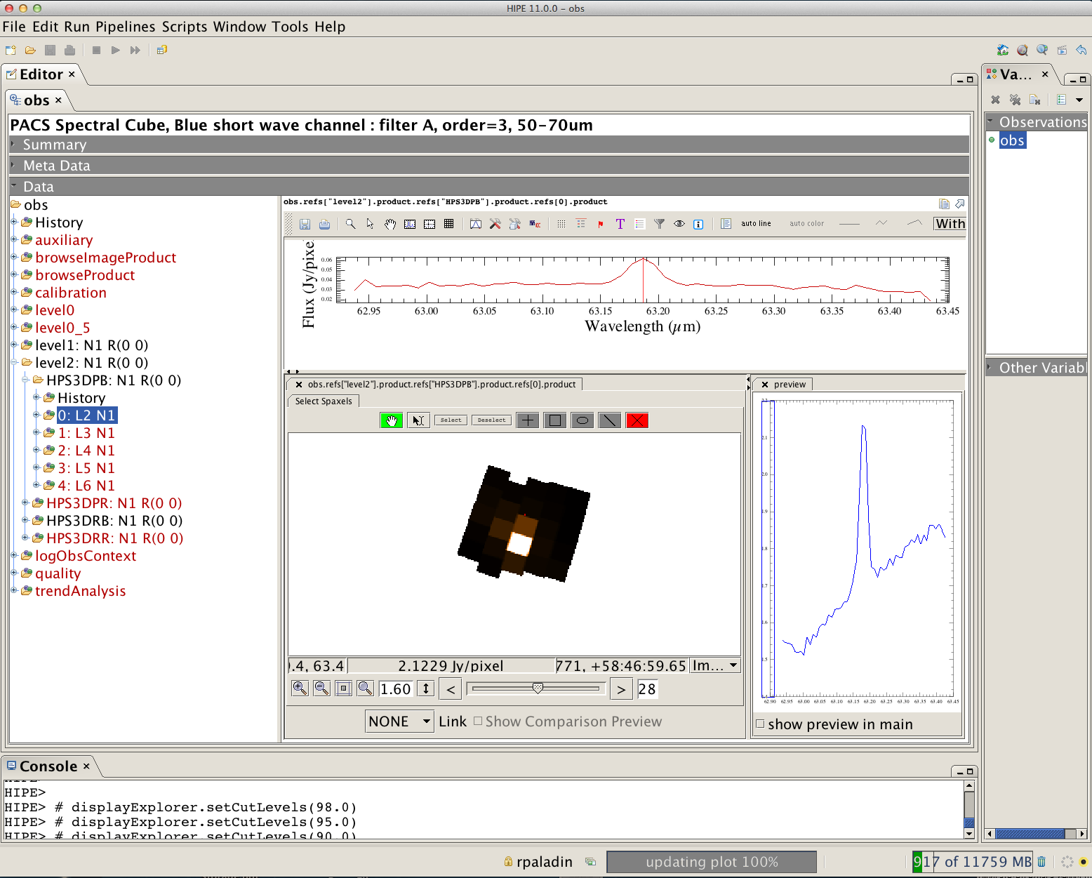
Level 2: Projected Cube
Spectrum Explorer Tool
(common to all Herschel instruments)

Slide 27
Summary of PACS spectrometer archived products
Level 0:
HPENG: engineering
HPGENHK: housekeeping
HPSDMCB/HPSDMCR: raw DecMec (blue/red)
HPSFITB/HPSFITR: Herschel PACS Spectrometer Fitted Blue/Red (→ “Signal” in /0)
HPPHK: housekeeping
HPSRAWB/HPSRAWR: raw data (blue/red)
Level 1:
HPS3DB/HPS3DR: Herschel PACS Spectrometer 3D Spectral Cube Blue/Red
(→ “flux”, “wave”, “ra”, “dec” in, e.g., /0: L2 N1 B R(0 0))
HPSCALB/HPSCALR: calibration (response/dark)
HPSFITB/HPSFITR: fitted slopes
Level 2:
HPS3DPB/HPS3DPR: Herschel PACS Spectrometer 3D Projected Cube Blue/Red
(→ “image”, “coverage” in, e.g., /0: L2 N1 A R(0 0))
HPS3DRB/HPS3DRR: Herschel PACS Spectrometer 3D Rebinned Cube Blue/Red
(→ “image”, “ra”, “dec”, “stddev”, “exposure”, “wavegrid” in, e.g., /0: L2 N1 R(0 0)
Level 2.5: (only for range un-chopped): on and off positions are in different OBSIDs. In Level 2.5, the
off is subtracted from the on

Slide 28
PACS Spectrometer:
Calibration

Slide 29
Spectrometer:
Flux calibration is estimated from a set of ~30 absolute flux sky calibrators (fiducial stars, asteroids and planets);
Based on this set of calibrators (and using the 3X3 calibration block scheme), the flux calibration error is ~7% in all bands, with 3-4% reproducibility
http://herschel.esac.esa.int/twiki/bin/view/Public/PacsCalibrationWeb

Slide 30
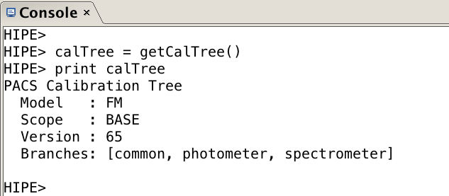
PACS calibration tree (calTree)
http://herschel.esac.esa.int/twiki/pub/Pacs/PacsCalibraBon/The_PACS_CalibraBon_Framework_-.‐_issue_0.13.pdf
The calibration tree is a tree-like structure which points to all the calibration products
The PACS calibration tree has three branches:
1) common
2) photometer
3) spectrometer

Slide 31
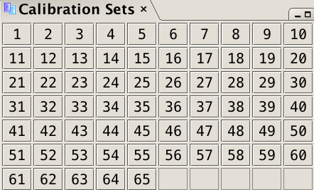
IMPORTANT
One of the most important reasons to reprocess your PACS data is to make sure that you are using the latest versions of the calibration files. This is true for both the photometer and spectrometer
To check the calibration files version of the data downloaded from the HSA, first load your OBSID into HIPE and then type the command below:
Compare the number you get (e.g. 56) from running the command above with the last number (e.g. 65) showing in the Calibration Sets table in HIPE
Window → Show View → Workbench → Calibration Sets

Slide 32
Documentation

Slide 33
PACS Observer’s Manual (last update: July ‘13)
http://herschel.esac.esa.int/Docs/PACS/pdf/pacs_om.pdf
PACS Data Reduction Guide: Spectrometer
http://127.0.0.1:8082/print/pacs_spec/pacs_spec.pdf#pacs_spec
NHSC PACS tutorials:
https://nhscsci.ipac.caltech.edu/sc/index.php/Pacs/DataProcessing

Slide 34
Additional Resources
Processing large PACS data sets, especially for the photometer, requires large memory allocations (64 GB or more). You can request a remote user account on our virtual system at NHSC. For more information, visit:
https://nhscsci.ipac.caltech.edu/sc/index.php/CompSupport/ExternalUsers
Our remote user accounts come automatically with a multi-threaded version of the PACS spectrometer pipeline. This means that you can speed up your spectrometer data processing by a factor 4 !

