Slide 1
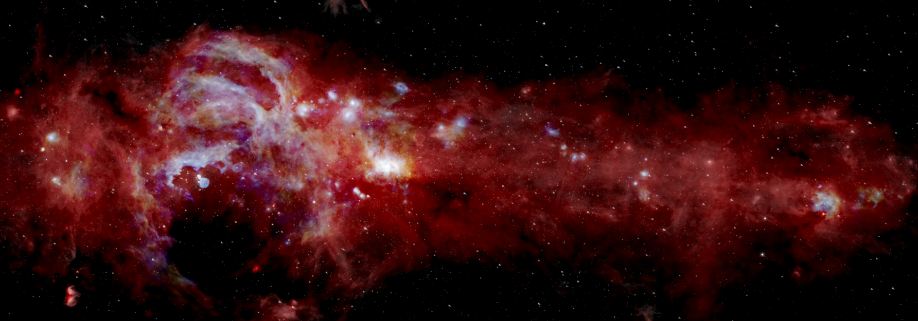
Stratospheric Observatory for Infrared Astronomy (SOFIA)
Allowing astronomers to study the solar system and beyond from 38,000-40,000 feet altitude
LEARN MORE:
SOFIA.USRA.EDU • NASA.GOV/SOFIA

Slide 2
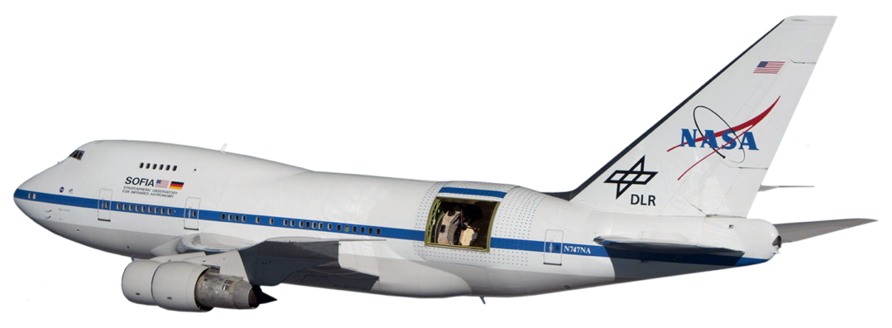
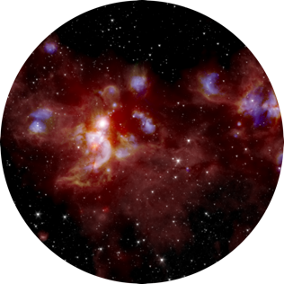
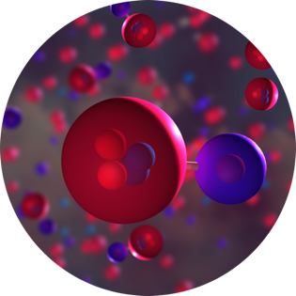
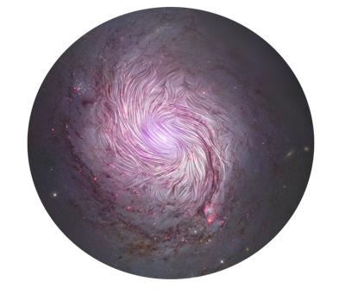
Infrared Astronomy in the Stratosphere Making discoveries about our solar system and the universe
Stratospheric Observatory for Infrared Astronomy (SOFIA)
World’s largest flying observatory features a 106-inch primary mirror and a telescope that weighs 37,500 pounds
Missions fly above 99% of the Earth’s water vapor, enabling studies of the universe at infrared wavelengths
The Birth of Stars and Planets
Path to Life: Our Interstellar Origins
Magnetic Fields and the Distant Universe

Slide 3
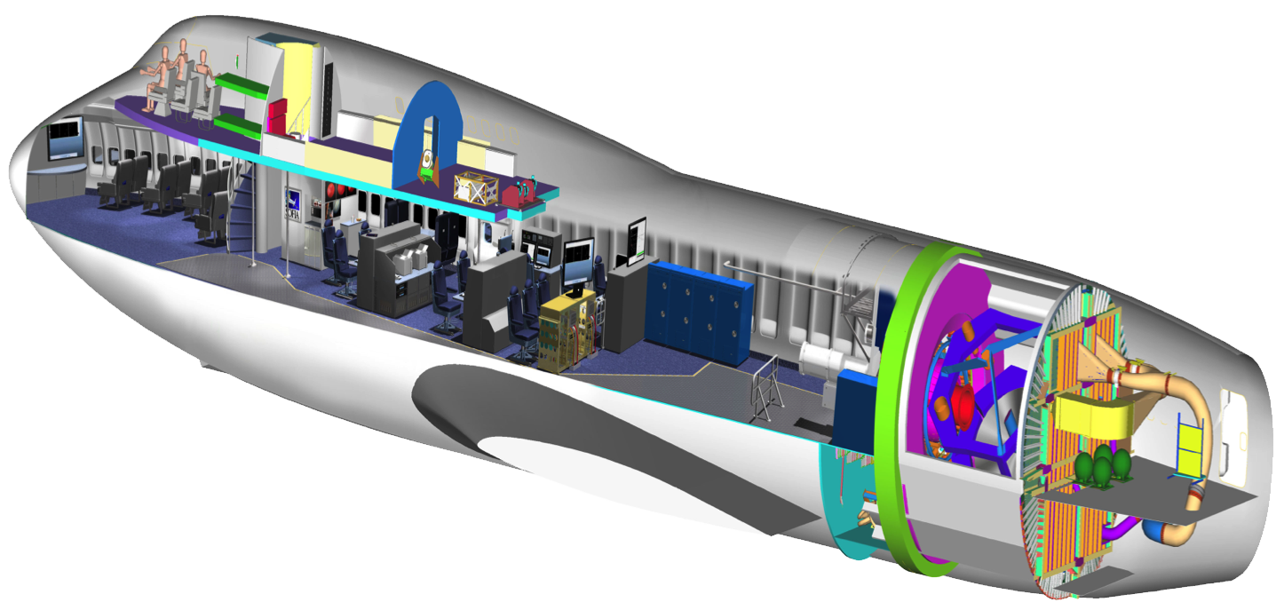
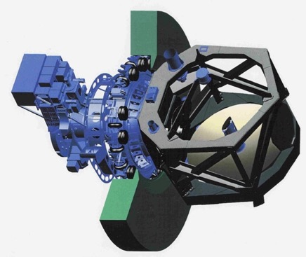
SOFIA Boeing 747-SP Platform Layout
Educators/Ambassadors Workstation
Scientists, engineers, telescope operators
2.7-meter telescope
Open cavity (door not shown)
Science instruments
Pressurized bulkhead

Slide 4
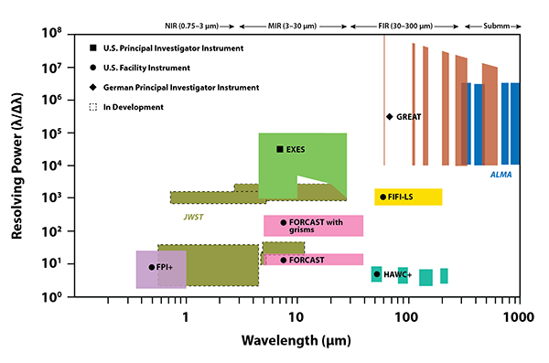
SOFIA Science Instrument Suite
SOFIA’s instruments bridge gaps in between existing ground-based observatories, like ALMA, and future space telescopes like JWST.

Slide 5
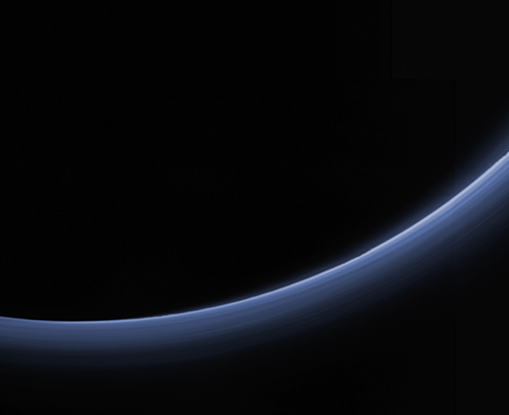
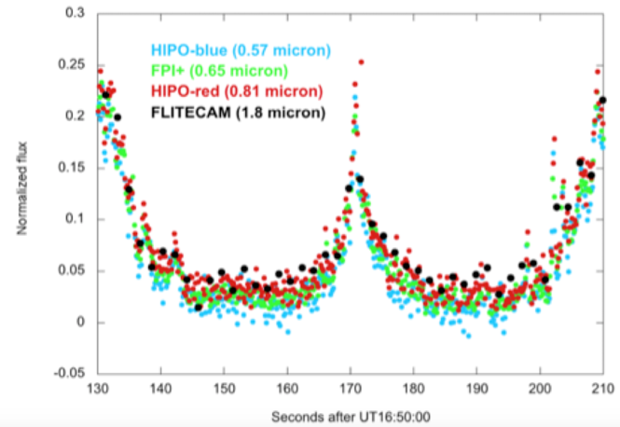
SOFIA Science: Pluto’s Atmosphere
Clues Hidden in Pluto’s Haze
Images from the New Horizons spacecraft show a blue haze.
SOFIA studied Pluto two weeks before the spacecraft arrived.
SOFIA’s multiwavelength observations reveal the particles in the haze are 1,000 times smaller than a human hair, which scatter blue light and create the tint.
The haze also thickens and fades in a regular cycle. This suggests Pluto may be able to hold on to its atmosphere, even as it moves farther from the Sun in its orbit.
Image: Blue haze from New Horizons.
Graph: Light curve from SOFIA

Slide 6
SOFIA Science: Milky Way
SOFIA mapped the center of our Milky Way Galaxy, including the ring of gas and dust surrounding the central black hole. The mid-infrared wavelengths observed by SOFIA reveal details that other observatories could not detect.

Slide 7
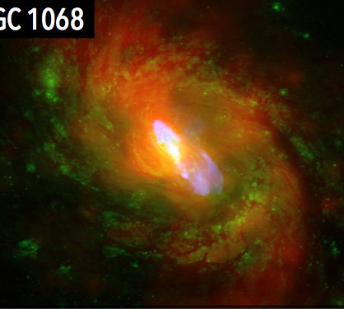
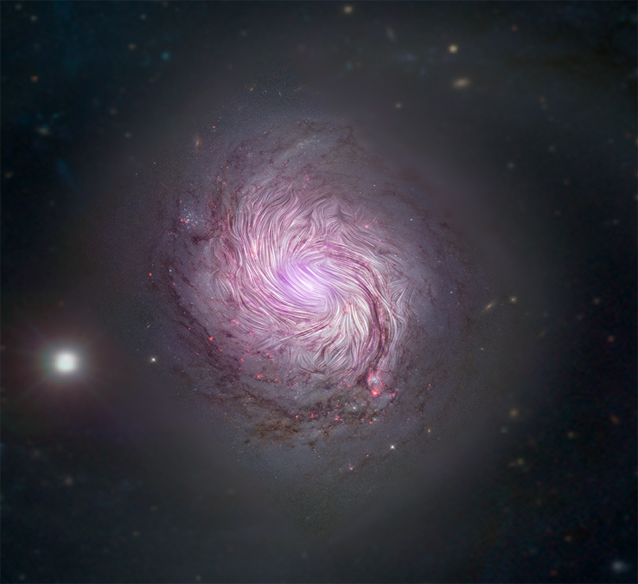
SOFIA Science: Star and Galaxy Formation
NGC 1068
SOFIA magnetic fields (streamlines) over an image from Hubble, Sloan Digital Sky Survey and the Nuclear Spectroscopic Array.
Do magnetic fields control the spiral structure of this galaxy?
A new instrument on SOFIA is allowing astronomers to study the role of magnetic fields in star and galaxy formation, including how spiral galaxies get their iconic shape.

Slide 8
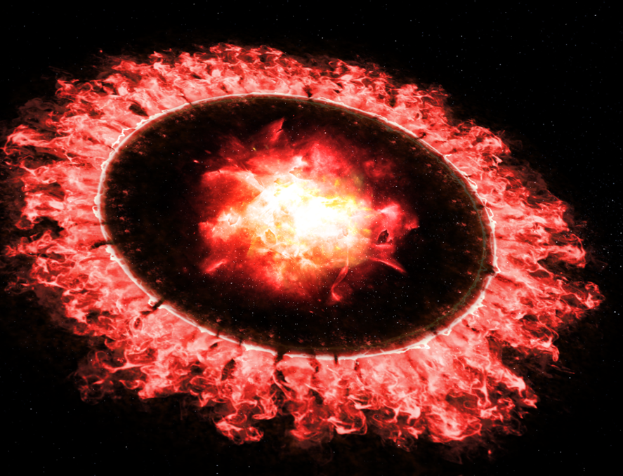
SOFIA Science: Interstellar Dust
SOFIA shows interstellar dust survives a supernova explosion
A supernova blast wave propagates through space at more than 6,000 miles per second and should destroy nearly everything in its path.
SOFIA found 10 times more dust than expected around Supernova 1987A.
The discovery suggests dust, a building block of stars and planet, may be able to reform or grow in the wake of a supernova explosion.
Illustration of the blast wave passing through the ring of dust around Supernova 1987A.

Slide 9
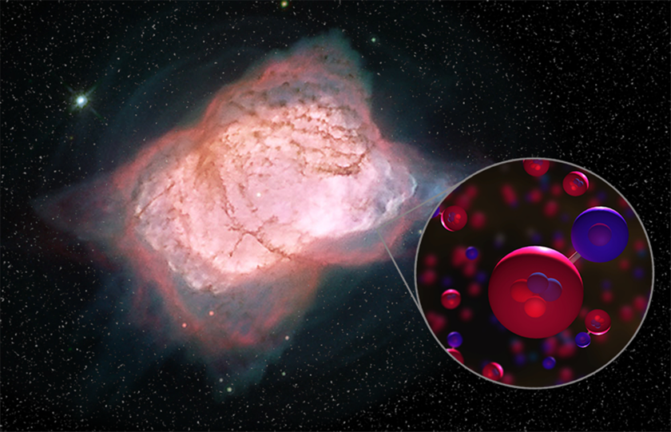
SOFIA Science: Path to Life and Interstellar Origins
SOFIA Found the Universe’s First Type of Molecule
Helium and hydrogen combined to form helium hydride, the universe’s first molecule, about 100,000 years after the Big Bang
Helium hydride was the first step in a chemical evolution, that transformed the universe from simple molecules to the complex place it is today.
Helium hydride should be present in some parts of the modern universe, but it had never been found in space — until SOFIA detected it.
SOFIA’s detection confirms a key part of the basic understanding of the early universe.
Image of planetary nebula 7027 (Hubble) and illustration of helium hydride molecules SOFIA detected.

